Slide 1


CS1010: Programming Methodology
Week1
Recap
Live Q&A
https://pollev.com/jin

Slide 2

Objectives
Learn about a systematic way to write programs for solving computational problems
Explore various hardware-related topics, such as memory management.
Become proficient with C and associated programming tools (editors, debuggers)
The course is called Programming Methodology.
It is NOT just about coding in C!

Slide 3
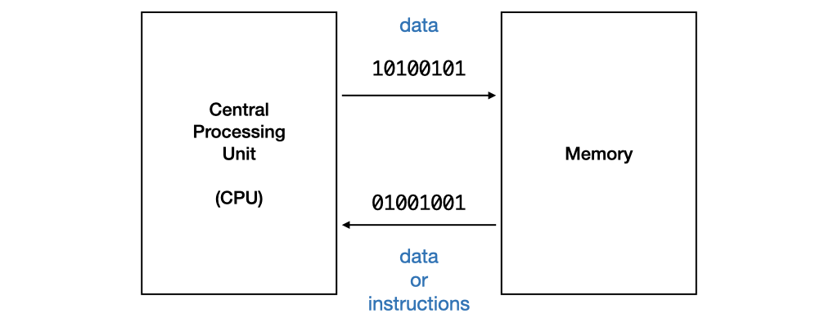
Program Execution
The CPU processes data or instructions from memory and stores data into memory.
Such data or instructions must be in machine code in binary format
But it is much easier to write program in high level programming languages…

Slide 4
The Edit, Compile and Execute Cycle
Compile
Execute
Edit
Use a compiler to translate the source code into executable
Use an editor to create/modify the source code
Execute/run the executable code
Process is iterative

Slide 5
Computational Problems and Algorithms
Computational Problems
have well-defined inputs, outputs, and constraints.
can be solved step-by-step by a computer.
Algorithms
are a set of exact, step-by-step instructions.
Take some values as the input, and produces some values as the output.

Slide 6
Problem Solving Process
Algorithmic
Determine problem features
Analysis
Iterative process
Write algorithm
Design
Produce code
Implementation
Check for correctness and efficiency
Testing

Slide 7
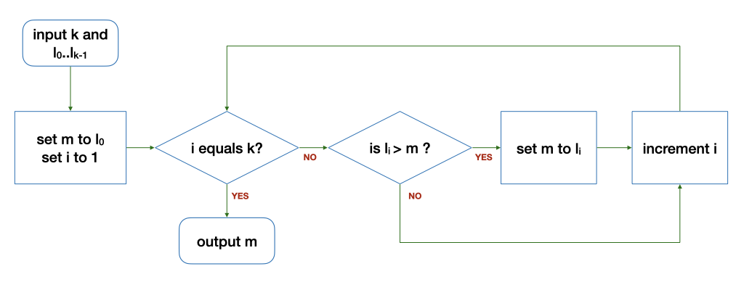
Algorithm: Example
Find the maximum of a list of k numbers {l₀,…,l_{k-1}}
Loop
Input: 6 5 9 8 1 3 2
Output: 9
k | i | l_{i} | m | Remark
6 | 1 | 9 | 5 | Before the loop
6 | 2 | 8 | 9 | After 1st round of the loop
6 | 3 | 1 | 9 | After 2nd round…
k | i | l_{i} | m | Remark
6 | 4 | 3 | 9 | After 3rd round…
6 | 5 | 2 | 9 | After 4th round…
6 | 6 | - | 9 | After 5th round…

Slide 8
Algorithm: Example
Find the maximum of a list of k numbers {l₀,…,l_{k-1}}
What are the variables and what they are used for?

Slide 9
Algorithm: Example
Find the maximum of a list of k numbers {l₀,…,l_{k-1}}
What are control structures used and what they are used for?
Sequence

Slide 10
Algorithm: Example
Find the maximum of a list of k numbers {l₀,…,l_{k-1}}
What are control structures used and what they are used for?
Selection

Slide 11
Algorithm: Example
Find the maximum of a list of k numbers {l₀,…,l_{k-1}}
What are control structures used and what they are used for?
Repetition

Slide 12
Correctness
What is wrong with the modified algorithm?
Loop
0
Input: 6 5 9 8 1 3 2
Output: 9
k | i | l_{i} | m | Remark
6 | 1 | 9 | 0 | Before the loop
6 | 2 | 8 | 9 | After 1st round of the loop
6 | 3 | 1 | 9 | After 2nd round…
k | i | l_{i} | m | Remark
6 | 4 | 3 | 9 | After 3rd round…
6 | 5 | 2 | 9 | After 4th round…
6 | 6 | - | 9 | After 5th round…

Slide 13
Correctness
What is wrong with the modified algorithm?
Loop
0
Input: 6 10 9 8 1 3 2
Output: 9
k | i | l_{i} | m | Remark
6 | 1 | 9 | 0 | Before the loop
6 | 2 | 8 | 9 | After 1st round of the loop
6 | 3 | 1 | 9 | After 2nd round…
k | i | l_{i} | m | Remark
6 | 4 | 3 | 9 | After 3rd round…
6 | 5 | 2 | 9 | After 4th round…
6 | 6 | - | 9 | After 5th round…

Slide 14
Learning to write a program that does what you want is the easy part.
Knowing what you want your program to do is the real challenge!

