Slide 1


CS1010: Programming Methodology
Week 2
Recap
Live Q&A
https://pollev.com/jin

Slide 2
Problem Solving Process
Algorithmic
Determine problem features
Analysis
Iterative process
Write algorithm
Design
Produce code
Implementation
Check for correctness and efficiency
Testing

Slide 3
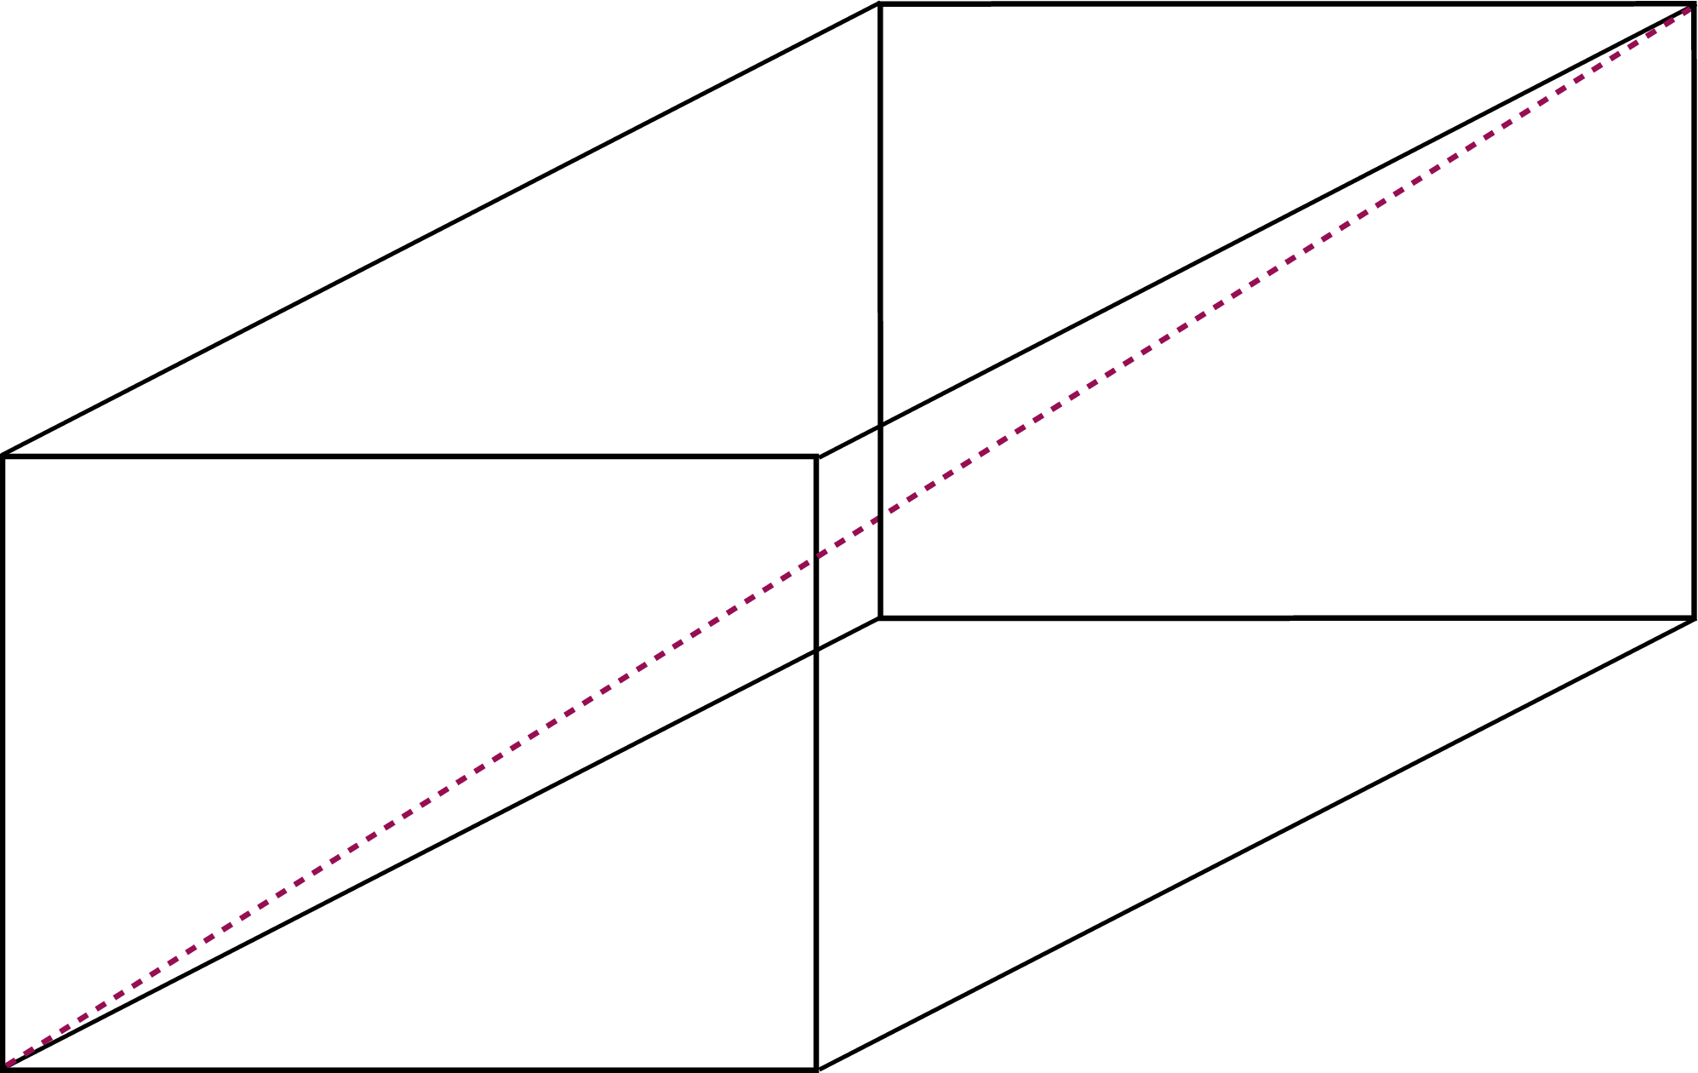
Problem Solving Techniques
Ex00-Q6: Find the surface area and the diagonal of a cuboid
Problem Analysis
Inputs:
width, length, height (all integers)
Outputs:
surface area (integer), diagonal (real number)
Constraints:
The outputs are the surface area and the diagonal of the cuboid represented by the inputs.

Slide 4
Problem Solving Techniques
Ex00-Q6: Find the surface area and the diagonal of a cuboid
Algorithm Design
Input:
Read in an integer for the width (Function from CS1010 Lib.)
Read in an integer for the length (Function from CS1010 Lib.)
Read in an integer for the height (Function from CS1010 Lib.)
Compute: …
Output: …
1. Breaking it down!
2. Borrowing from what we know!
3. Wishful thinking!

Slide 5
Problem Solving Techniques
Ex00-Q6: Find the surface area and the diagonal of a cuboid
Algorithm Design
Input: …
Compute:
Compute the surface area (compute surface area function)
Compute the diagonal (compute diagonal function)
Output: …
1. Breaking it down!
2. Borrowing from what we know!
3. Wishful thinking!

Slide 6
Problem Solving Techniques
Ex00-Q6: Find the surface area and the diagonal of a cuboid
Algorithm Design
Input: …
Compute: …
Output:
Print the computed surface area, which is an integer (Function from CS1010 I/O Lib.)
Print the computed diagonal, which is a real number (Function from CS1010 I/O Lib.)
1. Breaking it down!
2. Borrowing from what we know!
3. Wishful thinking!

Slide 7
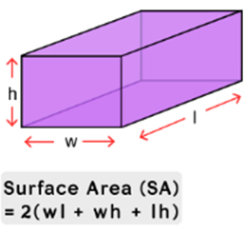
Problem Solving Techniques
Ex00-Q6: Find the surface area and the diagonal of a cuboid
Algorithm Design
Compute surface area function
Compute surface_area as 2 * (width * length + width * height + length * height) (formula)
Computation of area is repeated 3 times with different inputs!
1. Breaking it down!
2. Borrowing from what we know!
3. Wishful thinking!

Slide 8
Problem Solving Techniques
Ex00-Q6: Find the surface area and the diagonal of a cuboid
Algorithm Design
Compute surface area function
Compute area for the bottom (compute area function)
Compute area for the front (compute area function)
Compute area for the side (compute area function)
Compute the surface_area as 2 * the sum of the 3 areas
1. Breaking it down!
2. Borrowing from what we know!
3. Wishful thinking!

Slide 9
Problem Solving Techniques
Ex00-Q6: Find the surface area and the diagonal of a cuboid
Algorithm Design
Compute area function
Compute the area as rect_length * rect_width
1. Breaking it down!
2. Borrowing from what we know!
3. Wishful thinking!

Slide 10
Problem Solving Techniques
Ex00-Q6: Find the surface area and the diagonal of a cuboid
Algorithm Design
Compute diagonal function
Compute the sum_of_squares as width * width + length * length + height * height (formula)
Computation of square is repeated 3 times with different inputs!
Compute the diagonal as the square root of sum_of_squares (C Math Lib.)
1. Breaking it down!
2. Borrowing from what we know!
3. Wishful thinking!

Slide 11
Problem Solving Techniques
Ex00-Q6: Find the surface area and the diagonal of a cuboid
Algorithm Design
Compute diagonal function
Compute square of length (compute square function)
Compute square of width (compute square function)
Compute square of height (compute square function)
Compute the diagonal as the square root of the sum of the squares (C Math Lib.)
1. Breaking it down!
2. Borrowing from what we know!
3. Wishful thinking!

Slide 12
Problem Solving Techniques
Ex00-Q6: Find the surface area and the diagonal of a cuboid
Algorithm Design
Compute square function
Compute the square as number * number
1. Breaking it down!
2. Borrowing from what we know!
3. Wishful thinking!

Slide 13
Ex #2: Yet another solution for FindMax
FindMax (Recursion): Use a function max'' (L, r) which computes the maximum among L₀…L_{r} in a given list L
E.g., Let say L = {5, 9, 8, 1, 3, 2}
max'' (L, 0) = 5
max'' (L, 1) = 9
max'' (L, 2) = 9
max'' (L, 3) = 9
max'' (L, 4) = 9
max'' (L, 5) = 9
l₀, l₁ , l₂, l₃, l₄, l₅

Slide 14
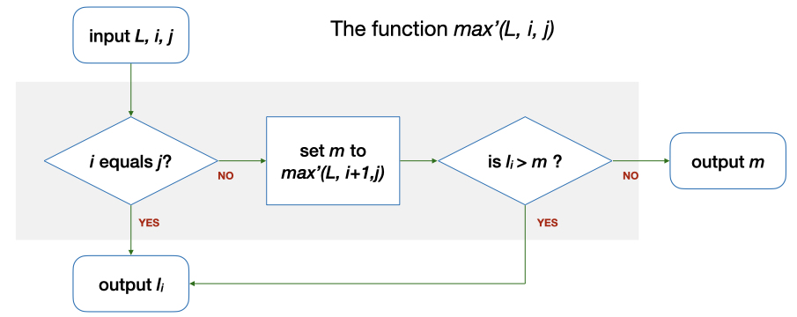
Ex #2: Yet another solution for FindMax
FindMax (Recursion): Use a function max'' (L, r) which computes the maximum among L₀…L_{r} in a given list L
Let say L = {5, 9, 8, 1, 3, 2}, Base case: max''(L, 0)
0 == r (0)? → Yes. Output l₀ (5).
r
max''(L, r)
r equals 0?
set m to
max''(L, r-1)
is l_{r} > m ?
l_{r}
l₀, l₁ , l₂, l₃, l₄, l₅

Slide 15
Ex #2: Yet another solution for FindMax
FindMax (Recursion): Use a function max'' (L, r) which computes the maximum among L₀…L_{r} in a given list L
Let say L = {5, 9, 8, 1, 3, 2}, Recursive Case: max''(L, 5)
0 == r (5)? → No. m is max'' (L, 4) = 9 → l₄ (2) > m (9)? → No. Output m (9).
r
max''(L, r)
r equals 0?
set m to
max''(L, r-1)
is l_{r} > m ?
l_{r}
l₀, l₁ , l₂, l₃, l₄, l₅

Slide 16
(Variable) Type declaration
Type declaration for variables (before use) is compulsory in C so that the computer can
Allocate the right number of bits in memory
Handle the value accordingly
Examples of type declarations in C
Declaration | Variable Name | Size | For storing
long value; | value | 4 bytes | An integer
char ch; | ch | 1 byte | A character
double ave; | ave | 8 bytes | A real number

Slide 17
Practice the problem-solving process and techniques.
Get started with recursion.
Know the types of your variables and declare them before use in a C program.

