Slide 1


CS1010: Programming Methodology
UNIT 21
Searching
Live Q&A
https://pollev.com/jin

Slide 2
Unit 21: Searching
Searching
Linear Search
Binary Search

Slide 3

Searching
A common task that we carry out without much thought everyday.
Searching for a location in a map
Searching for the contact of a particular person
Searching for a nice picture for your project report
Searching for a research paper required in your course
Problem statement:
Given a list of n items and a search key q, return the position of q in the list if it exists.

Slide 4
Linear Search
Also known as Sequential Search
Idea: Search the list from one end to the other end in linear progression.
Algorithm:
Example: Search for 24 in this list
// Search for key in list A with n items
linear_search(n, list, q){
for i = 0 to n-1
if list_{i} is q then report i
}
87 12 51 9 24 63
no
no
no
no
yes!
Return 4
What to report if key is not found?
Aim for a clean design

Slide 5
Linear Search
long search(long n, const long list[n], long q) {
for (long i = 0; i < n; i += 1) {
if (list[i] == q) {
return i;
}
}
return -1;
}
What if array contains duplicate values of the key?
Index of the first element found will be returned.

Slide 6
Linear Search
For an array with n elements, what is the worst case (that requires most comparisons) for Linear search?
When the key does not exist in the array.
What is the number of comparisons in the worst case?
n comparisons.
The time complexity of linear search is O(n).

Slide 7
Binary Search
What if the list is sorted before-hand?
We will be able to make use of the Binary Search algorithm, which takes O(log n) time!
The organization of data affects the choice of algorithm.
More of this in the later course
arr
[0]
[1]
[2]
[3]
[4]
[5]
[6]
[7]
[8]
5
12
17
23
38
44
77
84
90

Slide 8
Binary Search
The Binary Search algorithm
Look for the key in the middle position of the list. Either of the following 2 cases happens:
If the key is smaller than the middle element, “discard” the right half of the list and repeat the process.
If the key is greater than the middle element, “discard” the left half of the list and repeat the process.
Terminating condition: when the key is found, or when all elements have been “discarded”.

Slide 9
Binary Search
Example: Search key = 23
arr
[0]
[1]
[2]
[3]
[4]
[5]
[6]
[7]
[8]
5
12
17
23
38
44
77
84
90
Found!
Return 3
1. start = 0, end = 8, mid = (0+8)/2 = 4
arr[4] = 38 > 23
2. start = 0, end = 3, mid = (0+3)/2 = 1
arr[1] = 12 < 23
3. start = 2, end = 3, mid = (2+3)/2 = 2
arr[2] = 17 < 23
4. start = 3, end = 3, mid = (3+3)/2 = 3
arr[3] = 23 == 23

Slide 10
Binary Search
In binary search, each step eliminates the problem size (array size) by half!
The problem size gets reduced to 1 very quickly!
Such strategy, a special case of divide-and-conquer paradigm, can be naturally implemented using recursion.

Slide 11
Binary Search
Usage:
long search(const long list[], long i, long j, long q) {
if (i > j) {
return -1;
}
long mid = (i+j)/2;
if (list[mid] == q) {
return mid;
}
if (list[mid] > q) {
return search(list, i, mid-1, q);
}
return search(list, mid+1, j, q);
}
i and j indicate start and end of the array.
search(list, 0, n-1, q);

Slide 12
Binary Search
long search(const long list[], long i, long j, long q) {
if (i > j) {
// { q is not in list[0]..list[n-1] }
return -1;
}
long mid = (i+j)/2;
if (list[mid] == q) {
return mid;
}
if (list[mid] > q) {
// { q is not in list[0]..list[i-1] and list[mid]..list[n-1] }
return search(list, i, mid-1, q);
}
// { q is not in list[0]..list[mid] and list[j]..list[n-1] }
return search(list, mid+1, j, q);
}
The correctness of the code can be verified by the assertions.

Slide 13
Binary Search
Worst-case analysis
Array size n | Linear Search (n comparisons) | Binary search
100 | 100 | ≈7
1,000 | 1,000 | ≈10
10,000 | 10,000 | ≈14
100,000 | 100,000 | ≈17
1,000,000 | 1,000,000 | ≈20
10⁹ | 10⁹ | ≈30
O(n) vs O(log n)!

Slide 14
Problem Solving with Searching
Apply searching in various settings
In a 1D / 2D array
With integers, characters, strings, structures (to be introduced)
With customized criteria

Slide 15
CS1010: Programming Methodology
UNIT 22
Sorting
Live Q&A
https://pollev.com/jin

Slide 16
Unit 22: Sorting
Sorting
Counting Sort
Selection Sort
Bubble Sort
Insertion Sort

Slide 17
Sorting
Sorting is any process of arranging items in some sequence and/or in different sets – Wikipedia.
Sorting is important because once a set of items is sorted, many problems (such as searching) become easy.
Searching can be speeded up. (From linear search to binary search)
Determining whether the items in a set are all unique.
Finding the median item in a list.
Many others…

Slide 18
Sorting
Problem statement:
Given a list of n items, arrange the items in some order.
We will
Sort integers in increasing order.
Show 4 algorithms for sorting.
Analyze the time complexity of the algorithms.

Slide 19
Counting Sort
Given a list of integers in [0, MAX]
Count the frequency of the integers using an array
E.g., freq[0] → frequency of 0, freq[MAX] → frequency of max
The array has MAX+1 slots
Output each number into an array base on frequency, skipping those numbers which do not appear.
E.g., freq[0] == 0 → skipped, freq[2] == 2 → output 2 twice

Slide 20
Counting Sort
in
[1]
[3]
[4]
A list of 6 items in the range of [0, 9]
[0]
[2]
[5]
5
5
3
2
8
2
freq
[1]
[3]
[4]
[9]
[0]
[2]
[5]
[6]
[7]
[8]
10 slots in the freq array.
0
0
2
1
0
2
0
0
1
0
out
[1]
[3]
[4]
[0]
[2]
[5]
2
2
3
5
5
8

Slide 21
Counting Sort: Implementation
void counting_sort(size_t len, const long in[], long out[]){
long freq[MAX + 1] = { 0 };
for (size_t i = 0; i < len; i += 1) {
freq[in[i]] += 1;
}
long outpos = 0;
for (long i = 0; i <= MAX; i += 1) {
for (size_t j = outpos; j < outpos + freq[i]; j += 1) {
out[j] = i;
}
outpos += freq[i];
}
}

Slide 22
Counting Sort: Performance
Let say the length of the list is n.
The calculation of frequencies takes O(n) time
The output is done in nested loop
Outer loop takes O(MAX+1) iteration
The total number of output done in the inner loop is O(n) since every number in the list is output only once.
Total: O(n + MAX + 1 + n) = O(n + MAX)

Slide 23
Selection Sort
Key Idea
Find the maximum element in the current list
Swap it with the last element in the current list
array
[1]
[3]
[4]
[0]
[2]
[5]
[6]
[7]
[8]
23
17
5
90
12
44
38
84
77
Final array:
5
12
17
23
38
44
77
84
90

Slide 24
Selection Sort
Algorithm
Pass 1: Find the maximum element in the list array[0]…array[n-1].
Swap this with the last element array[n-1].
(Now the largest element is in the right place.)
23
17
5
90
12
44
38
84
77
23
17
5
77
12
44
38
84
90

Slide 25
Selection Sort
Algorithm
Pass 2: Find the maximum element in the list array[0]…array[n-2].
Swap this with the last element array[n-2].
….
23
17
5
77
12
44
38
84
90
23
17
5
77
12
44
38
84
90

Slide 26
Selection Sort
Selection Sort algorithm
Pass n-1: Find the maximum element in the list array[0]…array[1]
Swap this with the last element array[1].
12
5
17
23
38
44
77
84
90
5
12
17
23
38
44
77
84
90

Slide 27
Selection Sort
n = 9
max
last
array
[1]
[3]
[4]
[0]
[2]
[5]
[6]
[7]
[8]
1st pass:
23
17
5
90
12
44
38
84
77
max
last
2nd pass:
23
17
5
77
12
44
38
84
90
max
last
3rd pass:
23
17
5
77
12
44
38
84
90
max
last
4th pass:
23
17
5
38
12
44
77
84
90

Slide 28
Selection Sort
n = 9
max
last
5th pass:
23
17
5
38
12
44
77
84
90
max
last
6th pass:
23
17
5
12
38
44
77
84
90
max
last
7th pass:
12
17
5
23
38
44
77
84
90
max
last
8th pass:
12
5
17
23
38
44
77
84
90
Final array:
5
12
17
23
38
44
77
84
90

Slide 29
Selection Sort: Implementation
size_t max(size_t last, const long list[]){
long max_so_far = list[0];
size_t max_index = 0;
for (size_t i = 1; i <= last; i += 1) {
if (list[i] > max_so_far) {
max_so_far = list[i];
max_index = i;
}
}
return max_index;
}
void selection_sort(size_t n, long list[]){
for (size_t j = n - 1; j >= 1; j -= 1) {
size_t max_pos = max(j, list);
swap(list, max_pos, j);
}
}

Slide 30
Selection Sort: Performance
Let say the length of the list is n.
The for loop in selection sort iterates O(n) times.
In each loop, it finds the maximum element, and swaps.
Finding the index of the maximum element from list[0] to list[n - i] takes O(n - i) time.
Swapping (once only) takes constant time (and can be ignored).
Total: O(n²)
Pass | #steps
1 | n – 1
2 | n – 2
3 | n – 3
… | …
n – 1 | 1

Slide 31
Selection Sort vs Counting Sort
Selection Sort: O(n²)
Counting Sort: O(n + MAX)
Counting Sort is a lot more efficient!
But it requires the input numbers to be in [0, MAX] and MAX cannot be too large.
Otherwise it does not work / is not efficient.
Selection Sort does not make assumption on the input numbers and is a more general solution.

Slide 32
Bubble Sort
Selection sort makes one swap per pass.
Can we make more than one swap per pass?
Key idea of Bubble Sort
Check every pair
Swap the elements in the pair if they are in the wrong order.

Slide 33
Bubble Sort: One Pass
0
1
2
3
4
5
6
7
8
23
17
5
90
12
44
38
84
77
17
5
23
12
44
90
38
84
77
exchange
exchange
17
23
5
90
12
44
38
84
77
17
5
23
12
44
38
90
84
77
exchange
exchange
17
5
23
90
12
44
38
84
77
17
5
23
12
44
38
84
90
77
exchange
ok
exchange
17
5
23
12
90
44
38
84
77
17
5
23
12
44
38
84
77
90
exchange
Q: Is the array sorted?
Q: What have we achieved?
Done!

Slide 34
Bubble Sort: Implementation
void bubble_pass(long last, long a[]){
for (size_t i = 0; i < last; i += 1) {
if (a[i] > a[i+1]) {
swap(a, i, i+1);
}
}
}
void bubble_sort(long n, long a[]) {
for (size_t last = n - 1; last > 0; last -= 1) {
bubble_pass(last, a);
}
}

Slide 35
Bubble Sort: Performance
Let say the length of the list is n.
Bubble sort requires O(n) passes for an array with n elements.
In each pass, it compares and swaps
The number of comparisons is O(n - i).
The number of swaps is not fixed but no more than the number of comparisons.
Total: O(n²)
Pass | #steps
1 | n – 1
2 | n – 2
3 | n – 3
… | …
n – 1 | 1

Slide 36
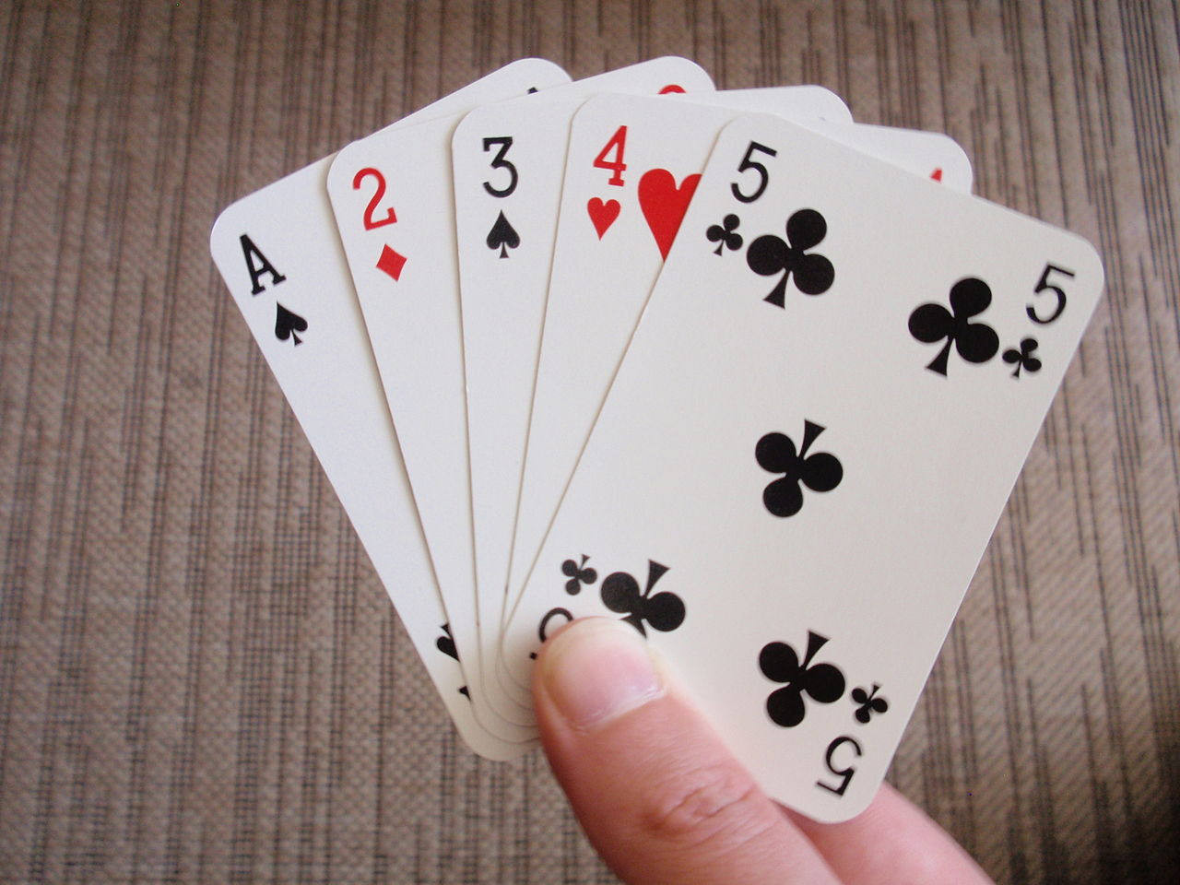
Insertion Sort
In a card game, we don’t normally sort our cards using Bubble Sort or Selection sort. (Just imagine that!)
The closer algorithm we use is perhaps Insertion Sort.
The idea is to keep inserting the new card into the correct position among the existing cards.

Slide 37
Insertion Sort
Algorithm
Given an array a, on pass i,
Insert a[i] into the correct position in the sorted region to its left, i.e. a[0] … a[i-1]
Example: pass 1 (assume n = 5)
Compare a[1] with a[0]
If a[1] < a[0], move a[1] to the front of a[0] (shifting needed)
The sorted region now consists of two elements: a[0] and a[1].

Slide 38
Insertion Sort
Sorted region
a [0] [1] [2] [3] [4]
Pass 1
Pass 2
10
5
7
1
6
Where to insert a[1] in the sorted region to its left?
5
10
7
1
6
5
10
7
1
6
Where to insert a[2] in the sorted region to its left?
5
7
10
1
6

Slide 39
Insertion Sort
Sorted region
a [0] [1] [2] [3] [4]
Pass 3
Pass 4
5
7
10
1
6
Where to insert a[3] in the sorted region to its left?
1
5
7
10
6
1
5
7
10
6
Where to insert a[4] in the sorted region to its left?
1
5
6
7
10

Slide 40
Insertion Sort: Implementation
void insert(long a[], size_t curr){
long i = curr;
long temp = a[curr];
while (i >= 0 && temp < a[i]) {
a[i] = a[i - 1];
i -= 1;
}
a[i] = temp;
}
void insertion_sort(size_t n, long a[]) {
for (size_t curr = 1; curr < n; curr += 1) {
insert(a, curr);
}
}

Slide 41
Problem Solving with Sorting
Apply sorting in various settings
In a 1D / 2D array
With integers, characters, strings, structures (to be introduced)
In ascending / descending / alphabetical / customized order
Use sorting as a preprocessing step to simplify problems and improve efficiency
Searching
Duplicate removal
Find top K elements

Slide 42
Homework
Check Visualgo for animations: https://visualgo.net/bn/sorting
Post-Lecture Diagnostic Quiz
Problem Set 21-22
Exercise 6

