Slide 1

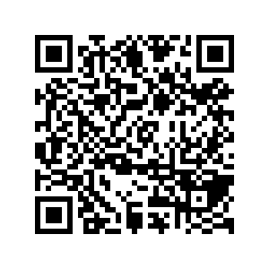
CS1010: Programming Methodology
UNIT 11
Loops
Live Q&A
https://pollev.com/jin

Slide 2
Unit 11: Loops
Repetition
The for Loop
The while Loop
The do-while Loop
Example
Infinite Loops!

Slide 3
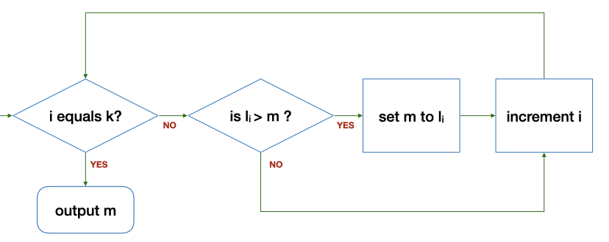
Control Structure: Repetition
Keep going as long as …
e.g., Keep going as long as there are more numbers (i.e., i does not equal k)
if m < l_{i}, then update m with the value of l_{i}
Increase i by 1

Slide 4
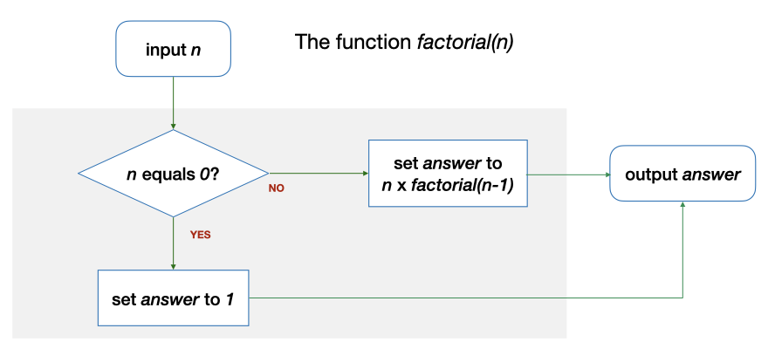
Repetition through Recursion
factorial(2) requires factorial(1), which in turn requires factorial (0)
long factorial(long n)
{
long answer;
if (n == 0) {
answer = 1;
} else {
answer = n * factorial(n - 1);
}
return answer;
}

Slide 5
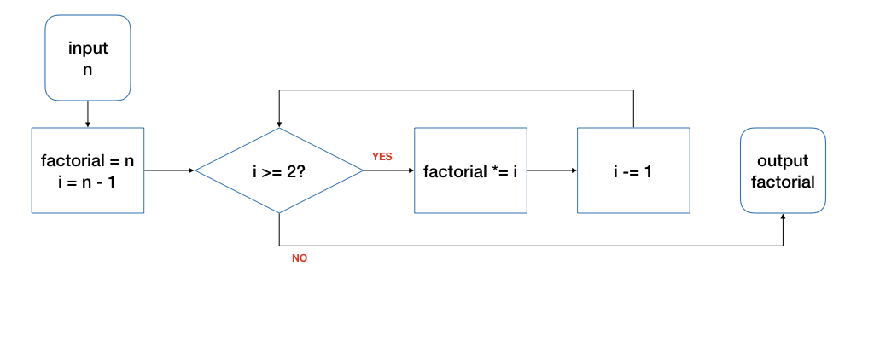
Repetition through Loops
initialize
condition
body
update
Input: 4
n | i | factorial | i >= 2? | Remark
4 | 3 | 4 | true | Before the loop
4 | 2 | 12 | true | After 1st round of the loop
4 | 1 | 24 | false | After 2nd round…
Tracing is an important skill!

Slide 6
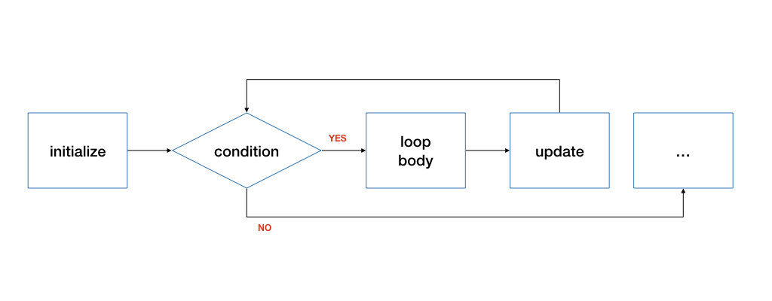
The for Loop
for ( initialize; condition; update )
{
// loop body
}
initialize: initialize the loop variable
condition: repeat loop while the condition on loop variable is true
update: change value of loop variable

Slide 7
The for Loop
Good for repetitions that have an explicit start / end / update.
long factorial(long n)
{
long product = n;
for (long i = n - 1; i >= 2; i -= 1) {
product *= i;
}
return product;
}
Any issues with this function?

Slide 8
The for Loop
long factorial(long n)
{
if (n == 0) { return 1; }
long product = n;
for (long i = n - 1; i >= 2; i -= 1) {
product *= i;
}
return product;
}

Slide 9
Ex #1: List a Range of Integers (1/3)
Problem: List all the integers within a particular range [lower, upper]
Components of the loop
Initialize?
Condition?
Loop body?
Update?
void list_integers(long lower, long upper) {
for (long num=lower; num<=upper; num+=1) {
cs1010_println_long(num);
}
}
Notes:
Program: Week4_ListIntegers.c

Slide 10
The while Loop
initialize
while ( condition )
{
// loop body
// update
}

Slide 11
The while Loop
long i = n - 1;
while (i >= 2) {
product *= i;
i -= 1;
}
for (long i = n - 1; i >= 2; i -= 1) {
product *= i;
}

Slide 12
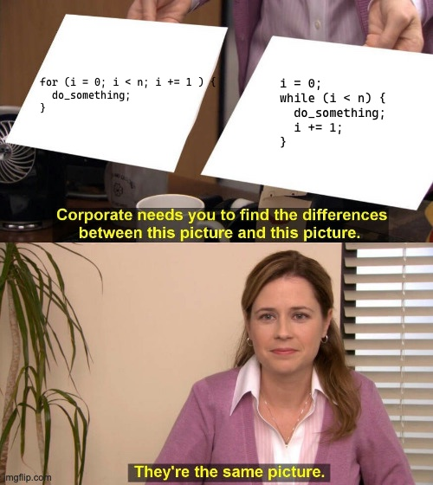
The while Loop

Slide 13
The while Loop (Simplified)
while ( condition )
{
// loop body
}
false
condition
true
loop body
Good for repetitions that do not have an explicit start / update.

Slide 14
Ex #2: Tracing a while Loop
void print_digits(long n) {
long digit;
while (n > 0) {
digit = n%10;
CS1010_println_long(digit);
n /= 10;
}
}
What are the values of n and digit at various point of time?
n: 28943
n | digit | n > 0 | Remark
28943 | - | true | Before the loop
2894 | 3 | true | After the first iteration…
289 | 4 | true | After the second iteration…

Slide 15
Skipping the Loop
long a = 2;
long b = 7;
while (a == b) {
CS1010_print_long(a);
a = a + 2;
}
Output: ?
When the loop condition is false on the first check, the loop body is not executed.

Slide 16
Infinite Loops!
long a = 2;
long b = 7;
while (a != b) {
cs1010_print_long(a);
a = a + 2;
}
2
4
6
8
10
:
:
Output: ?
Ctrl-c to interrupt
When the loop condition is always true, the loop body is executed forever – infinite loop.

Slide 17
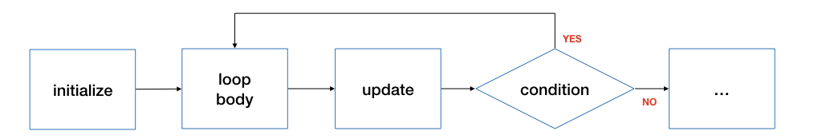
The do-while Loop
initialize
do {
// loop body
// update
} ( condition );
Do NOT forget the semi-colon at the end!
Execute the loop body at least once!

Slide 18
The do-while Loop
long i = n - 1;
do {
product *= i;
i -= 1;
} while (i >= 2);
for (long i = n - 1; i >= 2; i -= 1) {
product *= i;
}
These two are NOT exactly the same!

Slide 19
Example: Hi-Lo Game
Problem: Play a Hi-Lo Game with the user using a randomly generated secret number
The secret number should be between 1 and 100 (both inclusive).
User should keep making guess until the guess is correct.
Program responses according to whether user’s guess is smaller than, larger than, or equal to the jackpot.
Analysis
Input: guesses from the user
Output: messages according to whether user’s guess is smaller than, larger than, or equal to the jackpot.

Slide 20
Example: Hi-Lo Game
Problem: Play a Hi-Lo Game with the user using a randomly generated secret number
The secret number should be between 1 and 100 (both inclusive).
User should keep making guess until the guess is correct.
Program responses according to whether user’s guess is smaller than, larger than, or equal to the jackpot.
Design
Step 1: Generate a secret number
Step 2: Read a guess from the user
Step 3: Print a message (“too high”, “too low”) if the guess is not correct.
Go back to Step 2 if the guess is not correct.
Step 4: Print a message ("you got it.").

Slide 21
Example: Hi-Lo Game
#include <stdlib.h>
#include <sys/times.h>
#include "cs1010.h"
int main()
{
// Initialize the random number generator
srandom(times(0));
// Generate a random number between 1 and 100
long answer = (random() % 100) + 1;
…

Slide 22
Example: Hi-Lo Game
…
long guess;
do {
// Read guess and feedback to user
guess = cs1010_read_long();
if (guess > answer) {
cs1010_println_string("too high");
} else if (guess < answer) {
cs1010_println_string("too low");
}
} while (guess != answer);
// { guess == answer }
cs1010_println_string("you got it. congrats!");
}
Why a do-while loop is used here?
Why else-if instead of else?

Slide 23
CS1010: Programming Methodology
UNIT 12
Loop Invariant
Live Q&A
https://pollev.com/jin

Slide 24
Unit 12: Loop Invariant
Assertion for Loops
Loop Invariant

Slide 25
Assertion for loops
Problem: Count multiples of 5 between 1 and n-1
1
2
3
4
5
6
7
8
9
10
11
12
13
14
15
long count(long n) {
long y = 0;
long x = n;
while (x > 0) {
// line A
x -= 1;
// line B
if (x % 5 == 0) {
// line C
y += 1;
}
}
// line D
return y;
}
What assertions can be added at line A/B/C/D?
Note that this time round we are annotating an existing program based on its code.

Slide 26
Assertion for loops
Problem: Count multiples of 5 between 1 and n-1
1
2
3
4
5
6
7
8
9
10
11
12
13
14
15
long count(long n) {
long y = 0;
long x = n;
while (x > 0) {
// { (x > 0) && (x <= n) }
x -= 1;
// { (x >= 0) && (x < n) }
if (x % 5 == 0) {
// { (x >= 0) && (x < n) && x is multiple of 5 }
y += 1;
}
}
// { x <= 0 }
return y;
}
Does this function work correctly?

Slide 27
Loop Invariant
An assertion that is true before the loop, after each iteration of the loop, and after the loop.
1
2
3
4
5
6
7
8
9
10
11
12
13
14
15
16
long factorial(long n)
{
if (n == 0) { return 1; }
long product = 1;
long i = 1;
// Line A: before the loop
while (i < n) {
// Line B: beginning of each iteration
i += 1;
// Line C: …
product *= i;
// Line D: after each iteration
}
// Line E: after the loop
return product;
}

Slide 28
Loop Invariant
Think in terms of the purpose of the loop
1
2
3
4
5
6
7
8
9
10
11
12
13
14
15
16
long factorial(long n)
{
if (n == 0) { return 1; }
long product = 1;
long i = 1;
// A: { product == i! }
while (i < n) {
// B: { product == i! }
i += 1;
// C: { product == (i-1)! }
product *= i;
// D: { product == i! }
}
// E: { product == i! }
return product;
}

Slide 29
Homework
Post-Lecture Diagnostic Quiz
Problem Set 11/12
Exercise 2
PE preparation

