Slide 1

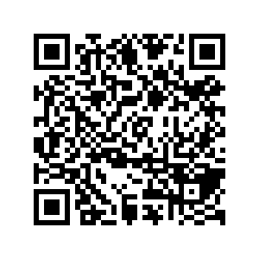
CS1010: Programming Methodology
Week 5
Recap
Live Q&A
https://pollev.com/jin

Slide 2
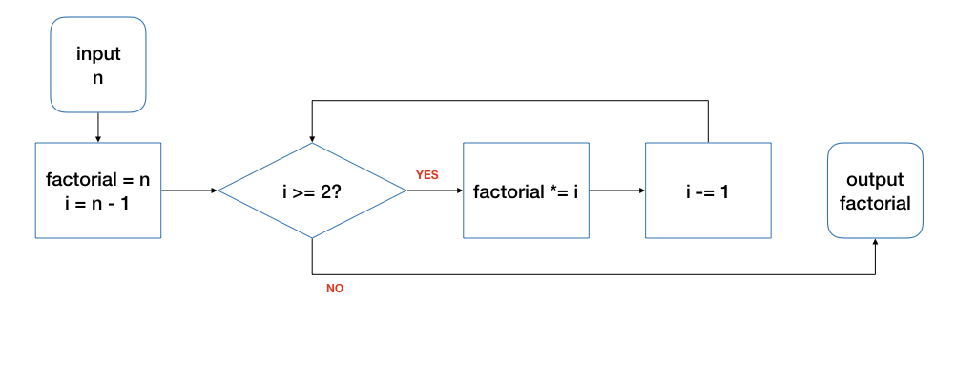
Repetition through Loops
initialize
condition
body
update
Input: 4
n | i | factorial | i >= 2? | Remark
4 | 3 | 4 | true | Before the loop
4 | 2 | 12 | true | After 1st round of the loop
4 | 1 | 24 | false | After 2nd round…
Tracing is an important skill!

Slide 3
The for Loop
initialize
condition
body
update
for (long i = n - 1; i >= 2; i -= 1) {
product *= i;
}
Good for repetitions that have an explicit start / end / update.
for ( initialize; condition; update )
{
// loop body
}

Slide 4
The while Loop
initialize
condition
body
update
long i = n - 1;
while (i >= 2) {
product *= i;
i -= 1;
}
while ( condition )
{
// loop body
}
Good for repetitions that do not have explicit start / end / update.

Slide 5
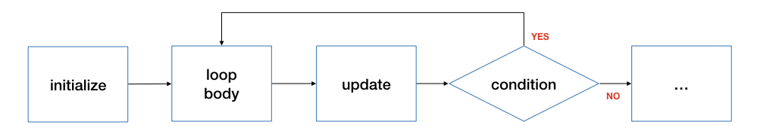
The do-while Loop
long i = n - 1;
do {
product *= i;
i -= 1;
} while (i >= 2);
do {
// loop body
} ( condition );
Good for repetitions that must be done at least once.

Slide 6
Nested Loops (w/ tracing)
…
a = 1;
while (a <= 4) {
b = a + 3;
while (b <= 10) {
b += 3;
}
a += 1;
}
…
a | b | a<=4 | b<=10 | Remark
1 | - | true | - | Before outer loop
1 | 4 | - | true | Before inner loop
1 | 7 | - | true | After 1st round of inner loop.
1 | 10 | - | true | After 2nd round of inner loop.
1 | 13 | - | false | After 3rd round of inner loop.
2 | 13 | true | - | After 1st round of outer loop.
2 | 5 | - | true | Before inner loop
2 | 8 | - | true | After 2nd round of inner loop.
… | … | … | … | …

Slide 7
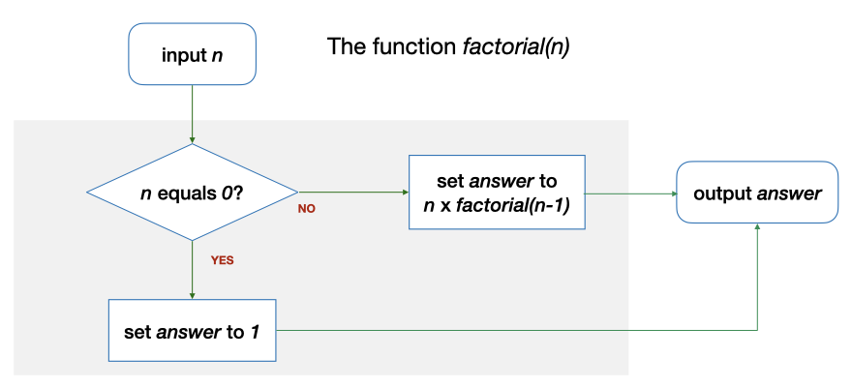
Repetition through Recursion
long factorial(long n)
{
long answer;
if (n == 0) {
answer = 1;
} else {
answer = n * factorial(n - 1);
}
return answer;
}

Slide 8
Conversion between Iteration and Recursion
long factorial(long n)
{
if (n == 0) { return 1; }
long product = n;
while (i >= 2) {
product *= i;
i -= 1;
}
return product;
}
Use recursion to get the result of performing all but the last step of computations.
long factorial(long n)
{
long answer;
if (n == 0) {
answer = 1;
} else {
answer = n * factorial(n - 1);
}
return answer;
}
Expand all the computations in the recursion into separate iterations.

Slide 9
Variants of Recursion…
long factorial(long n)
{
long answer;
if (n == 0) {
answer = 1;
} else {
answer = n * factorial(n - 1);
}
return answer;
}
factorial(5) →
5 * factorial(4) →
5 * 4 * factorial(3) →
… → 5!
Call factorial(n) to compute n!
long factorial_v2(long n, long result)
{
long answer;
if (n == 0) {
answer = result;
} else {
answer = factorial_v2(n – 1, n * result);
}
return answer;
}
factorial_v2(5, 1) →
factorial_v2(4, 5)→
factorial_v2(3, 5*4) →
factorial_v2(2, 5*4*3) →
… → 5!
Call factorial_v2(n, 1) to compute n!

Slide 10
Loop Invariant
An assertion that is true before the loop, after each iteration of the loop, and after the loop.
1
2
3
4
5
6
7
8
9
10
11
12
13
14
15
16
long factorial(long n)
{
if (n == 0) { return 1; }
long product = 1;
long i = 1;
// Line A: before the loop
while (i < n) {
// Line B: beginning of each iteration
i += 1;
// Line C: …
product *= i;
// Line D: after each iteration
}
// Line E: after the loop
return product;
}

Slide 11
Loop Invariant
Think in terms of the purpose of the loop
1
2
3
4
5
6
7
8
9
10
11
12
13
14
15
16
long factorial(long n)
{
if (n == 0) { return 1; }
long product = 1;
long i = 1;
// A: { n != 0 }
while (i < n) {
// B: …
i += 1;
// C: …
product *= i;
// D: { n != 0 }
}
// E: { n != 0 }
return product;
}

Slide 12
Loop Invariant
Think in terms of the purpose of the loop
1
2
3
4
5
6
7
8
9
10
11
12
13
14
15
16
long factorial(long n)
{
if (n == 0) { return 1; }
long product = 1;
long i = 1;
// A: { product == i! }
while (i < n) {
// B: …
i += 1;
// C: …
product *= i;
// D: { product == i! }
}
// E: { product == i! }
return product;
}

Slide 13
Loop Invariant
Think in terms of the purpose of the loop
long factorial(long n)
{
if (n == 0) { return 1; }
long product = 1;
long i = 1;
// A: { product == i! }
while (i < n) {
...
// D: { product == i! }
}
// E: { product == i! }
// { i == n }
// { product == n! }
return product;
}

Slide 14
Use the recess week to catch up and prepare for the midterm!

