Slide 1


CS1010: Programming Methodology
UNIT 13
Call Stack
Live Q&A
https://pollev.com/jin

Slide 2
Unit 13: Call Stack
Stack Frame
Call Stack

Slide 3
Variable Declaration - redux
Type declaration for variables (before use) is compulsory in C so that the computer can
Allocate the right amount of space in memory
Handle the value accordingly
Where do we declare variables?
In the body of the functions
In the header of the functions
Outside functions?
long getMax(long num1, long num2) { long max;
… return max;
}

Slide 4
Function Call - redux
What happens when a function is called?
The statements will be executed based on the inputs (if any)
What happens when the main() function above is called (by the operating system)?
Variable x is declared and initialized to 1
Variable y is declared.
int main()
{
long x = 1;
long y;
…
}

Slide 5
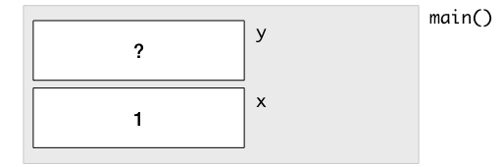
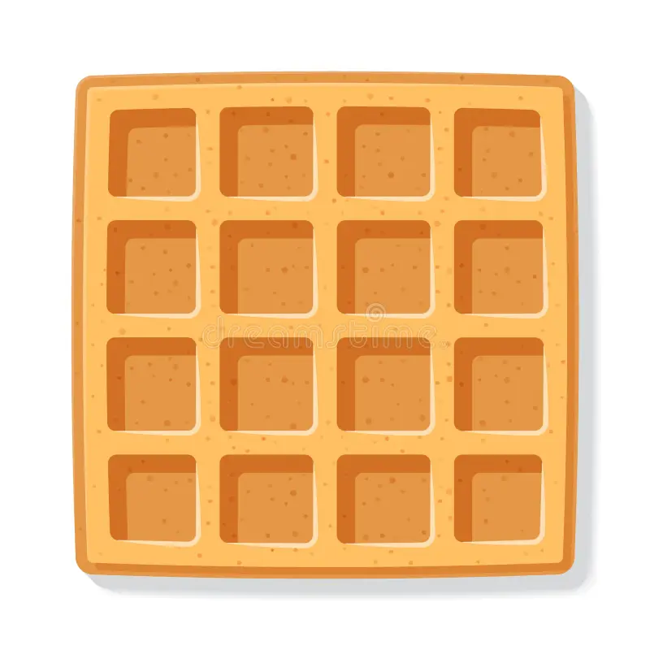
Stack Frame
What happens (in the memory) when you call this function…
A Stack Frame is created for main()
Some space (4 bytes) is allocated for variable x in the frame
The value 1 is stored into this space.
Some space (4 bytes) is allocated for variable y in the frame.
Stack Frame: The memory allocated to a function for storing variables (among other things).
int main()
{
long x = 1;
long y;
…
}

Slide 6
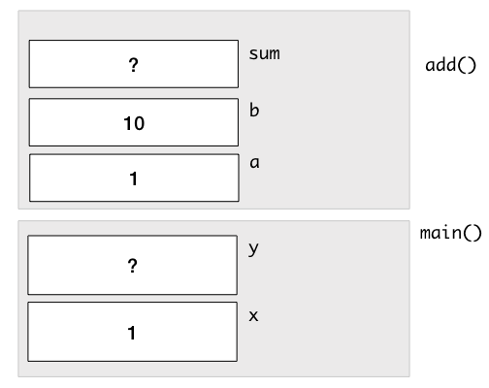
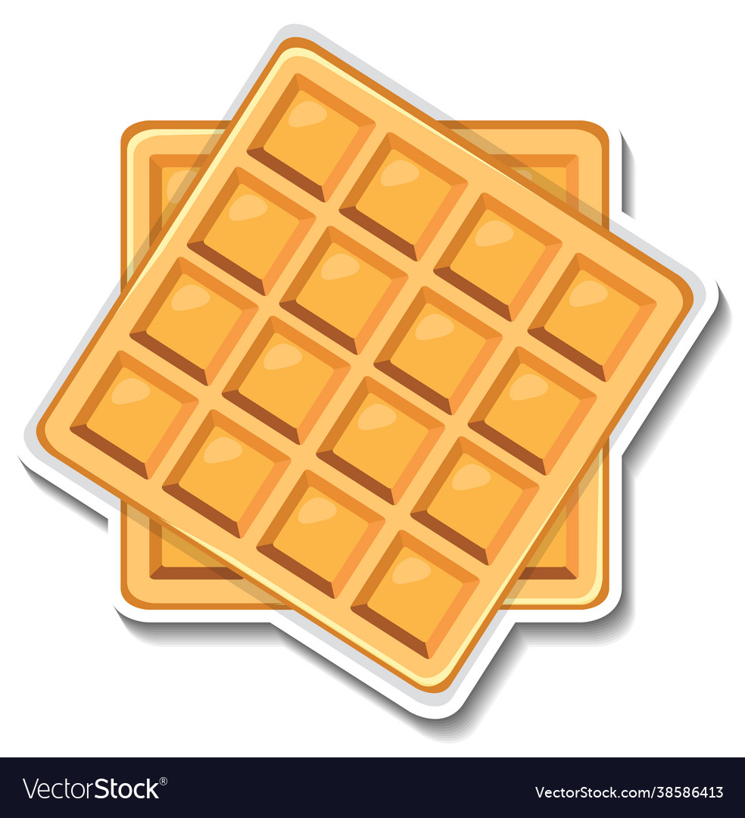
Call Stack
A Stack Frame is added to the Call Stack when a function is called with the values of the arguments copied over.
long add(long a, long b) {
long sum;
sum = a + b;
return sum;
}
int main()
{
long x = 1;
long y;
y = add(x, 10);
…
}
a.k.a. Call By Value
The Call Stack after sum is declared in add().

Slide 7

Call Stack
A Stack Frame is added to the Call Stack when a function is called with the values of the arguments copied over.
long add(long a, long b) {
long sum;
sum = a + b;
return sum;
}
int main()
{
long x = 1;
long y;
y = add(x, 10);
…
}
The Call Stack after sum is computed in add().

Slide 8
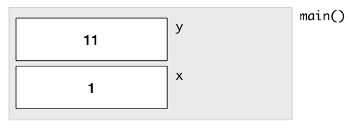
Call Stack
A Stack Frame is removed from the Call Stack after the function has completed.
long add(long a, long b) {
long sum;
sum = a + b;
return sum;
}
int main()
{
long x = 1;
long y;
y = add(x, 10);
…
}
The Call Stack after add() has been completed.

Slide 9
Call Stack
Each Stack Frame is independent from another.
long add(long a, long b) {
long x;
x = a + b;
return x;
}
int main()
{
long x = 1;
long y;
y = add(x, 10);
…
}
The Call Stack after x is computed in add().

Slide 10
Common Mistake
What happens when you call factorial(5) with the following function?
long factorial(long n)
{
long answer;
answer = n * factorial(n - 1);
return answer;
}
Infinite recursion.
May cause stack overflow as signaled by segmentation fault or crashing…

Slide 11
CS1010: Programming Methodology
UNIT 14
Fixed-Length Array
Live Q&A
https://pollev.com/jin

Slide 12
Unit 15: Array
Fixed-Length Array
Array as Lookup Table
Array as List
Common Mistakes
Array and Pointer
Function Definition / Call with Array

Slide 13
Variables – re-redux
What are the limitations of the variables we have learn so far?
It can only hold a single value.
What happens if we need to hold many different values of the same type for processing?
E.g.,
Marks of a class of 100 students
Number of days in each month
Postal codes in Singapore

Slide 14
Fixed-Length Array
A collection of data of a particular type, each accessible through an index.
Element type can be any data type (e.g., long, double, char)
Array size should be a positive integer.
Array index is from 0 to Array size - 1
long marks[10];
Element type
Array size
Array name
Array index
marks [0]
[1]
[2]
…
[8]
[9]
1
2
4
20
…
42
7

Slide 15
Fixed-Length Array
Declare an array marks of size 10 and initialize the first 3 elements later through array index.
long marks[10];
marks[0] = 1;
marks[1] = 2;
marks[2] = 4;
marks [0]
[1]
[2]
…
[8]
[9]
1
2
4
??
…
??
??
The rest of the elements are uninitialized.

Slide 16
Fixed-Length Array
Declare an array marks of size 10 and initialize it at the same time using an initializer
long marks[10] = {1, 2, 4,};
marks [0]
[1]
[2]
…
[8]
[9]
1
2
4
0
…
0
0
The rest of the elements are initialized to 0.
If array size is not specified, there will be no extra elements in the array.
long marks[] = {1, 2, 4,};
// marks has only 3 elements

Slide 17
Array as Look-up Table
Problem: Compute the number of days since 1 Jan until the 1st of a given month (1-12)
E.g., days(1) → 0, days(2) → 31, days(3) → 31+28 = 59 (assuming non-leap year).
Month | Days
1 | 0
Else 2 | 31
Else 3 | 31 + 28
Else 4 | 31 + 28 + 31
… | …

Slide 18
Array as Look-up Table
Problem: Compute the number of days since 1 Jan until the 1st of a given month (1-12)
E.g., days(1) → 0, days(2) → 31, days(3) → 31+28 = 59 (assuming non-leap year).
long days(long month)
{
long days_since = 0;
if (month == 2) {
days_since = 31;
} else if (month == 3) {
days_since = 31 + 28;
} else if (month == 4) {
days_since = 31 + 28 + 31;
} … // 8 more cases
return days_since;
}

Slide 19
Array as Look-up Table
Problem: Compute the number of days since 1 Jan until the 1st of a given month (1-12)
E.g., days(1) → 0, days(2) → 31, days(3) → 31+28 = 59 (assuming non-leap year).
days_in_month
[0]
[1]
[2]
…
[10]
[11]
31
28
31
??
…
30
31
Month | Days
1 | 0 (does not sum up anything)
Else 2 | sum up from slot 0 to slot 0
Else 3 | sum up from slot 0 to slot 1
Else 4 | sum up from slot 0 to slot 2
… | …
sum up from slot 0 to slot month – 2 in general!

Slide 20
Array as Look-up Table
Problem: Compute the number of days since 1 Jan until the 1st of a given month (1-12)
E.g., days(1) → 0, days(2) → 31, days(3) → 31+28 = 59 (assuming non-leap year).
long days(long month)
{
long days_in_month[12] = {31, 28, 31, 30, 31, 30, 31, 31, 30, 31, 30, 31};
if (month == 1) { return 0;}
long days_since = 0;
for (long i = 0; i <= month - 2; i += 1) {
days_since += days_in_month[i];
}
…
}
Why a for loop with these components?

Slide 21
Array as List
Problem: Find the maximum among a list of numbers.
Function definition with arrays.
long find_max(long list[], long length)
{
long max_so_far = list[0];
for (long i = 1; i != length; i += 1) {
if (list[i] > max_so_far) {
max_so_far = list[i];
}
}
return max_so_far;
}
Why this condition?
long arr[6] = {5, 9, 8, 1, 3, 2};
long max = find_max(arr, 6);
Function call with arrays.

Slide 22

Common Mistakes (1/2)
Array index out of bound
Array elements not initialized before use
long a[10];
for (long i = 0; i <= 10; i += 1) {
a[i] = 1;
}
a[10] is NOT a valid element in the array. Strange errors may occur!
long a[10];
long sum = 0;
for (long i = 0; i < 10; i += 1) {
sum += a[i];
}
Value of a[i] is uninitialized and hence unknown.

Slide 23

Common Mistakes (2/2)
Use of initializer after declaration
Array copy via direct assignment
long marks[10];
marks = {1, 2, 4,};
The initializer CANNOT be used after declaration.
long a[4] = {1, 2, 3, 4};
long b[4];
b = a;
Array copy should be done element by element using a loop.
for (long i = 0; i <= 4; i += 1)
{
b[i] = a[i];
}

Slide 24
Array and Memory
Example: long a[10]
a[0]
a[1]
a[2]
a[3]
a[4]
a[5]
a[6]
a[7]
a[8]
a[9]
&a[i] can be used to get the address (location) of element i in memory.
When the array name a appears in an expression, it refers to the address (location) of the first element (i.e. &a[0]) of that array (a.k.a., Array Decay).
These 2 outputs will always be the same.
long a[3];
cs1010_println_pointer(a);
cs1010_println_pointer(&a[0]);
cs1010_println_pointer(&a[1]);
55224724
55224724
55224728

Slide 25
Call By Value - redux
…
int main(void) {
long foo[4] = {44, 9, 17, 1};
double_value(foo[0]);
return 0;
}
void double_value(long value) {
value *= 2;
}
In main():
foo[0]
foo[1]
44
9
17
1
In double_value():
value
44
88

Slide 26
Call By Reference
…
int main(void) {
long foo[4] = {44, 9, 17, 1};
double_array(foo, 4);
return 0;
}
void double_array(long list[], long len) {
for (long i = 0; i < len; i += 1){
list[i] *= 2;
}
}
Use const to disallow such modifications.
In main():
foo[0]
foo[1]
44
9
17
1
88
18
34
2
In double_array():
list
length
i
?
0
1
4
&foo[0]
4
3
2

Slide 27
Other Facts with Array
Read the notes for information about
Array and pointers
Returning an array from a function
….

Slide 28
Homework
Post-Lecture Diagnostic Quiz (1%)
Due on 4th March, 2pm
Problem Set 13 &14
Exercise 2
Due on 4th March, 2pm
PE & Midterm preparation

