Slide 1


CS1010: Programming Methodology
UNIT 3
Functions
Live Q&A
https://pollev.com/jin

Slide 2
Unit 3: Functions
Problem Solving Techniques
Functions
More examples
Even more examples

Slide 3
Problem Solving Techniques
How to solve a new problem?
Find the range (i.e., max-min) of a list of k numbers {l₀,…,l_{k-1}}
Technique 1: Breaking it down!
Input: Read in a number k and a list L of k numbers
Compute: Compute the range of the given list L of k numbers
Output: Print the range
Input: 6 5 9 8 1 3 2
Output: 8

Slide 4
Problem Solving Techniques
How to solve a new problem?
Find the range (i.e., max-min) of a list of k numbers {l₀,…,l_{k-1}}
Technique 2: Borrowing from what we know!
Input: Read in a number k and a list L of k numbers
Same as the input step for FindMax (i.e., read in some numbers)
Output: Print the range
Same as the output step for FindMax (i.e., print one number)
Input: 6 5 9 8 1 3 2
Output: 8

Slide 5
Problem Solving Techniques
How about the Compute step?
Compute: Compute the range of the given list L of k numbers
How to apply Breaking it down again?
Observation: range = max - min
Technique 3: Wishful thinking
Assume that we have a magic black box for solving a smaller problem
i.e., given some inputs, this magic black box produces a value (usually an intermediate result) that we need.

Slide 6
Problem Solving Techniques
Compute: Compute the range (max-min) of a list L of k numbers
Compute the maximum of a list L of k numbers (Breaking it down)
Same as the compute step of FindMax (Borrowing from what we know)
Compute the minimum of a list L of k numbers (Breaking it down)
Assume we have it. (Wishful thinking)
Compute the difference between the maximum and the minimum

Slide 7
Problem Solving Techniques
Problem: Find the range (i.e., max-min) of a list of numbers
Algorithm:
Input: Read in a list L of k numbers
Compute:
Compute the maximum of a list L of k numbers
Compute the minimum of a list L of k numbers
Compute the difference between the maximum and the minimum
Output: Print the range
The real problem!

Slide 8
Functions
The magic black box (a.k.a. a Function)
Given some inputs, it produces a value that we need
Where to find it?
Provided by the standard C library or other libraries
Example: sqrt(x) computes the square root of x
Written by you!

Slide 9
More examples
Problem: Find the range (i.e., max-min) of a list of numbers
Algorithm:
Input: Read in a list L of k numbers
Compute:
Compute the maximum of a list L of k numbers
Compute the minimum of a list L of k numbers
Compute the difference between the maximum and the minimum
Output: Print the range
Two functions

Slide 10
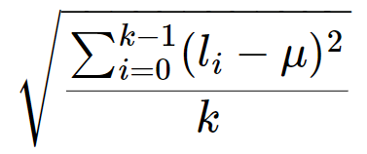
More examples
Problem: Find the standard deviation of a list of numbers
μ: mean (L, k)
L': subtract (L, k, μ)
L'': square (L', k)
μ'': mean (L'', k)
result: sqrt (μ'')
Let say k = 5, L = {1, 3, 5, 7, 9},
μ = 5
subtract (L, k, μ) = {-4, -2, 0, 2 ,4}
square (L', k) = {16, 4, 0, 4,16}
μ'' = mean (L'', k) = 8
sqrt (μ'') = 2.83

Slide 11
More examples
Problem: Find the standard deviation of a list L of k integers
result: sqrt ( mean ( square ( subtract (L, k, mean (L, k)), k), k)
Reuse of functions
A function, once defined, can be reused any number of times!
No need to reinvent the wheel every time!
mean is used twice!

Slide 12
More examples
Problem: Find the standard deviation of a list L of k integers
result: sqrt ( mean ( square ( subtract (L, k, mean (L, k)), k), k)
Function calling other functions
If we treat this computation as a function stddev (L, k), it calls sqrt, mean, square and subtract to complete the computation.

Slide 13



Ex #1: A Simple “Drawing” Problem
Problem: Draw
a rocket ship (which is a triangle over a rectangle over an inverted V),
a male stick figure (a circle over a rectangle over an inverted V), and
a female stick figure (a circle over a triangle over an inverted V)
rocket
male
Analysis:
No particular input / compute needed.
Just draw the needed 3 figures: 1 magic box for each figure.
There are common shapes shared by the 3 figures: 1 magic box for each shape.
female

Slide 14
Ex #1: A Simple “Drawing” Problem
Problem: Draw
a rocket ship (which is a triangle over a rectangle over an inverted V),
a male stick figure (a circle over a rectangle over an inverted V), and
a female stick figure (a circle over a triangle over an inverted V)
rocket
male
female
Design:
Draw 3 Figures
Draw Rocket Ship
Draw Male Stick Figure
Draw Female Stick Figure
Draw Triangle
Draw Rectangle
Draw Inverted V
Draw Circle
Draw Rectangle
Draw Inverted V
Draw Circle
Draw Triangle
Draw Inverted V

Slide 15
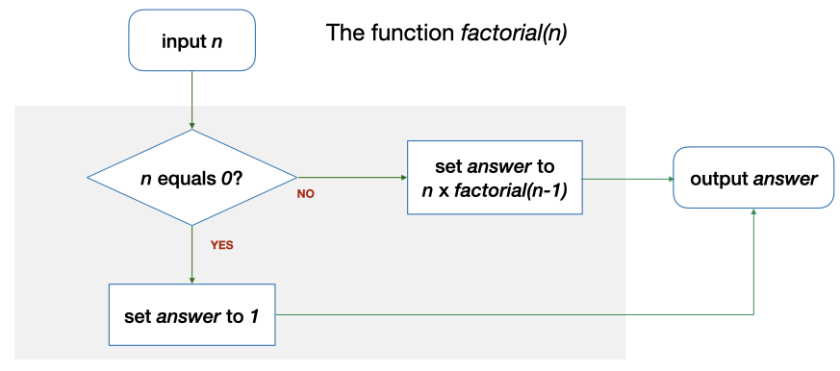
Even more examples
Problem: Compute the factorial of n
E.g., Let n = 4, n! = 4! = 1 * 2 * 3 * 4 = 24
Solution: Use a function factorial (n) which computes factorial n…but with a twist!
factorial calls itself?

Slide 16
Even more examples
Solution: Use a function factorial (n) which computes factorial n?
E.g., Let say n = 0. factorial (n) = …
n (0) == 0? → Yes. The answer is 1.
This is the base case.

Slide 17
Even more examples
Solution: Use a function factorial (n) which computes factorial n?
E.g., Let say n = 4. factorial (n) = …
n (4) == 0? → No. The answer is n * factorial (3) = 4 * 6 = 24.
This is the recursive case.

Slide 18
Even more examples
Problem: Find the maximum of a list of k numbers {l₀,…,l_{k-1}}
Alternative solution: use a function max' (L, i, j) which computes the maximum among L_{i}…L_{j} in a given list L
E.g., Let say L = {5, 9, 8, 1, 3, 2}
max' (L, 5, 5) = 2
max' (L, 4, 5) = 3
max' (L, 0, 5) = 9
l₀, l₁ , l₂, l₃, l₄, l₅

Slide 19
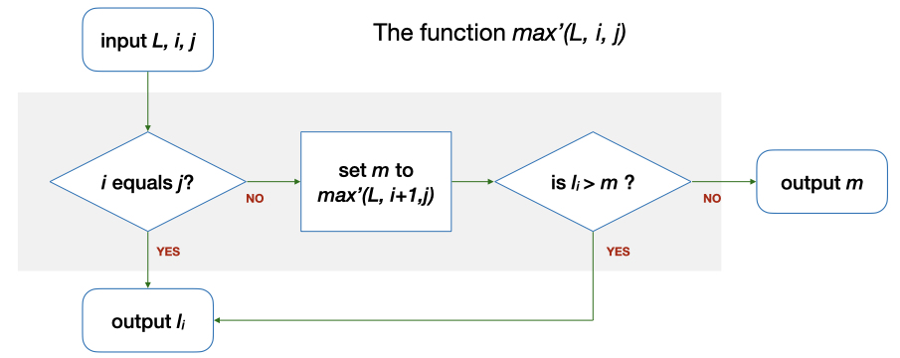
Even more examples
Alternative solution: use a function max' (L, i, j) which computes the maximum among L_{i}…L_{j} in a given list L
E.g., Let say L = {5, 9, 8, 1, 3, 2}, i = 5, j = 5. max' (L, 5, 5) = …
i (5) == j (5)? → Yes. Output l₅ (2)
l₀, l₁ , l₂, l₃, l₄, l₅
This is the base case.

Slide 20
Even more examples
Alternative solution: use a function max' (L, i, j) which computes the maximum among L_{i}…L_{j} in a given list L
E.g., Let say L = {5, 9, 8, 1, 3, 2}, i = 4, j = 5. max' (L, 4, 5) = …
i (4) == j (5)? → No. m is max' (L, 5, 5) = 2 → l₄ (3) > m (2)? → Yes. The answer is l₄ (3).
l₀, l₁ , l₂, l₃, l₄, l₅
This is the recursive case.

Slide 21
Even more examples
Alternative solution: use a function max' (L, i, j) which computes the maximum among L_{i}…L_{j} in a given list L
E.g., Let say L = {5, 9, 8, 1, 3, 2}, i = 0, j = 5. max' (L, 0, 5) = …
i (0) == j (5)? → No. m is max' (L, 1, 5) = 9 → l₀ (5) > m (9)? → No. The answer is m (9).
l₀, l₁ , l₂, l₃, l₄, l₅

Slide 22
Even more examples
Function calling itself (to obtain the solution of a simpler version of the problem and compute the final answer)
factorial (4) uses factorial (3) and multiplies it by 4
max' (L, 0, 5) uses max' (L, 1, 5) and compares it with l₀
This is Recursion!
This is Recursion!
This is Recursion!
…
This is the Base Case!

Slide 23
Ex #2: Yet another solution for FindMax
Problem: Find the maximum of a list of k numbers {l₀,…,l_{k-1}}
Alternative solution: use a function max'' (L, r) which computes the maximum among L₀…L_{r} in a given list L
E.g., Let say L = {5, 9, 8, 1, 3, 2}
max'' (L, 5) = 9
max' (L, 1) = 9
max' (L, 0) = 5
Can you draw the flowchart?
l₀, l₁ , l₂, l₃, l₄, l₅

Slide 24
What have You Learnt?
Problem solving techniques
Algorithms with functions
But how about the variables (i.e., data) used in the algorithms?

Slide 25
CS1010: Programming Methodology
UNIT 4
Types
Live Q&A
https://pollev.com/jin

Slide 26
Unit 4: Types
Computer Memory
Data Types
Data Type Declaration

Slide 27
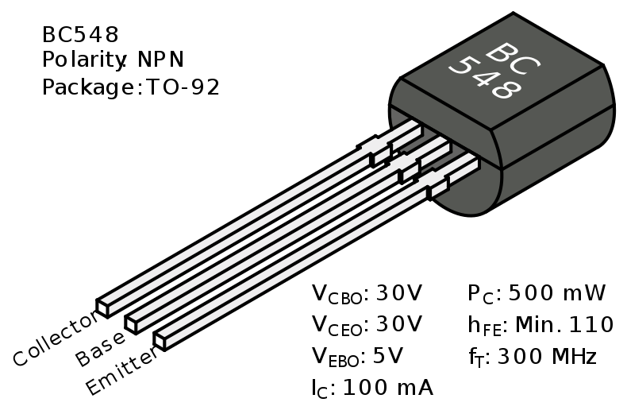
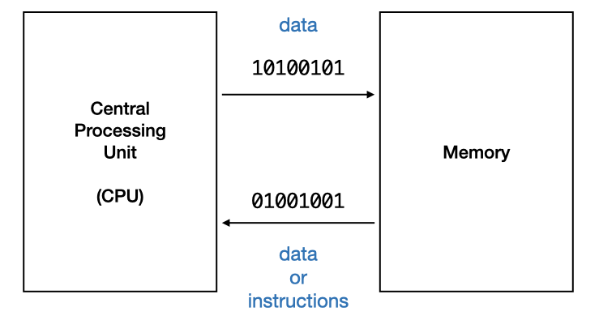
Computer Memory
Memory = a collection of switches (transistors) for storing information
Units
1 bit = the value represented in one switch (transistor)
Two states only: 0 or 1 (e.g., off or on, false or true)

Slide 28
Computer Memory
Units
1 byte = 8 bits
256 possibilities: 00000000, 00000001, …, 11111111 (e.g., integers from 0 to 255)
More bits and/or bytes = more data can be stored / represented.

Slide 29
(Data) Types
The formats used for storing different data
For integers
0~255: 8 bits / 1 byte / unsigned
42: 00101010
201: 11001001
-128~127: 8 bits / 1 byte
42: 00101010
-55: 11001001
-2,147,483,648 to 2,147,483,647: 32 bits / 4 bytes
10953: 0010101011001001
The same binary number may to different values in different type.
More bits required for larger integers.

Slide 30
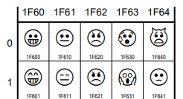
(Data) Types
For characters
ASCII character (e.g., letters, punctuations): 1 byte
A: 01000001
*: 00101010
Unicode characters (e.g. letters, emoticons, Mahjong tiles): 4 bytes

Slide 31
(Data) Types
For real numbers
Single precision: 4 bytes
1.53484220797e-41
Double precision: 8 bytes
5.41150101889917339836595798829e-320
Loss of precision occurs often
More bits required for higher precision

Slide 32
(Data) Types
For compound data?
Sequence of characters (a string)
Pair of real numbers (a point)
A string, a character, a number (a person)
…
No fixed size
To be introduced at the end of this course.

Slide 33
(Variable) Type declaration
Type declaration for variables (before use) is compulsory in C so that the computer can
Allocate the right number of bits in memory
Handle the value accordingly
Examples of type declarations in C
Declaration | Variable Name | Size | For storing
long value; | value | 4 bytes | An integer
char ch; | ch | 1 byte | A character
double ave; | Ave | 8 bytes | A real number

Slide 34
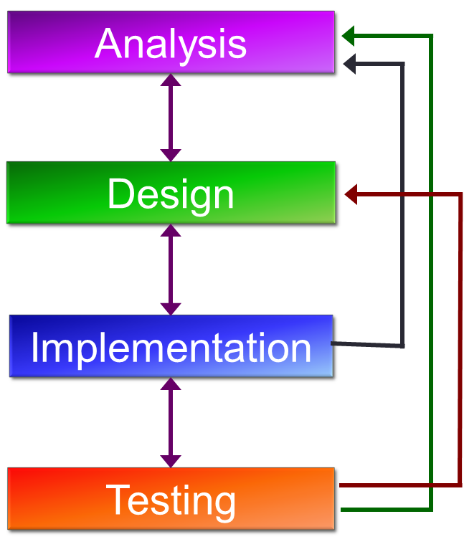
In the context of problem solving
Figure out what variables you need
Declare and use them accordingly in the program

Slide 35
Homework
Post-Lecture Diagnostic Quiz (1%)
To be due next Tuesday, 2pm.
Unlimited number of attempts.
Problem Set 3.1 to 3.2 (under Unit 3)
To be discussed in the forum

