Slide 1


CS1010: Programming Methodology
Week 6
Recap
Live Q&A
https://pollev.com/jin

Slide 2
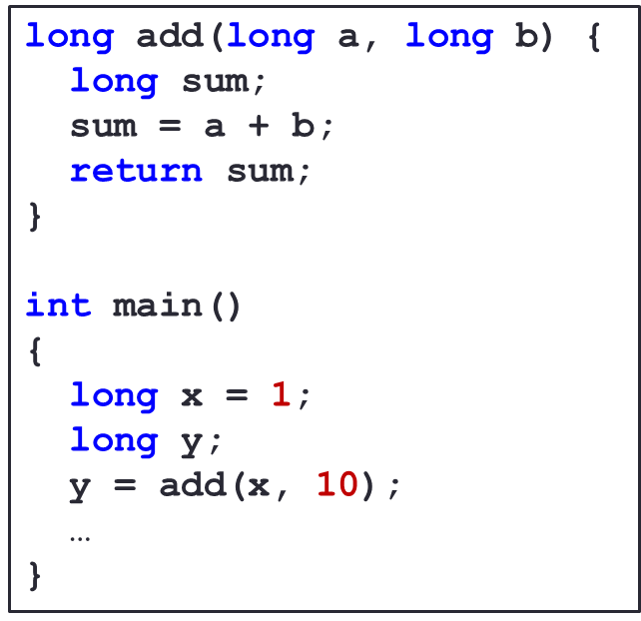
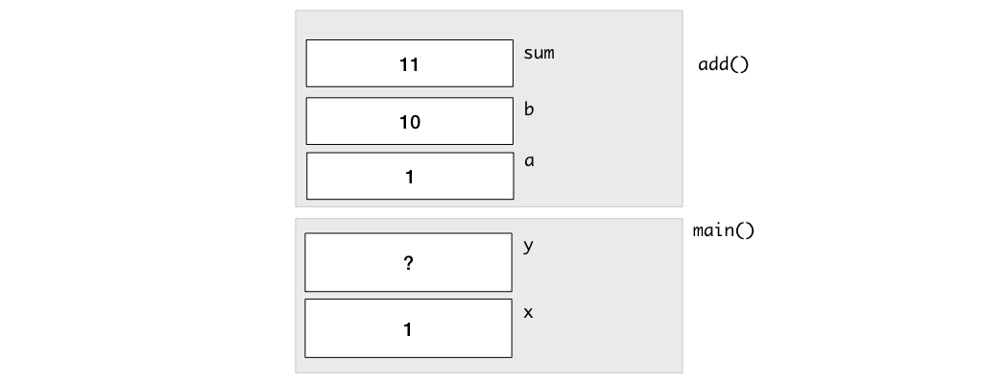
Call Stack
It contains Stack Frames which are
used to store the variables of the function call.
added whenever a function is called with the values of the arguments copied over to the parameters.
removed when the call is done
a.k.a. Call By Value

Slide 3
Fixed-Length Array
A collection of data of a particular type, each accessible through an index.
Element type can be any data type (e.g., long, double, char)
Array size should be a positive integer.
Array index is from 0 to Array size - 1
long marks[10];
Element type
Array size
Array name
Array index
marks [0]
[1]
[2]
…
[8]
[9]
1
2
4
20
…
42
7

Slide 4
Array as Look-up Table, Input List, ….
long days(long month){
long days_in_month[12] = {31, 28, 31, 30, 31, 30, 31, 31, 30, 31, 30, 31};
…
for (long i = 0; i <= month - 2; i += 1) {
days_since += days_in_month[i];
}
…
}
long find_max(long list[], long length)
{
long max_so_far = list[0];
for (long i = 1; i != length; i += 1) {
if (list[i] > max_so_far) {
max_so_far = list[i];
}
}
return max_so_far;
}

Slide 5
Array and Memory
Example: long a[10]
a[0]
a[1]
a[2]
a[3]
a[4]
a[5]
a[6]
a[7]
a[8]
a[9]
&a[i] can be used to get the address (location) of element i in memory.
When the array name a appears in an expression, it refers to the address (location) of the first element (i.e. &a[0]) of that array (a.k.a., Array Decay).
These 2 outputs will always be the same.
long a[3];
cs1010_println_pointer(a);
cs1010_println_pointer(&a[0]);
cs1010_println_pointer(&a[1]);
55224724
55224724
55224728

Slide 6
Function Definition / Call with Array
…
int main(void) {
long foo[4] = {44, 9, 17, 1};
double_array(foo, 4);
return 0;
}
void double_array(long list[], long len) {
for (long i = 0; i < len; i += 1){
list[i] *= 2;
}
}
In main():
foo[0]
foo[1]
44
9
17
1
88
18
34
2
a.k.a. Call By Reference
In double_array():
list
len
i
?
0
1
4
&foo[0]
4
3
2

Slide 7
Statistics of the assessments so far…
PE0 (Max: 20)
Mean: 12
25-percentile: 10
50-percentile: 12
75-percentile: 15
Midterm (Max: 30)
Mean: 13
25-percentile: 9
50-percentile: 13
75-percentile: 17

Slide 8
Quick tips for PE1
Avoid compilation errors and warnings
Incremental Coding
Avoid deduction on style
Check and follow CS1010 Stye Guide
No recursion
Focus on using loops for repetition
No dynamic arrays
Only fixed length arrays
No trivial questions

Slide 9
Problem Solving Process
Algorithmic
Determine problem features
Analysis
Iterative process
Write algorithm
Design
Produce code
Implementation
Check for correctness and efficiency
Testing

Slide 10
Reflect on the first half of the semester and plan for the second half!

