Slide 1

CS1010: Programming Methodology
Week 13
The Future

Slide 2
Week 13: The Future
Exam Matters
CS2030 / CS2040

Slide 3
Exam Matters
Date: 29 Apr (Tuesday)
Time: 5-7pm
Format: F2f – Hardcopy (Pen and Paper)
Venue: TBA
Open Book
But only printed/written materials allowed
Calculators allowed
Although you do not need one

Slide 4
Exam Matters
Scope:
Everything covered in the lectures, labs and course materials.
Format:
MCQs
Short Structured Questions
Long (Programming) Questions

Slide 5
Tips
MCQs
Understanding of Concepts / Algorithms / Functions
Logical Thinking
Basic Syntax
Tracing

Slide 6
Tips
Short Structured Questions
Tracing
Logical Thinking
Assertion / Loop Invariant

Slide 7
Tips
Long Programming Questions
Coding on Paper
Focusing on topics not covered in PEs
Problem Solving
Familiarity with C Syntax
Tracing
Memory Management
Time Complexity

Slide 8
Help Session
25 April (Fri), 10am-12nn
Online via Zoom
Past year paper (23/24 Sem 2) + Q&A

Slide 9
Consultations
25/28 April (Fri/Mon), 12nn-5pm
COM2-02-10
Sign-up link in Canvas Announcement

Slide 10
From CS1010…
Mainly Procedural
Get input
Compute
Compute intermediate results
Compute final results
Print output
Simple Data Structures / Algorithms
max
last
box1
length
width
height
23
17
5
12
38
44
77
84
90

Slide 11
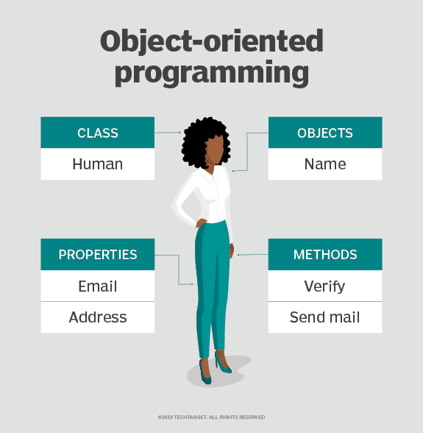
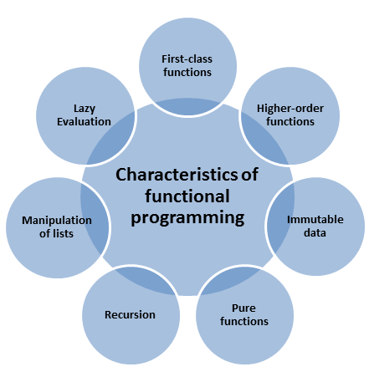
To CS2030…
Modern Programming Paradigms
https://searchapparchitecture.techtarget.com/definition/object-oriented-programming-OOP
https://www.modernescpp.com/index.php/the-definition-of-functional-programming

Slide 12
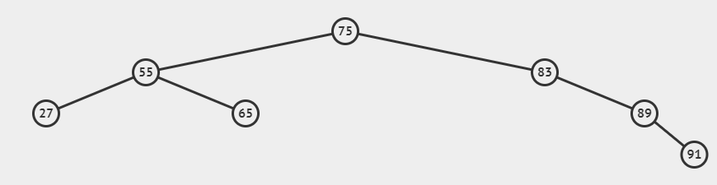
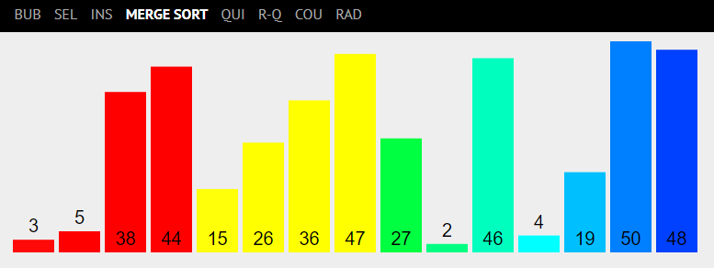
To CS2040…
More about Data Structures and Algorithms
https://visualgo.net/en/

Slide 13
All the best for your Final Assessments!

