Slide 1


CS1010: Programming Methodology
UNIT 23
Tower of Hanoi
Live Q&A
https://pollev.com/jin

Slide 2
Unit 23: Tower of Hanoi
Gist of Recursion
Recursive Thinking
Tower of Hanoi

Slide 3


Gist of Recursion
Iteration vs Recursion: How to compute factorial(3)?
You, do f(2) for me. I’ll return 3 * your answer to my boss.
Recursion man
You, do f(1) for me. I’ll return 2 * your answer to my boss.
Iteration man
I do f(3) all by myself…return 6 to my boss.
You, do f(0) for me. I’ll return 1 * your answer to my boss.
f(3)
f(2)
I will do f(0) all by myself, and return 1 to my boss.
f(3)
f(1)
f(0)

Slide 4
Gist of Recursion
Problems that lend themselves to a recursive solution have the following characteristics:
The base cases of the problem have a straightforward, non-recursive solution.
The recursive cases make use of the solutions to smaller problems of the same nature
Such cases can be recursively reduced to the base cases.
The solutions of the smaller problems are combined / processed further to obtain the solution of the original problem

Slide 5
Gist of Recursion
To write a recursive function:
Identify the base case(s) of the relation
Identify the recurrence relation
int factorial(long n) {
if (n == 0)
return 1;
else
return n * factorial(n-1);
}
int fib(long n) {
if (n < 2)
return n;
else
return fib(n-1) + fib(n-2);
}

Slide 6

Thinking Recursively
It is apparent that to do recursion you need to think “recursively”:
Breaking a problem into smaller problems of the same nature
Is there only one way of breaking a problem into simpler problems?

Slide 7
Think: Sum of Squares
Given 2 positive integers x and y, where x ≤ y, compute
sumSq(x,y) = x² + (x+1) ² + … + (y-1) ² + y²
For example
sumSq(5,10) = 5² + 6² + 7² + 8² + 9² + 10² = 355
How do you break this problem into smaller problems?
How many ways can it be done?

Slide 8
Think: Sum of Squares
Version 1: ‘going up’
long sumSq1(long x, long y) {
if (x == y) return x * x;
else return x * x + sumSq1(x+1, y);
}
sumSq(5, 10) = 5 * 5 + sumSq(6,10)
Version 2: ‘going down’
long sumSq2(long x, long y) {
if (x == y) return y * y;
else return y * y + sumSq2(x, y-1);
}
sumSq(5, 10) = 10 * 10 + sumSq(5,9)

Slide 9
Think: Sum of Squares
Trace trees
355
355
sumSq1(5,10)
sumSq2(5,10)
25
+
330
100
+
255
sumSq1(6,10)
sumSq2(5,9)
36
+
294
81
+
174
sumSq1(7,10)
sumSq2(5,8)
49
+
245
64
+
110
sumSq1(8,10)
sumSq2(5,7)
64
+
181
49
+
61
sumSq1(9,10)
sumSq2(5,6)
81
+
100
36
+
25
sumSq1(10,10)
sumSq2(5,5)
100
25

Slide 10
Think: Sum of Squares
Version 3: ‘combining two half-solutions’
long sumSq3(long x, long y) {
long mid; // middle value
if (x == y)
return x * x;
else {
mid = (x + y)/2;
return sumSq3(x, mid) + sumSq3(mid+1, y);
}
}

Slide 11
Think: Sum of Squares
Trace tree
355
sumSq3(5,10)
110
245
sumSq3(5,7)
sumSq3(8,10)
61
49
145
100
sumSq3(5,6)
sumSq3(7,7)
sumSq3(8,9)
sumSq3(10,10)
25
36
49
64
81
100
sumSq3(5,5)
sumSq3(6,6)
sumSq3(8,8)
sumSq3(9,9)
25
36
64
81

Slide 12
Common Types of Recursion
Integers
Base case: a single digit or 0
Recursive case: number – 1 or number / 10
Example: factorial, sumDigits
1D arrays (including strings)
Base case: an array of 1 element or an empty array
Recursive case: the array minus the first / last element or the left / right half of the elements.
Example: findMax, binarySearch
2D arrays
Base case: a single row / column or an empty array
Recursive case: the array minus one row / column

Slide 13
Tower Of Hanoi
Invented by Edouard Lucas, a French mathematician, in1883.
Setup
3 pegs (A, B and C) and a tower of n disks on the first peg
The smallest disk on the top and the biggest at the bottom.
Objective: Move the whole tower from peg A to peg C
The rules
Only one disk (the one at the top) can be moved at a time.
A bigger disk must not rest on a smaller disk

Slide 14
Tower Of Hanoi
Demo: Tower of Hanoi
Instructions for a tower of 3 disks:
Move disk from A to C
Move disk from A to B
Move disk from C to B
Move disk from A to C
Move disk from B to A
Move disk from B to C
Move disk from A to C

Slide 15
Tower Of Hanoi
Example: A tower with 3 disks.
Move disk from A to C
Move disk from A to B
Move disk from C to B
Move disk from A to C
Move disk from B to A
Move disk from B to C
Move disk from A to C
A
B
C

Slide 16
Tower Of Hanoi
Example: A tower with 3 disks.
Move disk from A to C
Move disk from A to B
Move disk from C to B
Move disk from A to C
Move disk from B to A
Move disk from B to C
Move disk from A to C
A
B
C

Slide 17
Tower Of Hanoi
Example: A tower with 3 disks.
Move disk from A to C
Move disk from A to B
Move disk from C to B
Move disk from A to C
Move disk from B to A
Move disk from B to C
Move disk from A to C
A
B
C

Slide 18
Tower Of Hanoi
Example: A tower with 3 disks.
Move disk from A to C
Move disk from A to B
Move disk from C to B
Move disk from A to C
Move disk from B to A
Move disk from B to C
Move disk from A to C
A
B
C

Slide 19
Tower Of Hanoi
Example: A tower with 3 disks.
Move disk from A to C
Move disk from A to B
Move disk from C to B
Move disk from A to C
Move disk from B to A
Move disk from B to C
Move disk from A to C
A
B
C

Slide 20
Tower Of Hanoi
Example: A tower with 3 disks.
Move disk from A to C
Move disk from A to B
Move disk from C to B
Move disk from A to C
Move disk from B to A
Move disk from B to C
Move disk from A to C
A
B
C

Slide 21
Tower Of Hanoi
Example: A tower with 3 disks.
Move disk from A to C
Move disk from A to B
Move disk from C to B
Move disk from A to C
Move disk from B to A
Move disk from B to C
Move disk from A to C
A
B
C

Slide 22
Tower Of Hanoi
Example: A tower with 3 disks.
Move disk from A to C
Move disk from A to B
Move disk from C to B
Move disk from A to C
Move disk from B to A
Move disk from B to C
Move disk from A to C
Voilà!
A
B
C

Slide 23
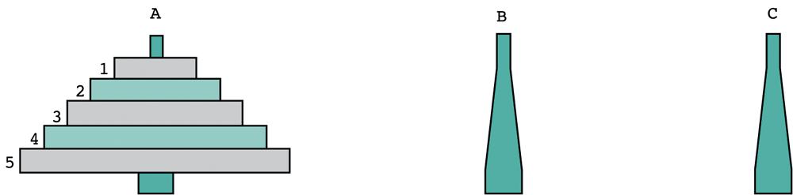
Tower Of Hanoi
Can be interpreted as:
1. move four disks from peg A to peg B
2. move disk 5 from peg A to peg C
3. move four disks from peg B to peg C

Slide 24
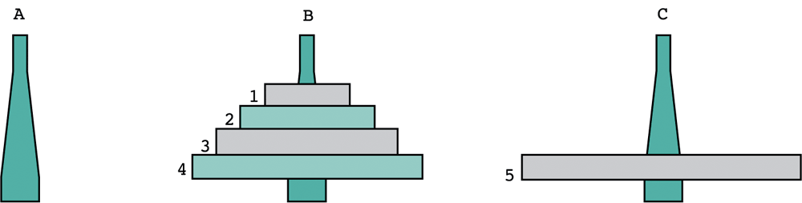
Tower Of Hanoi
Towers after steps 1 and 2:
But how do we execute step 1? Or step 3?
Step 3 can be interpreted as:
3.1 move three disks from peg B to peg A
3.2 move disk 4 from peg B to peg C
3.3 move three disks from peg A to peg C

Slide 25
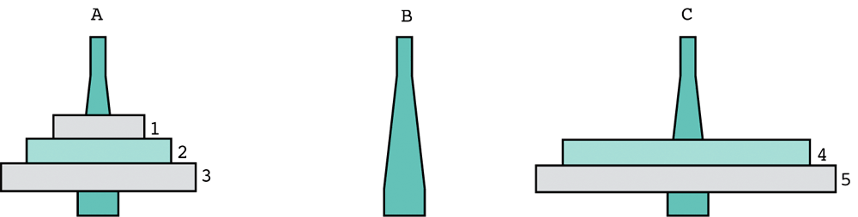
Tower Of Hanoi
Towers after steps 1, 2, 3.1 and 3.2:
Can you start to visualise how to solve this using recursion?

Slide 26
Tower Of Hanoi
Abstraction:
Disks: Integers 1 to k
Pegs: Integers 1 to 3
Implementation:
void solve_tower_of_hanoi(long k, long source, long dest, long placeholder) {
if (k == 1) {
print(k, source, dest);
} else {
solve_tower_of_hanoi(k - 1, source, placeholder, dest);
print(k, source, dest);
solve_tower_of_hanoi(k - 1, placeholder, dest, source);
}
}
O(2^{n})

Slide 27
Tower Of Hanoi
void print(long k, long source, long dest) {
cs1010_print_string("Disk ");
cs1010_print_long(k);
cs1010_print_string(": Peg ");
cs1010_print_long(source);
cs1010_print_string(" -> Peg ");
cs1010_print_long(dest);
}

Slide 28
Tower Of Hanoi
k is 1
source is 1
dest is 3
palceholder is 2
Tracing tower(3, 1, 3, 2)
tower(3, 1, 3, 2);
print (1, 1, 3)
k is 2
source is 1
dest is 2
placeholder is 3
k is 1
source is 3
dest is 2
placeholder is 1
k is 3
source is 1
dest is 3
placeholder is 2
solve (1, 1, 3, 2)
print (2, 1, 2)
solve (1, 3, 2, 1)
print (1, 3, 2)
solve (2, 1, 2, 3)
print (3, 1, 3)
solve (2, 2, 3, 1)
k is 2
source is 2
dest is 3
placeholder is 1
k is 1
source is 2
dest is 1
placeholder is 3
solve (1, 2, 1, 3)
print (2, 2, 3)
solve (1, 1, 3, 2)
print (1, 2, 1)
k is 1
source is 1
dest is 3
placeholder is 2
print (1, 1, 3)

Slide 29
Tower Of Hanoi
Output generated by tower(3, 1, 3, 2);
Disk 1: Peg 1 -> Peg 3
Disk 2: Peg 1 -> Peg 2
Disk 1: Peg 3 -> Peg 2
Disk 3: Peg 1 -> Peg 3
Disk 1: Peg 2 -> Peg 1
Disk 2: Peg 2 -> Peg 3
Disk 1: Peg 1 -> Peg 3

Slide 30
CS1010: Programming Methodology
UNIT 24
Permutation
Live Q&A
https://pollev.com/jin

Slide 31
Unit 24: Permutation
Permutation

Slide 32
Permutation
The arrange of items in a sequence, as well as the process of enumerating all such elements
Example:
Given a string of 3 letters a, b and c
Arrange all letters in all possible sequences
6 permutations
abc, acb, bac, bca, cba, cab

Slide 33
Permutation
Observations:
The start of permutations can be any letter in the string.
Given a particular starting letter, we need to
Arrange the remaining letters in all possible way
== permutate a string of n-1 letters!
abc, acb, bac, bca, cba, cab
a, b, c
a: bc, cb
b: ac, ca
c: ba, ab

Slide 34
Permutation
Recursive Thinking:
Base case:
No need to permute when there is only 1 letter left.
Recursive case:
Use the original starting letter as the start
Permute the rest n-1 letters
…
ab: c → abc
abc
a: bc, cb → abc, acb

Slide 35
Permutation
Recursive Thinking:
Recursive case:
Use the second letter as a start by swapping
Permute the rest n-1 letter
Swap back
Use the third letter as a start by swapping
Permute the rest n-1 letter
Swap back
Done!
abc → bac
b: ac, ca → bac, bca
bac → abc
abc → cba
c: ba, ab → cba, cab
cba → abc

Slide 36
Permutation
O(n!)
// Generate all permutations of all the characters // in a[curr] … a[len-1]
void permute(char a[], long len, long curr) {
// base case
if (curr == len - 1) {
cs1010_println_string(a);
return;
}
// Permute with the first letter as the start
permute(a, len, curr + 1);
// Swap each remaining letter with the first letter, permute and swap back
for (long i = curr + 1; i < len; i += 1) {
swap(a, curr, i);
permute(a, len, curr + 1);
swap(a, i, curr);
}
}

Slide 37
Permutation
Is an example of recursion by itself…
Is also a way to enumerate all possible solutions this way and testing them one by one to find valid ones…

Slide 38
CS1010: Programming Methodology
UNIT 25
N Queens
Live Q&A
https://pollev.com/jin

Slide 39
Unit 25: N Queens
N Queens

Slide 40
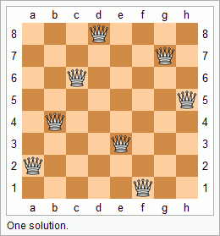
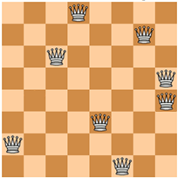


N Queens
Problem: Given a n x n chessboard, find a possible placement of n queens on the chessboard, such that the queens do not threaten each other
Examples:

Slide 41
N Queens
Problem: Given a n x n chessboard, find a possible placement of n queens on the chessboard, such that the queens do not threaten each other
Analysis
A placement is a sequence of positions for n rows
{'d', 'g', 'c', 'h', 'b', 'e', 'a', 'f'}
There cannot be repeated positions since two queens cannot be in the same column.

Slide 42
N Queens
Problem: Given a n x n chessboard, find a possible placement of n queens on the chessboard, such that the queens do not threaten each other
Recursive Thinking
What if we generate all permutations of the placements (recursively) and check whether it works?

Slide 43
N Queens
Implementation:
O(n!)
void nqueens(char queens[], long n, long row) {
if (row == n-1) {
if (!threaten_each_other_diagonally(queens, n)) {
cs1010_println_string(queens);
}
return;
}
nqueens(queens, n, row + 1);
for (long i = row + 1; i < n; i += 1){
swap(queens, row, i);
nqueens(queens, n, row + 1);
swap(queens, row, i);
}
}

Slide 44
N Queens
Problem: Given a n x n chessboard, find a possible placement of n queens on the chessboard, such that the queens do not threaten each other
Improvement
Observation: Any placement starting with {'a', 'b', …} cannot work since the first two queens already threaten each other.
Permutate further only if the existing positions of the placement does not fail the check.

Slide 45
N Queens
Implementation:
void nqueens(char queens[], long n, long row) {
…
if (!threaten_each_other_diagonally(queens, row)) {
nqueens(queens, n, row + 1);
}
for (long i = row + 1; i < n; i++) {
swap(queens, row, i);
if (!threaten_each_other_diagonally(queens, row)) {
nqueens(queens, n, row + 1);
}
swap(queens, row, i);
}
}

Slide 46
Homework
Post-Lecture Diagnostic Quiz
Problem Set 23-25
Exercise 7
PE2 preparation

