Slide 1


CS1010: Programming Methodology
UNIT 5
First C Program
Live Q&A
https://pollev.com/jin

Slide 2
Unit 5: First C Program
Your First C Function
Your First C Program
Functions from the Math Library
Your First C Program (Redux)

Slide 3
(Self-defined) Functions
The magic black box (a.k.a. a Function)
Given some inputs, it produces a value that we need
Example: square(x) computes the square of x.
Provided by the standard C library or other libraries
To be written by you!

Slide 4
Your First C Function
Components of a function (definition)
Header: consists of return type, function name, and a list of parameters (with their types) separated by commas
Return type: any of the data types or void (no return value)
Body: code to perform the task; contains a return statement a value should be returned (if any); uses indentation for clarity.
Function name
Parameter type
Return type
Parameter name
long square(long x)
{
return x * x;
}
Arithmetic computation
Compulsory for all statements
Indentation
Return statement

Slide 5
Your First C Function
Components of a function (call)
Consists of the function name and the argument(s); performs the specified task of the function
square(3)
Function name
Argument
The instructions in the function definition of square() will be executed with 3 as the input and 9 will be returned as the output.
long square(long x)
{
return x * x;
}

Slide 6
Your First C Function
Expanded version of square() with declaration and assignment statements.
long square(long x)
{
long result = x * x;
return result;
}
long square(long x)
{
return x * x;
}
Expanded
Original

Slide 7
Your First C Function
Components of a variable declaration
Consists of a type and a variable name
Common types:
long, double, char…
Variable names
Must start with a letter, follow by any sequence of letters, digits, and underscores (invalid names: 2days, five/three)
Cannot be a keyword (e.g., long, return)
Case sensitive (e.g., result is different from Result)
long hypotenuse_square;

Slide 8
Your First C Function
Components of an assignment statement
Consists of a variable and an expression; stores the value of the expression into the variable
Can be combined with declaration as well
result = 3 * 3;
result = square(3);
long result = 3 * 3;

Slide 9
Your First C Program
Consists of a main function
The starting point of execution
Contains variable declarations and major steps of your algorithm (e.g., input / compute / output)
Returns an integer (status code for execution, 0 → All is well)
long square(long x)
{
return x * x;
}
int main()
{
long hypotenuse_square;
hypotenuse_square = square(3) + square(4);
return 0;
}

Slide 10

Common Mistakes with Variables (1/2)
No declaration
Re-declaration
int main()
{
hypotenuse_square = …;
}
All variables should be declared before use.
int main()
{
long hypotenuse_square;
…
long hypotenuse_square;
…
}
All variables should be declared only once.

Slide 11
Common Mistakes with Variables (2/2)
Not initializing variables
Program may work on some machine but not on another!
EXTREMELY COMMON MISTAKE
long a, b;
a = b + 3;
Cannot assume that the initial value of b is zero!
Unnecessary initialization of variables
Incompatible type
long x = 0;
x = 531;
long x = 10.2;
x is 10
Truncation occurs
Use long for integers and double for real numbers.

Slide 12
Self-defined Functions
Other self-defined functions can be defined and called.
long square(long x)
{
return x * x;
}
int main()
{
long hypotenuse_square;
hypotenuse_square = square(3) + square(4);
return 0;
}

Slide 13
Functions from the Math Library
double sqrt(double x) – computes the square root of a number; requires math.h and -lm for compilation
#include <math.h>
long square(long x)
{
return x * x;
}
double hypotenuse_of(long base, long height)
{
return sqrt(square(base) + square(height));
}
int main()
{
hypotenuse_of(3, 4);
return 0;
}
Read the compilation guide at "Software/Tools" → "CLang" to know more about this.

Slide 14

Your First C Program (Redux)
Self-defined functions must be defined before use.
But it might be difficult to write the complete definition for all functions right away…
long square(long x)
{
return x * x;
}
int main()
{
…square(3)…
}
int main()
{
…square(3)…
}
long square(long x)
{
return x * x;
}

Slide 15
Your First C Program (Redux)
Self-defined functions must be defined or declared before use.
Components of a function (declaration)
Function definition without the body.
This is Wishful Thinking!
Function declaration
Function definition
long square(long x);
long square(long x)
{
return x * x;
}

Slide 16
Your First C Program (Redux)
Function declaration before use, followed by definition later
Function definition before use
long square(long x);
int main()
{
… square(3) …
}
long square(long x)
{
return x * x;
}
long square(long x)
{
return x * x;
}
int main()
{
…square(3)…
}
Good for managing difficulty and keeping the code organized.
OK if you only have simple functions

Slide 17
CS1010: Programming Methodology
UNIT 6
CS1010 I/O Library
Live Q&A
https://pollev.com/jin

Slide 18
Unit 6: The CS1010 I/O Library
Input / Output
The CS1010 I/O Library

Slide 19
Input / Output
What happens when you run this program?
#include <math.h>
long square(long x)
{
return x * x;
}
double hypotenuse_of(long base, long height)
{
return sqrt(square(base) + square(height));
}
int main()
{
hypotenuse_of(3, 4);
}

Slide 20
Input / Output
The program:
Runs by itself without asking for input
Performs the same computation every time
Does not show the result of the computation
More interactions required…
Ask the users for the base and height
Print the computed length
Doable using C functions printf() / scanf()
But they are complicated and unsafe…

Slide 21
CS1010 I/O Library
Requires cs1010.h
Provides the following functions for reading inputs
long cs1010_read_long();
double cs1010_read_double();
…
Read in single number
cs1010_print_long();
[wait for user input]

Slide 22
CS1010 I/O Library
Provides the following functions for printing outputs
void cs1010_print_long(long x);
void cs1010_print_double(double x);
…
void cs1010_println_long(long x);
void cs1010_println_double(double x);
…
Print without newlines
cs1010_print_long(3);
cs1010_print_long(4);34
Print with newlines
cs1010_println_long(3);
cs1010_println_long(4);
3
4

Slide 23
CS1010 I/O Library
What happens when you run this program?
…
#include "cs1010.h"
…
int main()
{
double hypotenuse;
long base = cs1010_read_long();
long height = cs1010_read_long();
hypotenuse = hypotenuse_of(base, height);
cs1010_println_double(hypotenuse);
…
}

Slide 24
CS1010 I/O Library
Provided as part of the skeleton files in general.
For your own uses, follow the instructions in “CS1010 I/O Library” to install the library and compile with it.

Slide 25
CS1010: Programming Methodology
UNIT 7
Arithmetic Computations
Live Q&A
https://pollev.com/jin

Slide 26
Unit 7: Arithmetic Computations
The Basics
Compound Operators
Common Mistakes
List of C features banned in CS1010

Slide 27
The Basics
+, -, *, / have the same definition / associativity / precedence as their math counter-parts
Works on integers and real numbers
() can be used to change / indicate the order of execution
long b = 10;
long c = 2;
long a = b + 2 * c / 4;
a is 11
long a = (b + 2) * c / 4;
a is 6
long a = b + (2 * c / 4);
a is 11

Slide 28
The Basics
% is modulo
a % b gives the remainder of a divided by b
Works on integers only
A lot more powerful / useful than you think!
long a = 5 % 2;
long b = 17 % 10;
long c = 123 % 100
a is 1
b is 7
c is 23

Slide 29
Compound Operator
The following (very common) statements
can be simplified as:
In general, op is +, -, *, / and %
means
index = index + 1; // increment the variable index
age = age * 2; // double the variable age
index += 1;
age *= 2;
a op= b;
a = a op b

Slide 30
Common Mistakes
Unintended integer division
What is the value of half?
Truncation occurs!
double half = 3/2;
half is 1
EXTREMELY COMMON MISTAKE
double half = 3/2.0;
Avoid truncation by changing any of the operands to a real number.
double half = 3/(double)2;

Slide 31
Pop Quiz
What are the values of the variables?
long m = 10/4;
double n = 10/4;
long p = 10/4.0;
double q = 10/4.0;
double r = (double)10/4;
m is 2
n is 2.0
p is 2
q is 2.5
r is 2.5

Slide 32
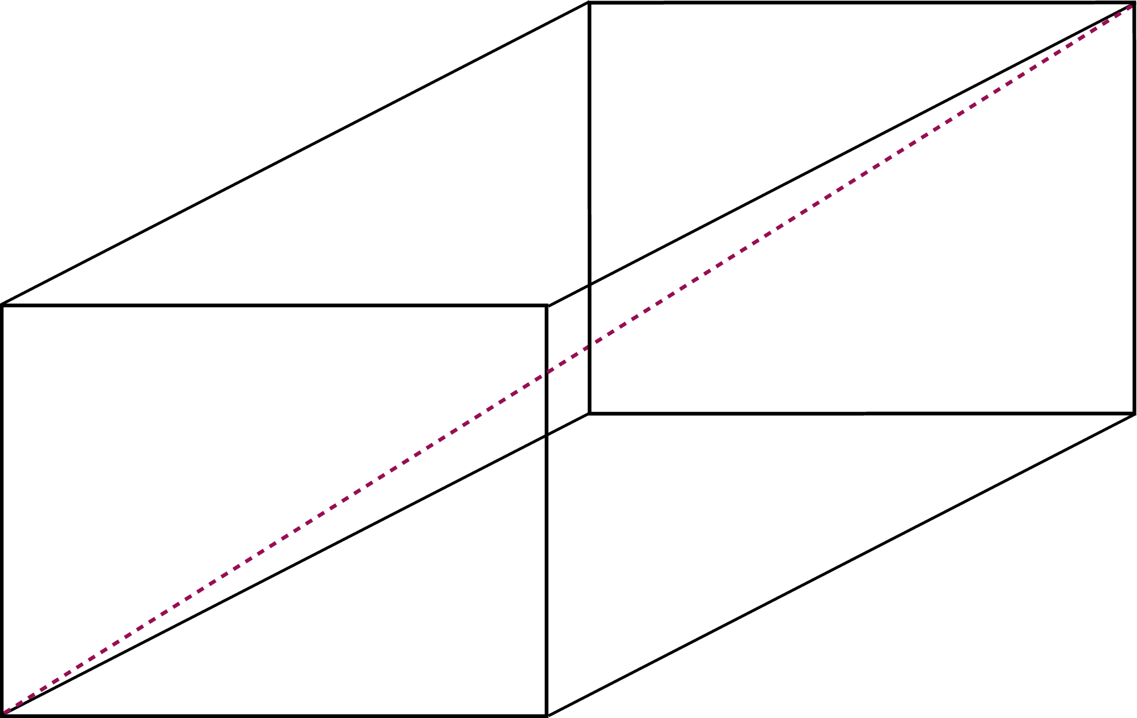
Putting All These Together
Ex00-Q6: Find the surface area and the diagonal of a cuboid
Algorithm Design
Input:
Read in an integer for the width (Function from CS1010 Lib.)
…
long width = cs1010_read_long();
In main()

Slide 33
Problem Solving Techniques
Algorithm Design
Compute:
Compute the surface area (compute surface area function)
...
long compute_surface_area(long width, long length, long height);
Function declaration
long surface_area = compute_surface_area(width, length, height);
Function call in main()
long compute_surface_area(long width, long length, long height){
…
return surface_area;
}
Function definition

Slide 34
Problem Solving Techniques
Algorithm Design
Compute Surface Area:
Compute the bottom area (compute area function)
...
long compute_area(long rect_length, long rect_width);
Function declaration
long front_area = compute_area(width, length);
Function call in compute_surface_area()
long compute_area(long rect_length, long rect_width){
…
return area;
}
Function definition

Slide 35
Problem Solving Techniques
Ex00-Q6: Find the surface area and the diagonal of a cuboid
Algorithm Design
Output:
Print the surface area, which an integer (CS1010 Lib.)
...
cs1010_println_long(surface_area);
In main()

Slide 36
List of C Features Banned in CS1010
Increment / Decrement operators
++, --
Less representative / precise types
int, short, float
Global variables
Discouraged (but not banned)
scanf / printf
Skipping of parentheses
long a = 1, b = 1, c, d;
c = ++a;
d = b++;
Read "C in CS1010" for a complete list!

Slide 37
Homework
Quizzes (by 4 Feb, 2pm)
Post-lecture Quiz
Problem Set 5 (under Unit 5)
Exercise 0

