Slide 1

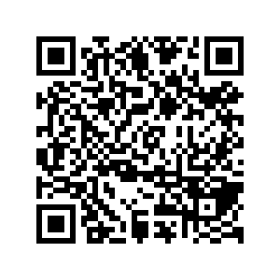
CS1010: Programming Methodology
UNIT 8
Conditional Statements
Live Q&A
https://pollev.com/jin

Slide 2
Unit 8: Conditional Statements
Sequential / Non-sequential Control Flow
if-else Statements
Skipping else
Conditional Operators
Nested if-else Statements
if-(else-if-)else… Statements

Slide 3
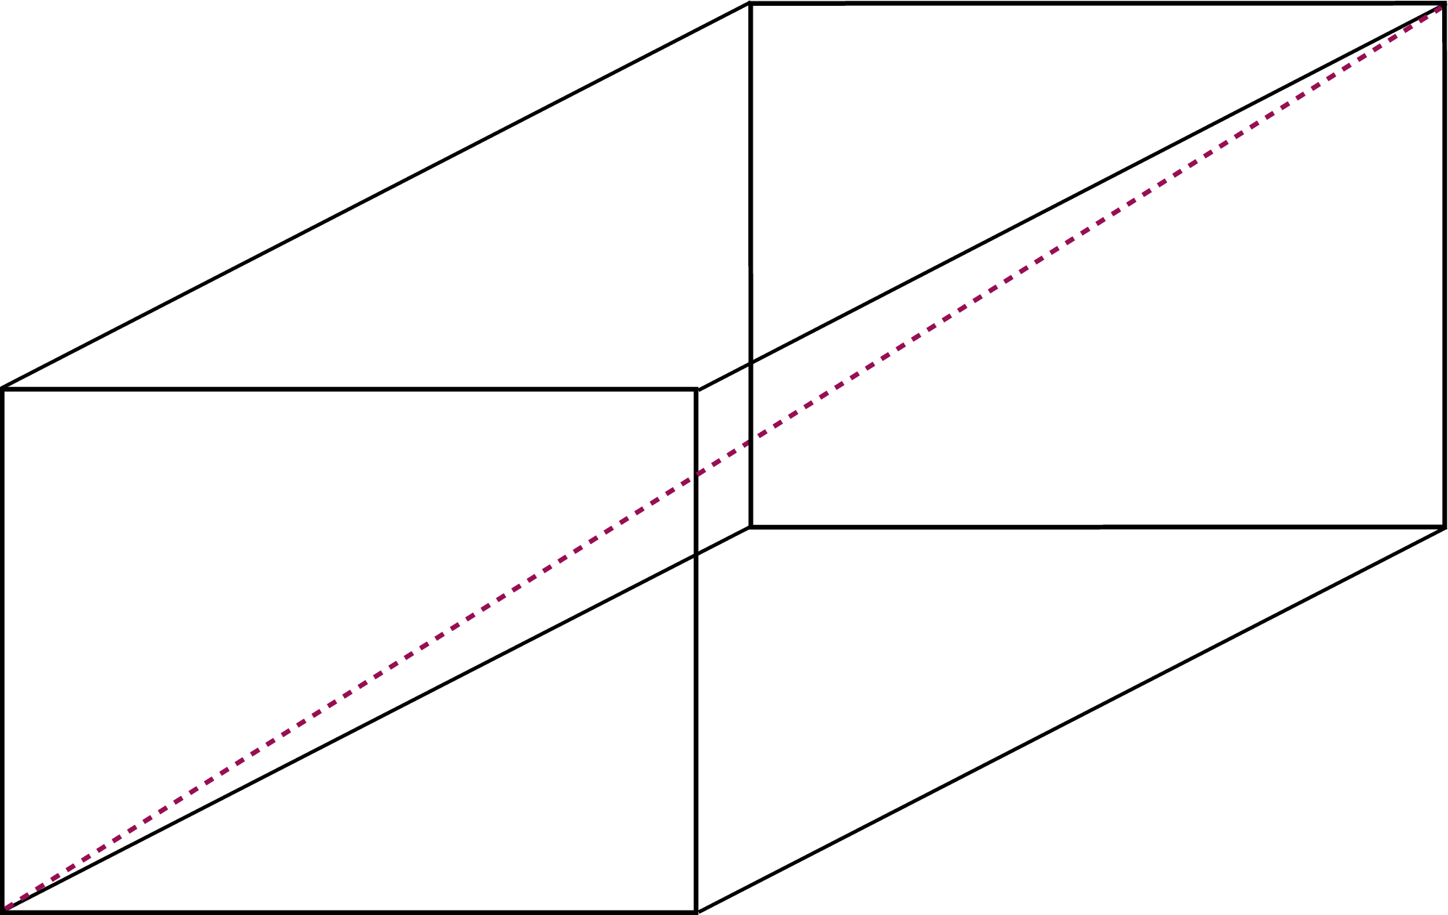
Sequential Control Flow
Ex00-Q6: Find the surface area and the diagonal of a cuboid
Algorithm Design
Input:
Read in the dimensions of the cuboid
Compute:
Compute the surface area and the diagonal
Output:
Print the surface area and the diagonal

Slide 4
Non-Sequential Control Flow
Ex00-Q6: Find the surface area and / or the diagonal of a cuboid depending on user input.
1 for surface area, 2 for diagonal, 3 for both
Algorithm Design
Input:
Read in the dimensions of the cuboid and the selected option

Slide 5
Non-Sequential Control Flow
Ex00-Q6: Find the surface area and / or the diagonal of a cuboid depending on user input.
1 for surface area, 2 for diagonal, 3 for both
Algorithm Design
Compute:
If option selected is 1 or 3, compute the surface area
If option selected is 2 or 3, compute the diagonal

Slide 6
Non-Sequential Control Flow
Ex00-Q6: Find the surface area and / or the diagonal of a cuboid depending on user input.
1 for surface area, 2 for diagonal, 3 for both
Algorithm Design
Output:
If option selected is 1 or 3, print the surface area
If option selected is 2 or 3, print the diagonal

Slide 7
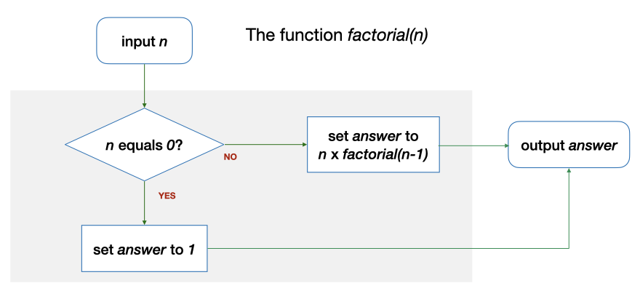
Non-Sequential Control Flow
Another example: Base case or Recursive case?

Slide 8
Non-Sequential Control Flow
Another example: Base case or Recursive case?
1
2
3
4
5
6
7
8
9
10
long factorial(long n)
{
long answer;
if (n == 0) {
answer = 1;
} else {
answer = n * factorial(n - 1);
}
return answer;
}

Slide 9
if-else Statements
if (n == 0) {
answer = 1;
} else {
answer = n * factorial(n - 1);
}
true
exp?
false
Syntax
if ( <logical expression> ) {
“true block”: statements to be executed if the expression is true
} else {
“false block”: statements to be executed if the expression is false
}

Slide 10
if-else Statements
if (n == 0) …
(Simple) Logical expressions
<exp> comp_op <exp>
<exp>: math expressions, variables, values, function calls
comp_op: ==, !=, >, >=, <, <=
Examples
2 < 3, 5 > n, n % 2 != 0, n == square(x)…

Slide 11

if-else Statements
Common Mistakes
if (n = 0) …
This assigns 0 to n instead.
if (n >= 0)
{
// handle positive values…
}
> should be used instead…
double expected_value = 0.3;
double sum = sqrt(0.015625)
+ sqrt(0.030625);
if (sum == expected_value) …
The expression could be false since not all real numbers can be represented accurately.

Slide 12
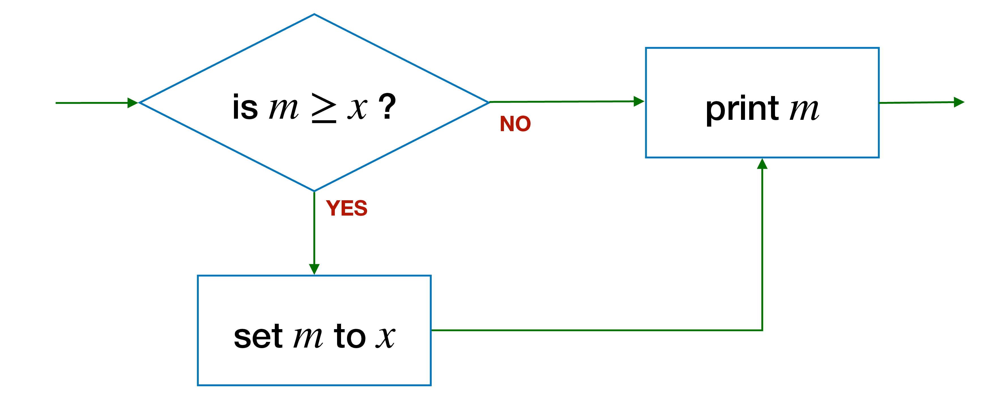
Skipping else
if (m >= x) {
m = x; // update m
} else {
??? // nothing to do
}
cs1010_println_long(m);
true
exp?
if (m >= x) {
m = x; // update max
}
cs1010_println_long(m);
false

Slide 13
Pop Quiz
Problem: Find the maximum value between 2 variables.
long getMax(long num1, long num2) { long max;
if (num1 > num2){ max = num1;
} if (num2 > num1)){ max = num2;
}
return max;
}
… long max = num1;
if (num2 > num1){ max = num2;
}
return max;
…
What is wrong with this function?
What is the correct logic?

Slide 14
Pop Quiz
Problem: Find the maximum value between 2 variables.
long getMax(long num1, long num2) { long max;
if (num1 > num2){ max = num1;
} if (num2 > num1)){ max = num2;
}
return max;
}
… long max;
if (num1 > num2){ max = num1;
} else {
max = num2;
}
return max;
…
What is wrong with this function?
What is the correct logic?

Slide 15
Conditional Operators
Problem: Find the maximum value between 2 variables.
… long max;
if (num1 > num2){ max = num1;
} else {
max = num2;
}
return max;
…
…
long max;
max = (num1 > num2) ? num1 : num2;
return max;
…
Syntax
condition ? true expression : false expression;

Slide 16
More than 2 possibilities?
Problem: Print a letter grade based on a score
A possible solution:
if score is 8 or higher → print A
if score is less than 8 but 5 or higher → print B
if score is less than 5 but 3 or higher → print C
if score is less than 3 → print D
Score | Letter Grade
8 or higher | A
Less than 8 but 5 or higher | B
Less than 5 but 3 or higher | C
Less than 3 | D
Completely separate steps!

Slide 17
More than 2 possibilities?
Problem: Print a letter grade based on a score
Score | Letter Grade
8 or higher | A
Else | 5 or higher | B
 | Else | 3 or higher | C
 | Less than 3 | Else | D
Dependent on previous checks.
With nesting.

Slide 18
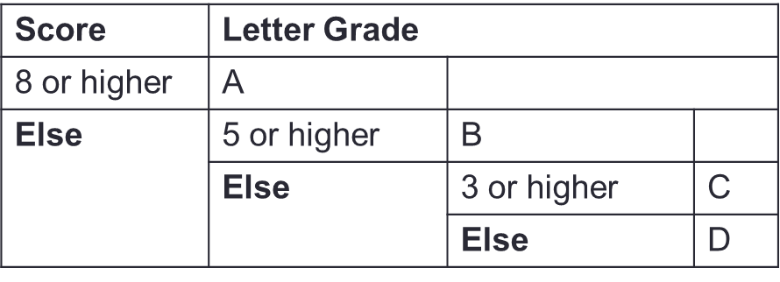
Nested if-else Statements
Problem: Print a letter grade based on a score
…
if (score >= 8) {
// print "A"
} else {
if (score >= 5) {
// print "B"
} else {
if (score >= 3) {
// print "C"
} else {
// print "D"
}
}
}
…

Slide 19
Nested if-else Statements
Problem: Print a letter grade based on a score
…
if (score >= 8) {
cs1010_println_string("A");
} else {
if (score >= 5) {
cs1010_println_string("B");
} else {
if (score >= 3) {
cs1010_println_string("C");
} else {
cs1010_println_string("D");
}
}
}
…

Slide 20
More than 2 possibilities?
Problem: Print a letter grade based on a score
Score | Letter Grade
8 or higher | A
Else 5 or higher | B
Else 3 or higher | C
Else | D
Dependent on previous checks.
No nesting.

Slide 21
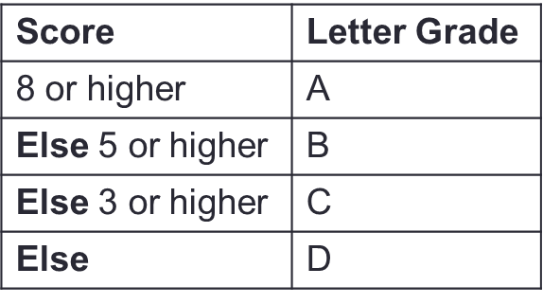
if-(else-if-)else… Statements
Problem: Print a letter grade based on a score
…
if (score >= 8) {
// print "A"
} else if (score >= 5) {
// print "B"
} else if (score >= 3) {
// print "C"
} else {
// print "D"
}
…

Slide 22
Ex#1: CS1010 Schedule
Problem: Print the CS1010 schedule based on day (1/2/3/4/5) and time (1000/1100/…)
E.g., 1 and 1000 → output "Tutorial" 5 and 1200 → output "No activity"
Work out two sets of logic
Logic 1: Based on day and time together
Logic 2: Based on day first and then time.
 | 1000 | 1100 | 1200 | 1300 | 1400 | 1500 | 1600 | 1700
1 (Mon) | Tutorial | Tutorial | Tutorial | Tutorial | - | - | - | -
2 (Tue) | Lecture | Lecture | - | - | - | - | - | -
3 (Wed) | - | - | - | - | - | - | - | -
4 (Thu) | - | - | - | - | - | - | - | -
5 (Fri) | - | - | - | - | - | - | - | -

Slide 23
Ex#1: CS1010 Schedule
Logic 1:
day equals 3/4/5 → output "No activity".
Otherwise
if day equals 1
if time is between 1000-1400 → …
Otherwise →
Otherwise …
 | 1000 | 1100 | 1200 | 1300 | 1400 | 1500 | 1600 | 1700
1 (Mon) | Tutorial | Tutorial | Tutorial | Tutorial | - | - | - | -
2 (Tue) | Lecture | Lecture | - | - | - | - | - | -
3 (Wed) | - | - | - | - | - | - | - | -
4 (Thu) | - | - | - | - | - | - | - | -
5 (Fri) | - | - | - | - | - | - | - | -

Slide 24
Ex#1: CS1010 Schedule
Logic 2:
if day equals 1 AND time is between 1000-1400 → output …
Otherwise, if day equals 2 AND time is between 1000-1200 → output …
Otherwise, if …
 | 1000 | 1100 | 1200 | 1300 | 1400 | 1500 | 1600 | 1700
1 (Mon) | Tutorial | Tutorial | Tutorial | Tutorial | - | - | - | -
2 (Tue) | Lecture | Lecture | - | - | - | - | - | -
3 (Wed) | - | - | - | - | - | - | - | -
4 (Thu) | - | - | - | - | - | - | - | -
5 (Fri) | - | - | - | - | - | - | - | -

Slide 25
Ex#1: CS1010 Schedule
Logic 3?:
time is between …
…
 | 1000 | 1100 | 1200 | 1300 | 1400 | 1500 | 1600 | 1700
1 (Mon) | Tutorial | Tutorial | Tutorial | Tutorial | - | - | - | -
2 (Tue) | Lecture | Lecture | - | - | - | - | - | -
3 (Wed) | - | - | - | - | - | - | - | -
4 (Thu) | - | - | - | - | - | - | - | -
5 (Fri) | - | - | - | - | - | - | - | -

Slide 26
CS1010: Programming Methodology
UNIT 9
Logical Expressions
Live Q&A
https://pollev.com/jin

Slide 27
Unit 9: Logical Expressions
Boolean Values
Logical Operators
Short-Circuit Evaluation

Slide 28
Boolean Values
All logical expressions evaluate to Boolean values true or false.
In modern C,
Data type: bool (requires stdbool.h)
bool is_diff = x != y; // evaluates to true or false
if (is_diff) {
cs1010_println_string("x and y store different values.");
} else {
cs1010_println_string("x and y store the same value.");
}
Name your Boolean variables is_... or has_...!

Slide 29
Boolean Values
All logical expressions evaluate to Boolean values true or false.
Traditionally…
Any non-zero value to represent true (1 is used as the representative value for true in output)
0 to represent false
Example:
long is_diff = x - y;
if (is_diff) {
cs1010_println_string("x and y store different values.");
} else {
cs1010_println_string("x and y store the same value.");
}

Slide 30
Logical Operators
&& (and), || (or), ! (not)
For creating complex logical expression
Examples:
Gen Z is the generation of people who was born between 1995 and 2005… → (birth_year >= 1995) && (birth_year <= 2005)
A | B | A && B | A || B | !A
False | False | False | False | True
False | True | False | True | True
True | False | False | True | False
True | True | True | True | False

Slide 31
Common Mistake
What is wrong with this code?
The expression 1995 <= birth_year <= 2005 is equivalent to ((1995 <= birth_year) <= 2005)
(1995 <= birth_year) gives 1 or 0
1 or 0 is always less than 2005!
if (1995 <= birth_year <= 2005) {
cs1010_println_string("You are from Generation Z.");
} else {
cs1010_println_string("You are NOT from Generation Z.");
}
…((1995 <= birth_year) && (birth_year <= 2005)…

Slide 32
Short-Circuit Evaluation
expr1 && expr2
If expr1 is false, skip evaluating expr2 and return false immediately, as the result will always be false.
Example: (birth_year >= 1995) && (birth_year <= 2005)
expr1 || expr2
If expr1 is true, skip evaluating expr2 and return true immediately, as the result will always be true.
Example: (birth_year < 1995) || (birth_year > 2005)
Make things faster in some cases
Example: (number < 100000) && is_prime(number) VS
is_prime(number) && (number < 100000)

Slide 33
CS1010: Programming Methodology
UNIT 10
Assertion
Live Q&A
https://pollev.com/jin

Slide 34
Unit 10: Assertion
Assertion
De Morgan's Law

Slide 35
Assertion
A logical expression that must be always (i.e., regardless of input) true for the program to be correct.
Can be written anywhere in the code and checked automatically (e.g., using assert() from assert.h)
Useful for ensuring the algorithm is correctly translated
… // some code for Step 1
// {Assertion that must be true after Step 1}
… // some code for Step 2
// {Assertion that must be true after Step 2}
… // some code for Step 3
// {Assertion that must be true after Step 3}

Slide 36
Example 1
Important: Write assertions based on your algorithm, not your code!
Problem: Find the maximum value between two variables
if (…) {
// { x > y }
…
// {(x > y) && (max == x)}
else {
// { x <= y }
…
// {(x <= y) && (max == y)}
}
x > y
x <= y

Slide 37
Example 1
Important: Write assertions based on your algorithm, not your code!
Problem: Find the maximum value between two variables
{ ((x > y) && (max == x)) || ((x <= y) && (max == y))}
if (x > y) {
// { x > y }
max = x;
// {(x > y) && (max == x)}
else {
// { x <= y }
max = y;
// {(x <= y) && (max == y)}
}
x > y
x <= y

Slide 38
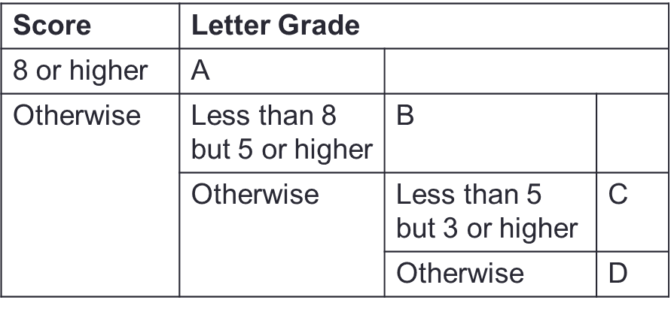
Example 2
Problem: Print a letter grade based on a score
if (…) {
// { score >= 8 }
} else {
// { score < 8 }
if (…) {
// { (score < 8) && (score >= 5) }
} else {
// { score < 5 }
if (…) {
// { (score < 5) && (score >= 3) }
} else {
// { score < 3 }
}
}
}

Slide 39
Example 2
Problem: Print a letter grade based on a score
if (score >= 8) {
// { score >= 8 }
} else {
// { score < 8 }
if (score >= 5) {
// { (score < 8) && (score >= 5) }
} else {
// { score < 5 }
if (score >= 3) {
// { (score < 5) && (score >= 3) }
} else {
// { score < 3 }
}
}
}

Slide 40
De Morgan's Law
!(e1 && e2) is the same as (!e1) || (!e2)
!(e1 || e2) is the same as (!e1) && (!e2)
Help to quickly write the assertion for false block
if (…) {
// { (birth_year >= 1995) && (birth_year <= 2005) }
} else {
// { !((birth_year >= 1995) && (birth_year <= 2005)) }
}
// { (!(birth_year >= 1995) || !(birth_year <= 2005) }
// { (birth_year < 1995) || (birth_year > 2005) }

Slide 41
Homework
Post-Lecture Diagnostic Quiz (1%)
Problem Set 8/9/10
Exercise 1
PE preparation

