Slide 1


CS1010: Programming Methodology
UNIT 19
Multi-Dimensional Arrays
Live Q&A
https://pollev.com/jin

Slide 2
Unit 19: Multi-Dimensional Arrays
Multi-Dimensional Arrays
Different types of 2D Arrays
Initializing 2D Arrays
Functions and 2D Arrays

Slide 3

Multi-dimensional Arrays
Examples:
1
2
3
…
30
31
Jan
32.1
31.8
31.9
32.3
32.4
Feb
32.6
32.6
33.0
…
0
0
:
Dec
31.8
32.3
30.9
31.6
32.2
Tic Tac Toe: 3 x 3
Daily temperatures: temperatures 12 x 31
Jerna
Suise
Zass
Ex1
Ex2
Ex3
Ex1
Ex2
Ex3
Emily
Ex1
Ex2
Ex3
Lab1
79
75
66
Lab1
52
50
45
Ex1
Ex2
Ex3
Lab1
59
68
60
Lab2
90
83
77
Lab2
57
60
63
Lab1
76
80
62
Lab2
0
0
0
Lab3
81
73
79
Lab3
52
59
66
Lab2
60
72
48
Lab3
67
71
75
Lab4
58
64
52
Lab4
33
42
37
Lab3
76
80
62
Lab4
38
52
35
Lab5
93
80
85
Lab5
68
68
72
Lab4
60
72
48
Lab5
78
86
82
Lab5
58
79
73
Students’ lab marks: marks 4 x 5 x 3

Slide 4
Multi-dimensional Arrays
In general, an array can have any number of dimensions
Example of a Fixed-Length 2-dimensional (2D) array:
// array with 3 rows, 5 columns
long a[3][5];
a[0][0] = 2;
a[2][4] = 9;
a[1][0] = a[2][4] + 7;
0
1
2
3
4
0
2
1
16
2
9
Fixed-Length 2D Arrays are stored in row-major order
  That is, elements in row 0 comes before row 1, etc.
a[0][0]
…
a[0][4]
a[1][0]
…
a[1][4]
a[2][0]
…
a[2][4]
row 0
row 1
row 2

Slide 5
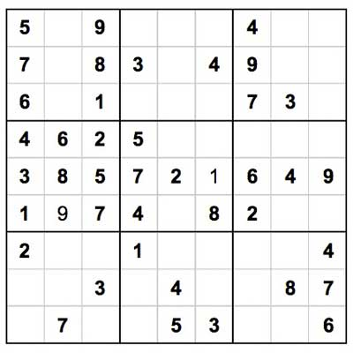
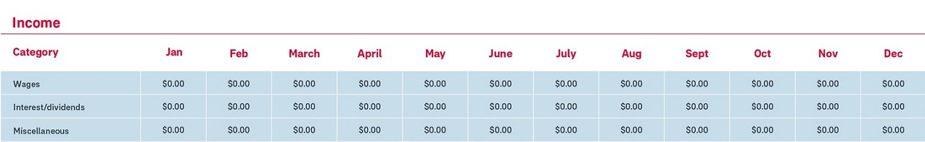
Different Types of 2D Arrays
Fixed Length 2D Array
For data with known dimensions
  Tic-tac-toe
  Sudoku
  Monthly income of 3 categories for a year
// array with 10 rows, 20 columns
// array of 10 elements, each being an array of 20 elements
long matrix[10][20];
3 x 3
9 x 9
3 x 12

Slide 6
Different Types of 2D Arrays
Fixed Size Array of Dynamically Allocated Array
For data with one unknown dimension
  Gradebook of 10 assignments
  for some students.
// array with 10 rows, Y columns
// array of 10 elements, each being an array of Y elements
double *buckets[10];
// read in the length of each subarray
size_t num_of_cols = cs1010_read_size_t();
// dynamically allocate each subarray
for (long i = 0; i < 10; i += 1) {
buckets[i] = calloc(num_of_cols, sizeof(double));
}
Remember to free the allocated memory after use.
Buckets
0
1
2
3
4
0
…
1
…
10 x ?
…
9
…

Slide 7
Different Types of 2D Arrays
Dynamically Size 2D Array
For data with flexible dimensions
  Matrix
// array with X rows, Y columns
// array of X elements, each being an array of Y elements
double **canvas;
// read in number of rows and columns
size_t num_of_rows = cs1010_read_size_t();
size_t num_of_cols = cs1010_read_size_t();
canvas = calloc(num_of_rows, sizeof(double *));
for (size_t i = 0; i < num_of_rows; i += 1) {
canvas[i] = calloc(num_of_cols, sizeof(double));
}
Remember to free the subarrays before the array.
Buckets
0
1
2
3
4
0
…
? x ?
…
1
2
…
…

Slide 8
Different Types of 2D Arrays
Jagged arrays
Good for data with unusual dimensions
  Half square
// array with 10 rows, varying number of columns
// array of 10 elements, each being an array of varying size
double *half_square[10];
for (size_t i = 0; i < num_of_rows; i += 1) {
half_square[i] = calloc(i + 1, sizeof(double));
}
Buckets
0
1
2
0
1
2
…

Slide 9
Initializing Arrays
Using initializers (Fixed-length 2D arrays only)
Using loops with assignment statements (All types of 2D arrays)
long matrix[3][3] = {
{1, 0, -1},
{-1, 1, 0},
{0, -1, 1}
};
long matrix[3][3] = {{0}};
Shortcut for initializing everything to 0.
long matrix[3][3];
for (size_t i = 0; i < 3; i += 1){
for (size_t j = 0; j < 3; j += 1){
matrix[i][j] = i * 3 + j;
}
}
0
1
2
3
4
5
6
7
8

Slide 10
Functions and 2D arrays
Functions that takes in one row of a 2D array
Actual function call
void bar(size_t num_of_cols, long *matrix_row) { .. }
void bar(size_t num_of_cols, long matrix_row[]) { .. }
Same as functions that takes in a 1D array.
long matrix[3][3];
bar(3, matrix[0]);

Slide 11
Functions and 2D arrays
Functions that takes the whole 2D array
Actual function call
Note: The first method is only for Fixed Length 2D Array since the number of columns must be known at the time of coding.
void qux(size_t num_of_rows, size_t num_of_cols,
long matrix[][20]) { .. }
void qux(size_t num_of_rows, size_t num_of_cols,
long *matrix[]) { .. }
void qux(size_t num_of_rows, size_t num_of_cols,
long **matrix) { .. }
Cannot be omitted.
qux(10, 20, matrix);

Slide 12
Problem Solving with 2D arrays
0
1
2
Tic-Tac-Toe
  0 / 1 / 2 → empty, player 1, player 2
Who wins?
How to check a row?
  E.g., top row is board[0][0], board[0][1], board[0][2]
  For a specific row (r from 0~2), check whether board[r][0] == board[r][1] && board[r][1] == board[r][2]
0
1
0
2
1
0
1
1
2
2
2
2

Slide 13
Problem Solving with 2D arrays
0
1
2
Tic-Tac-Toe
  0 / 1 / 2 → empty, player 1, player 2
Who wins?
How to check a column?
  E.g., left column is board[0][0], board[1][0], board[2][0]
  For a specific column (c from 0~2), check board[0][c] == board[1][c] && board[1][c] == board[2][c]
0
1
0
2
1
0
1
1
2
2
2
2

Slide 14
Problem Solving with 2D arrays
0
1
2
Tic-Tac-Toe
  0 / 1 / 2 → empty, player 1, player 2
Who wins?
How to check diagonals?
  E.g., left diagonal is board[0][0], board[1][1], board[2][2]
  For the left diagonal, check board[0][0] == board[1][1] && board[1][1] == board[2][2]
  For the right diagonal, check board[0][2] == board[1][1] && board[1][1] == board[2][0]
What happens if the board is larger?
0
1
0
2
1
0
1
1
2
2
2
2

Slide 15
Problem Solving with 2D arrays
Class enrolment
  enrol[c][s] indicates whether student s is enrolled in class c.
Which classes are the most popular?
  Sum each row and find max
Which students are not enrolled to any class?
  Check for all zeros in a column
  Sum each column and find zero
0
1
2
3
4
5
6
7
0
1
0
1
0
1
1
1
0
1
1
0
1
1
1
0
1
1
2
0
1
1
1
0
0
1
0

Slide 16
CS1010: Programming Methodology
UNIT 20
Efficiency
Live Q&A
https://pollev.com/jin

Slide 17
Unit 22: Efficiency
Good Habits for Writing Efficient Code
Time Complexity Analysis

Slide 18
Good Habits for Writing Efficient Code
No redundant work
  Do only what is necessary
bool is_prime(long n){
for (long i = 2; i <= n - 1; i += 1) {
if (n % i == 0) {
return false;
}
}
return true;
}
100 seconds vs 3 seconds on is_prime(10000000001)!
bool is_prime(long n){
for (long i = 2; i <= sqrt(n); i += 1) {
if (n % i == 0) {
return false;
}
}
return true;
}
This is more efficient!

Slide 19
Good Habits for Writing Efficient Code
Why only check up to sqrt(n) instead of n-1?
  If there is a factor k greater than sqrt(n), n / k is also a factor, which it is less than sqrt(n).
  If there are no factors up to sqrt(n), there cannot be any factors bigger than sqrt(n).
  It is safe to only check up to sqrt(n).
Example: Let say n = 18, sqrt(n) ~= 4.
  If there is a factor greater than 4 (e.g., 9)…
  n / k (i.e., 18 / 9 = 2) is also a factor, which is less than 4.
  It is safe to only check up to 4.

Slide 20
Good Habits for Writing Efficient Code
No duplicates
  Do NOT repeat work.
Example
  Compute the range of a list of k numbers.
  Solution 1
    Go through the list once to compute the maximum
    Go through the list (again) to compute the minimum
    Compute maximum – minimum
  Solution 2
    Go through the list once to compute both the maximum and the minimum at the same time
    Compute maximum – minimum
This is more efficient!

Slide 21
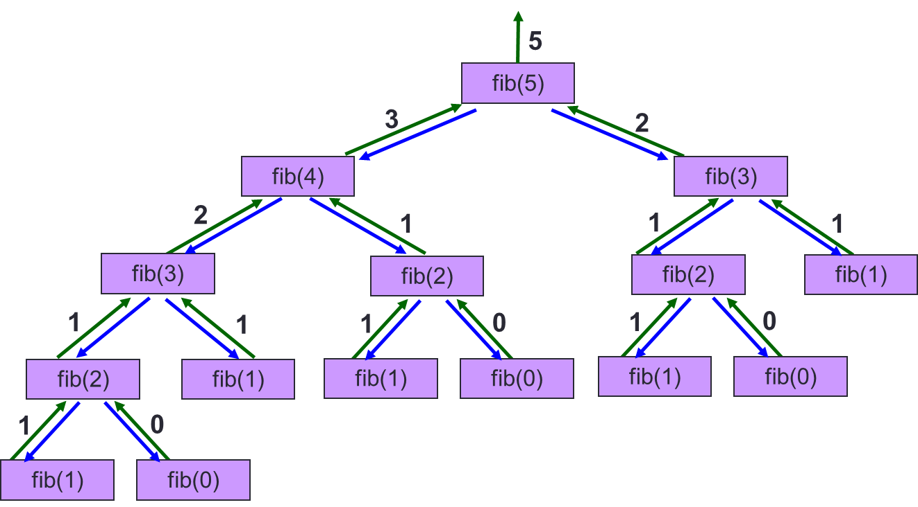
Good Habits for Writing Efficient Code
No duplicates
  Do NOT repeat work.
Example
long fib(long n) {
if (n == 1 || n == 2)
return n;
else
return fib(n - 1) + fib(n - 2);
}
The iterative version is more efficient!

Slide 22
Time Complexity Analysis
The Naïve approach: Count the number of steps required for an input n…
Example
  7 steps per iteration: 1 comparison + 2 additions + 4 assignments
  n – 2 iterations
  2 extra steps: 1 assignment (initialization) + 1 comparison (final check of condition).
  7n – 12 in total
for (long i = 2; i != n; i += 1) {
first = second;
second = third;
third = first + second;
}
The key loop in the iterative version of fib.
Too detailed and not particularly useful…

Slide 23
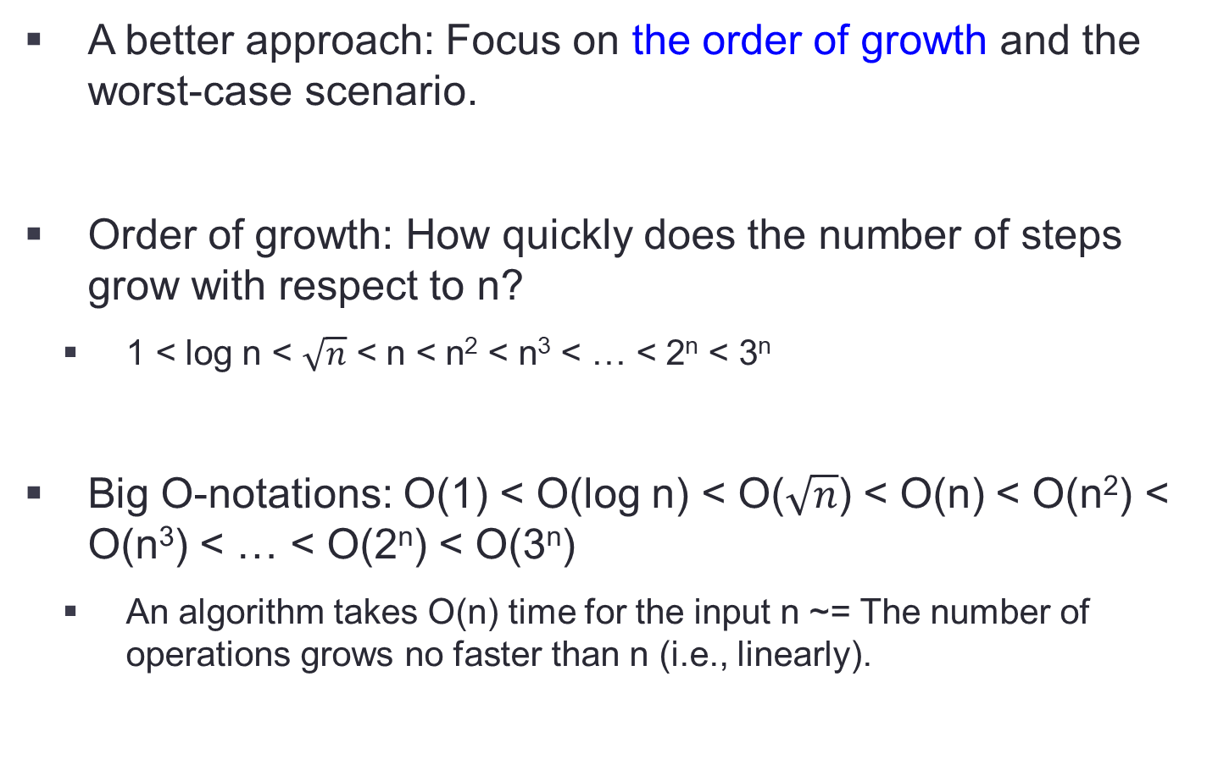
Time Complexity Analysis
A better approach: Focus on the order of growth and the worst-case scenario.
Order of growth: How quickly does the number of steps grow with respect to n?
  1 < log n < $\sqrt{n}$ < n < n² < n³ < … < 2^{n} < 3^{n}
Big O-notations: O(1) < O(log n) < O($\sqrt{n}$) < O(n) < O(n²) < O(n³) < … < O(2^{n}) < O(3^{n})
  An algorithm takes O(n) time for the input n ~= The number of operations grows no faster than n (i.e., linearly).

Slide 24
Time Complexity Analysis
A better approach: Focus on the order of growth and the worst-case scenario.
Example
  Initial computation: 7n – 12
  Drop constants and keep only the term with the highest rate of growth.
  Final result: O(n)
for (long i = 2; i != n; i += 1) {
first = second;
second = third;
third = first + second;
}

Slide 25
Time Complexity Analysis
A better approach: Focus on the order of growth and the worst-case scenario.
Best / worst-case scenario: The input that leads to the minimal / maximum computation
The best case is usually trivial so we should focus on worst case.

Slide 26
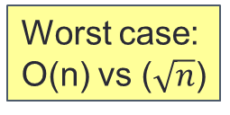
Time Complexity Analysis
A better approach: Focus on the order of growth and the worst-case scenario.
Example
bool is_prime(long n){
for (long i = 2; i <= n - 1; i += 1) {
if (n % i == 0) {
return false;
}
}
return true;
}
Best case:
Both O(1)
Worst case:
O(n) vs ($\sqrt{n}$)
bool is_prime(long n){
for (long i = 2; i <= sqrt(n); i += 1) {
if (n % i == 0) {
return false;
}
}
return true;
}
This is more efficient!

Slide 27
More examples
Draw a rectangle given the dimensions m and n.
1
2
3
4
5
6
7
8
9
10
11
12
13
14
15
void draw_line(long m, char *first, char *mid, char *last) {
cs1010_print_string(first);
for (long j = 0; j < m - 2; j += 1) {
cs1010_print_string(mid);
}
cs1010_println_string(last);
}
void draw_rectangle(long m, long n) {
draw_line(m, TOP_LEFT, HORIZONTAL, TOP_RIGHT);
for (long i = 0; i < n - 2; i += 1) {
draw_line(m, VERTICAL, " ", VERTICAL);
}
draw_line(m, BOTTOM_LEFT, HORIZONTAL, BOTTOM_RIGHT);
}
┏ ━ ━ ━ ┓ ┃ ┃ ┃ ┃
┗ ━ ━ ━.┛
O(n*m)
In each draw_line(): (1 step + (m-2) iterations of 1 step + 1 step) = m
In draw_rectangle(): (1 + n-2 + 1) calls to draw_line() with m = n * m

Slide 28
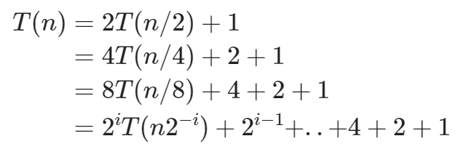
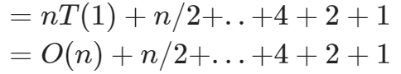
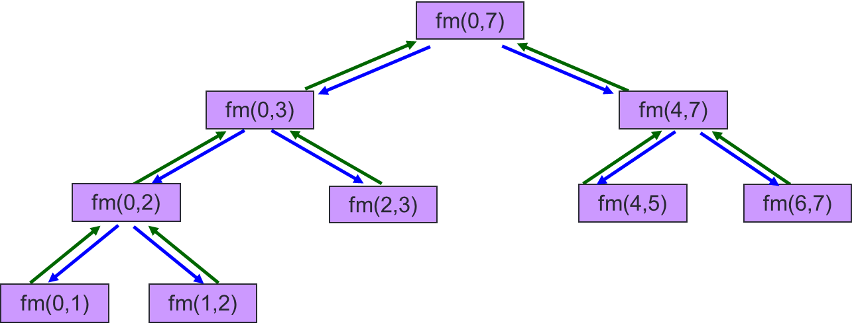
More examples
Recursive find max
long find_max(const long list[], long start, long end){
if (start >= end – 1){
return list[start];
}
long mid = (start + end) / 2;
long left = find_max(list, start, mid);
long right = find_max(list, mid, end);
if (left >= right) {
return left;
}
return right;
}
O(n)

Slide 29
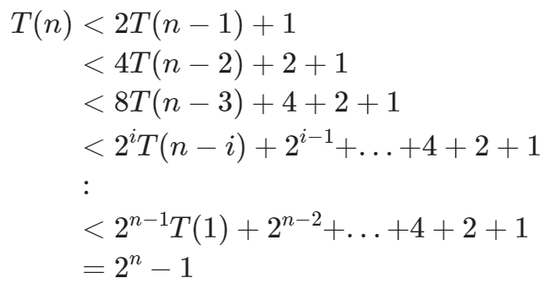
More examples
Fibonacci
long fib(long n) {
if (n == 1 || n == 2)
return n;
else
return fib(n-1) + fib(n-2);
}
long fib(long n) {
if (n == 1 || n == 2)
return n;
else
return fib(n - 1) + fib(n - 2);
}
O(2^{n})

Slide 30
More examples
Collatz
1
2
3
4
5
6
7
8
9
long count_num_of_steps(long n)
{
long num_of_steps = 0;
while (n != 1) {
n = collatz(n);
num_of_steps += 1;
}
return num_of_steps;
}
O(??) since the loop may not terminate.

Slide 31
Homework
Diagnostic Quizzes
  Lecture 8: due 20 Mar, 2pm (extended due to PE1)
  Lecture 9: due 24 Mar, 2pm
Problem Set 19-20
Exercises
  Exercise 4 due 20 Mar, 2pm (extended due to PE1)
  Exercise 5 due 24 Mar, 2pm

