Slide 1

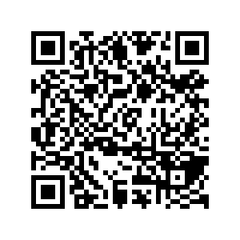
CS1010: Programming Methodology
Week 4
Recap
Live Q&A
https://pollev.com/jin

Slide 2
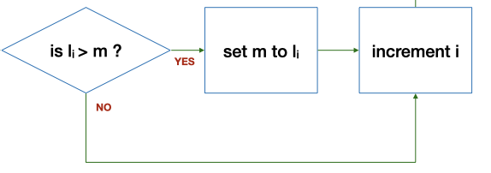
Control Structure: Selection
If … then … else …

Slide 3
if-else Statements
if (n == 0) {
answer = 1;
} else {
answer = n * factorial(n - 1);
}
true
exp?
false
if (v < 0) {
v = -v; // flip the sign
}
cs1010_println_long(v);
true
exp?
false
Skipping else

Slide 4
if-else Statements
if (n == 0) …
(Simple) Logical expressions
  <exp> comp_op <exp>
  <exp>: math expressions, variables, values, function calls
  comp_op: ==, !=, >, >=, <, <=
Examples
  2 < 3, 5 > n, n % 2 != 0,
  n == square(x)…

Slide 5
if-else Statements
&& (and), || (or), ! (not)
For creating complex logical expression
Example:
  Gen Z is the generation of people who was born between 1995 and 2005… → (birth_year >= 1995) && (birth_year <= 2005)
A | B | A && B | A || B | !A
False | False | False | False | True
False | True | False | True | True
True | False | False | True | False
True | True | True | True | False

Slide 6
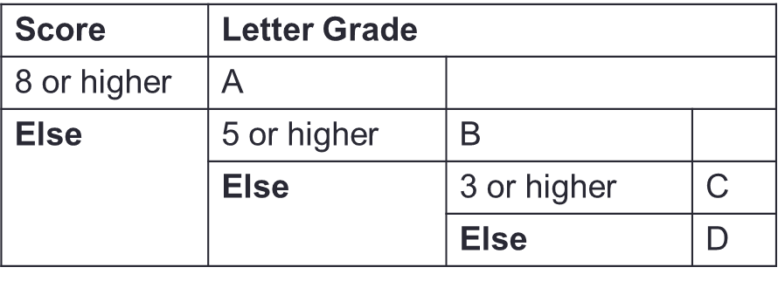
Nested if-else Statements
  Problem: Print a letter grade based on a score
…
if (score >= 8) {
// print "A"
} else {
if (score >= 5) {
// print "B"
} else {
if (score >= 3) {
// print "C"
} else {
// print "D"
}
}
}
…
Dependent on previous checks.
With nesting.
Less than 8
Less than 5

Slide 7
Ex: CS1010 Schedule
Problem: Print the CS1010 schedule based on day (1/2/3/4/5) and time (1000/1100/…)
 | 1000 | 1100 | 1200 | 1300 | 1400 | 1500 | 1600 | 1700
1 (Mon) | Tutorial | Tutorial | Tutorial | Tutorial | - | - | - | -
2 (Tue) | Lecture | Lecture | - | - | - | - | - | -
3 (Wed) | - | - | - | - | - | - | - | -
4 (Thu) | - | - | - | - | - | - | - | -
5 (Fri) | - | - | - | - | - | - | - | -
Condition | Output
day >= 3 | N
Else | day is 2 | time is before 1200 | L
 |  | Else | N
 | Else | time is before 1400 | T
 |  | Else | N

Slide 8
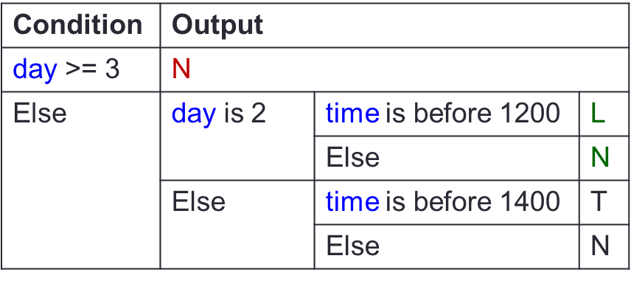
Ex: CS1010 Schedule
if (day >= 3) {
// Output "N"
} else {
if (day == 2){
if (time < 1200)){
// Output "L"
} else {
// Output "N"
}
} else {
if (time < 1400)){
// Output "T"
} else {
// Output "N"
}
}
}

Slide 9
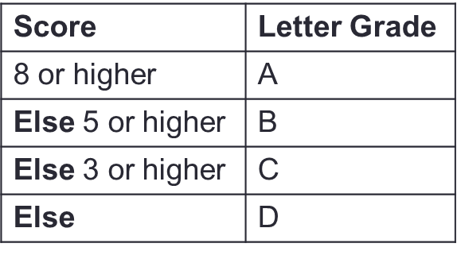
if-(else-if-)else… Statements
  Problem: Print a letter grade based on a score
…
if (score >= 8) {
// print "A"
} else if (score >= 5) {
// print "B"
} else if (score >= 3) {
// print "C"
} else {
// print "D"
}
…
Dependent on previous checks.
No nesting.

Slide 10
Ex: CS1010 Schedule
Problem: Print the CS1010 schedule based on day (1/2/3/4/5) and time (1000/1100/…)
 | 1000 | 1100 | 1200 | 1300 | 1400 | 1500 | 1600 | 1700
1 (Mon) | Tutorial | Tutorial | Tutorial | Tutorial | - | - | - | -
2 (Tue) | Lecture | Lecture | - | - | - | - | - | -
3 (Wed) | - | - | - | - | - | - | - | -
4 (Thu) | - | - | - | - | - | - | - | -
5 (Fri) | - | - | - | - | - | - | - | -
Condition | Output
day is 1 and time is before 1400 | T
Else day is 2 and time is before 1200 | L
Else | N

Slide 11
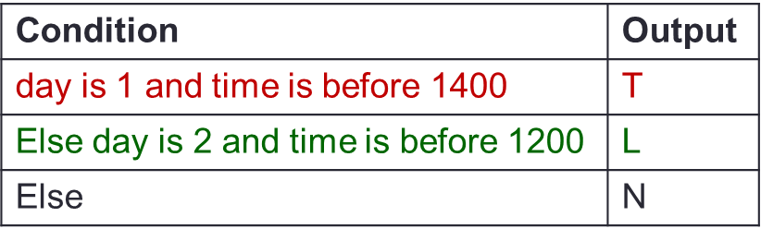
Ex: CS1010 Schedule
if (day == 1 && time < 1400) {
// Output "T"
} else if (day == 2 && time < 1200){
// Output "L"
} else {
// Output "N"
}

Slide 12
Boolean Values
All logical expressions evaluate to Boolean values true or false.
Such values can be stored in / returned as a bool variable
bool compare(long x, long y)
{
bool is_diff = x != y; // evaluates to true or false
if (is_diff) {
cs1010_println_string("x and y
store different values.");
} else {
cs1010_println_string("x and y
store the same value.");
}
return is_diff;
}

Slide 13
Short-Circuit Evaluation
expr1 && expr2
  If expr1 is false, skip evaluating expr2 and return false immediately, as the result will always be false.
  Example: (birth_year >= 1995) && (birth_year <= 2005)
expr1 || expr2
  If expr1 is true, skip evaluating expr2 and return true immediately, as the result will always be true.
  Example: (birth_year < 1995) || (birth_year > 2005)
Make things faster in some cases
  Example: (number < 100000) && is_prime(number) VS
  is_prime(number) && (number < 100000)

Slide 14
Assertion
For specifying, understanding, checking of logic.
Problem: Find the maximum value between two variables
if (x > y) {
// { x > y }
max = x;
// {(x > y) && (max == x)}
else {
// { x <= y }
max = y;
// {(x <= y) && (max == y)}
}
x > y
x <= y

Slide 15
De Morgan's Law
!(e1 && e2) is the same as (!e1) || (!e2)
!(e1 || e2) is the same as (!e1) && (!e2)
Help to quickly write the assertion for false block
if (…) {
// { (birth_year >= 1995) && (birth_year <= 2005) }
} else {
// { !((birth_year >= 1995) &&
(birth_year <= 2005)) }
}
// { (!(birth_year >= 1995) ||
!(birth_year <= 2005) }
// { (birth_year < 1995) ||
(birth_year > 2005) }

Slide 16
Ex: CS1010 Schedule
if (…) {
// { day == 1 && time < 1400 } // Assertion_1
} else {
// { day != 1 || time >= 1400 }// Assertion_2
if (…){
// { (day == 2 && time < 1200)&& Assertion_2}
} else {
// { day != 2 || time >= 1400)&& Assertion_2}
}
}
Condition | Output
day is 1 and time is before 1400 | T
Else | If day is 2 and time is before 1200 | L
 | Else | N

Slide 17
Think logically!
Clarify your doubts before PE0!

