Slide 1


CS1010: Programming Methodology
UNIT 15
Pointers
Live Q&A
https://pollev.com/jin

Slide 2
Unit 15: Pointers
Memory Address
The Address-of (&) Operator
Pointers and the Dereference (*) Operator
NULL Pointer
Common Mistakes
Pointer Arithmetics
Pointer and Array

Slide 3
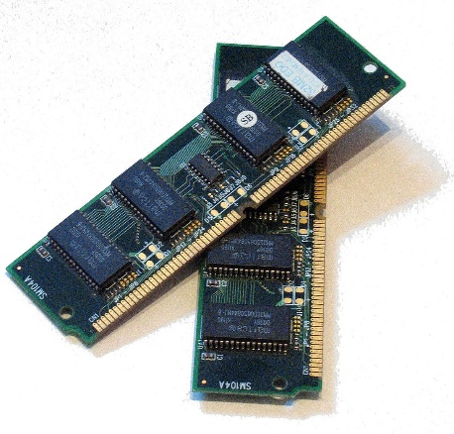
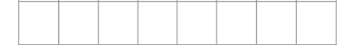
Memory Address
Every location in the memory
  Can be used to store 1 byte (i.e., 8 bits) of data
  Has an address (i.e., a unique index number).
10001011
1 GB ~= 1 billion byte
…
…
25685528
25685532
What is the address of this location?

Slide 4
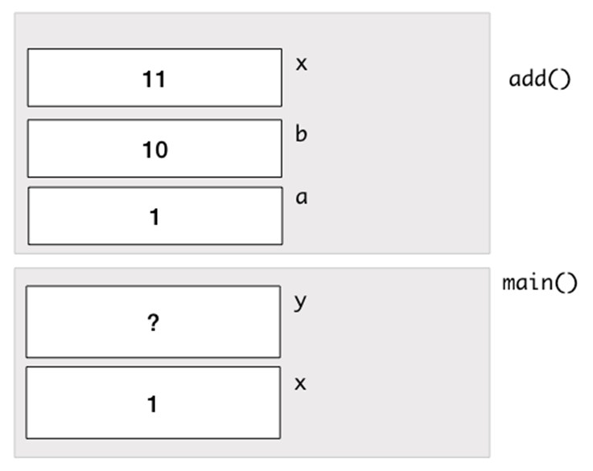
Memory Address
Do the two x variables share the same addresses? How to confirm your answer?
long add(long a, long b) {
long x;
x = a + b;
return x;
}
int main(void) {
long x = 1;
long y;
y = add(x, 10);
return 0;
}

Slide 5
The Address-of (&) Operator
The address-of (&) operator can be used to obtain the address of a variable.
  The address can be printed using cs1010_println_pointer().
long add(long a, long b) {
long x;
x = a + b;
cs1010_println_pointer(&x);
return x;
}
int main(){
long x = 1;
long y;
y = add(x, 10);
cs1010_println_pointer(&x);
return 0;
}
Sample outputs:
25685528
25685552
The two addresses are always different from each other.

Slide 6
Pointers and the Dereference (*) Operator
Two purposes
  Declares a pointer (i.e., a variable for storing a memory address).
  Accesses a memory location given an address
double *addr;
double c;
addr = &c;
addr is of the type double * (i.e., a pointer to a double variable) and it stores the address of c.
*addr = 1.0;
This accesses the address stored in addr and changes the value at the address to 1.0.
addr
c
Since the address stored in addr actually belongs to c, *addr is equivalent to c!
1.0

Slide 7
Example
i
12
j
12
long i = 10, j = 20;
long *p; // p is a pointer to some long variable
10
20
p
p = &i; // p now stores the address of variable i
cs1010_println_long(*p);
Important!
Now *p is equivalent to i
10
// *p accesses the value of pointed/referred variable
*p = *p + 2; // increment *p (which is i) by 2
// same effect as: i = i + 2;
p = &j; // p now stores the address of variable j
Important!
Now *p is equivalent to j
*p = i; // value of *p (which is j now) becomes 12
// same effect as: j = i;

Slide 8
NULL pointer
A pointer that contains the NULL value
Commonly used to indicate that the pointer is invalid
double *addr;
addr = NULL;
addr points to nowhere.

Slide 9
Common Mistakes
Unmatched types
Uninitialized pointers
Null pointer exception
double *addr;
long c;
addr = &c;
addr is for storing addresses of double variables, not long variables.
double *addr;
*addr = 1.0
addr is uninitialized so *addr refers to an unknown location.
double *addr;
addr = NULL;
*addr = 5;
Exception since addr points to nowhere.

Slide 10
Pop Quiz
What is the result of *ptr + 1?
*ptr is equivalent to x, so *ptr + 1 is 2!
But how about ptr + 1?
long x;
long *ptr;
x = 1;
ptr = &x;

Slide 11
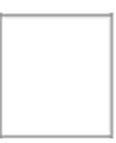
Pointer Arithmetics
What is the result of ptr + 1?
Adding 1 to a pointer itself skips to the address of the next item in the memory.
If x is at location 25685528 and a long variable takes up 8 bytes…
  ptr + 1 is 25685536
long x;
long *ptr;
x = 1;
ptr = &x;
8 bytes allocated for x
…
…
25685528 (ptr)
25685536 (ptr + 1)

Slide 12
Pointer and Array
What is the result of ptr + 1?
Remember: When the array name a appears in an expression, it refers to the address (location) of the first element (i.e. &a[0]) of that array (a.k.a., Array Decay).
If a (i.e., &a[0]) is 25685528…
  ptr + 1 is 25685536 (i.e., &a[1])
ptr + i is &a[i] if ptr contains a.
long a[10];
long *ptr;
ptr = a;

Slide 13
CS1010: Programming Methodology
UNIT 16
Call by Reference
Live Q&A
https://pollev.com/jin

Slide 14
Unit 16: Call by Reference
Pure Functions (Call by Value)
Functions with Side Effects (Call by Reference)

Slide 15
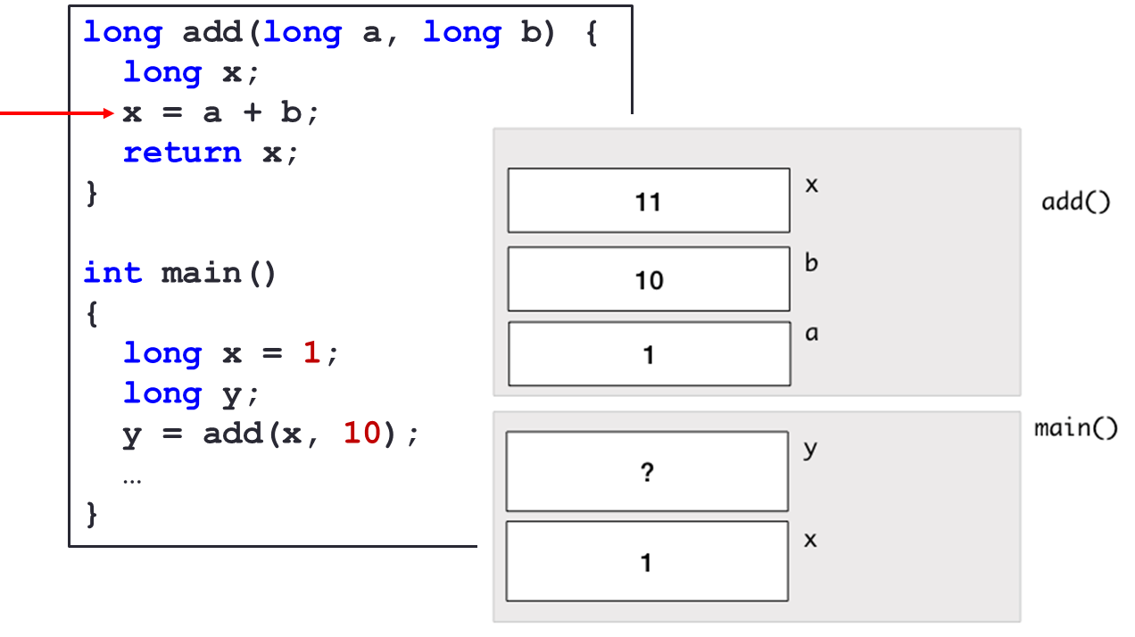
Pure Functions
Do not affect the variables in other functions due to the Call-by-Value mechanism
  The value of a variable is passed into function.

Slide 16
Pure Functions
Benefits: Easy to debug
  Every function is self-contained
Limitations: Unable to return multiple values
  Only a single value can be returned (via the return statement).
Does the following function f(n) return both 2n and 3n?
long f(long n) {
return 2 * n;
return 3 * n;
}
No. Once a return statement is executed, the function ends immediately.

Slide 17

Example: Swap()
Problem: Swap two values.
…
long main() {
long var1, var2;
long var1 = cs1010_read_long();
long var2 = cs1010_read_long();
swap(var1, var2);
cs1010_print_long(var1);
cs1010_print_string(" ");
cs1010_print_long(var2)
return 0;
}
void swap(long var1, long var2) {
long temp;
temp = var1; var1 = var2; var2 = temp;
}
Input: 72 9
Output: 72 9

Slide 18
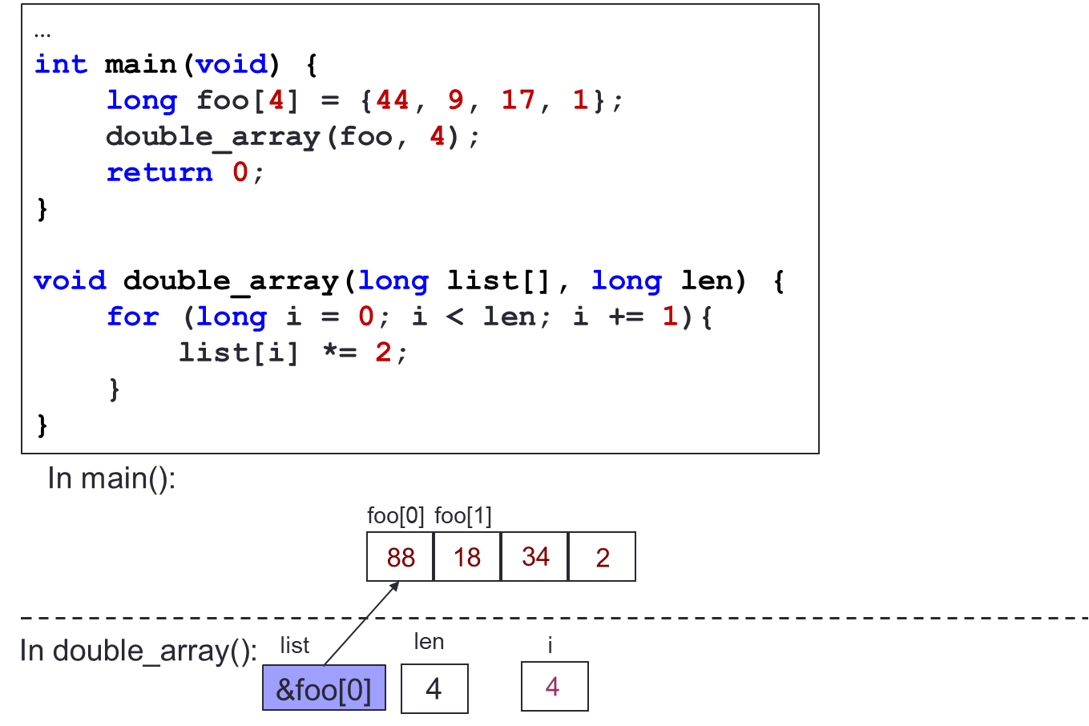
Functions with Side Effects
Affects the variables in other functions due to Call-by-Reference
  The reference / address of a variable is passed into function
foo is affected by doubleArray since the address of the array is passed in.

Slide 19
Example: Swap()
9
72
In main():
var1
72
var2
9
…
int main() {
long var1 = cs1010_read_long();
long var2 = cs1010_read_long();
swap(&var1, &var2);
cs1010_print_long(var1);
cs1010_print_string(" ");
cs1010_print_long(var2)
}
void swap(long *ptr1, long *ptr2) {
long temp;
temp = *ptr1; *ptr1 = *ptr2; *ptr2 = temp;
}
In swap():
ptr1
ptr2
Input: 72 9
Output: 9 72

Slide 20
Example: Collatz from Ex02
Problem: … Print the number with the largest total stopping time and its corresponding total stopping time …
…
int main() {
long n = cs1010_read_long();
long max_num_steps;
long max_n;
find_max_steps(n, &max_n, &max_num_steps);
cs1010_println_long(max_n);
cs1010_println_long(max_num_steps);
}

Slide 21
Example: Collatz from Ex02
void find_max_steps(long n, long *max_n, long *max_num_steps) {
*max_num_steps = 0;
*max_n = 1;
for (long i = 1; i <= n; i += 1) {
long num_of_steps = count_num_of_steps(i);
if (num_of_steps >= *max_num_steps) {
*max_n = i;
*max_num_steps = num_of_steps;
}
}
}

Slide 22
CS1010: Programming Methodology
UNIT 17
Heap
Live Q&A
https://pollev.com/jin

Slide 23
Unit 17: Heap
Heap
Memory Allocation
Memory Deallocation

Slide 24
Properties of a Call Stack
Automatic allocation / deallocation.
Life span of a frame = a function call
Relatively limited in size.
What if we need something with more control, flexibility and availability.

Slide 25
Heap
Another region of the memory outside Call Stack
Manual allocation / deallocation
Life-span = from allocation to de-allocation
Bigger in size than the Call Stack
Use case:
  Reserve a region for an array whose size depends on the input from the user.

Slide 26
C functions for Allocation
malloc
  Allocate the memory of a particular size
Does NOT clear the data in the allocated region.
void *malloc(size_t size);
long *array = malloc(10 * sizeof(long));
Allocate the memory required for an array of 10 elements of the type long.

Slide 27
C functions for Allocation
calloc
  Allocate and clear memory of a particular size.
The data in the allocated region are reset to 0.
  This is practically initialization!
void *calloc(size_t count, size_t size);
long *array = calloc(10, sizeof(long));
Allocate (and clears) the memory required for an array of 10 elements of the type long.

Slide 28
C functions for Deallocation
free
  Release the memory previously allocated through a pointer.
void free(void ptr);
long *array = malloc(…);
free(array);
Release the memory allocated to the array.

Slide 29
Dynamically allocated array
size_t num_of_students = cs1010_read_size_t();
long *marks;
marks = cs1010_read_long_array(num_of_students)
if (marks == NULL) {
// signal error and return
}
for (size_t i = 0; i < num_of_students; i += 1) {
cs1010_println_long(marks[i]);
}
// do other things to marks
:
free(marks);

Slide 30


Common Mistakes
Forgetting to deallocate memory
  Also known as memory leak
  The program will crash when memory runs out!
Accessing the deallocated memory via the original pointer
long *array = malloc(…);
free(array);
*array = 0;
long *array = malloc(…);
free(array);
array = NULL;
The original pointer should be set to NULL to avoid misuse.

Slide 31
CS1010: Programming Methodology
UNIT 18
String
Live Q&A
https://pollev.com/jin

Slide 32
Unit 18: String
Characters
String
String Copy
Common Mistake

Slide 33
Recap: Characters
The data type char can be used to store single characters (e.g., 'g', '4'…)
Special characters
  '\0': null character
  '\t': tab
  '\n': newline
char c1 = 'g';
char c2 = '4';
Not the same as c2 = 4!
char c3 = '100';
Only single characters can be stored.

Slide 34
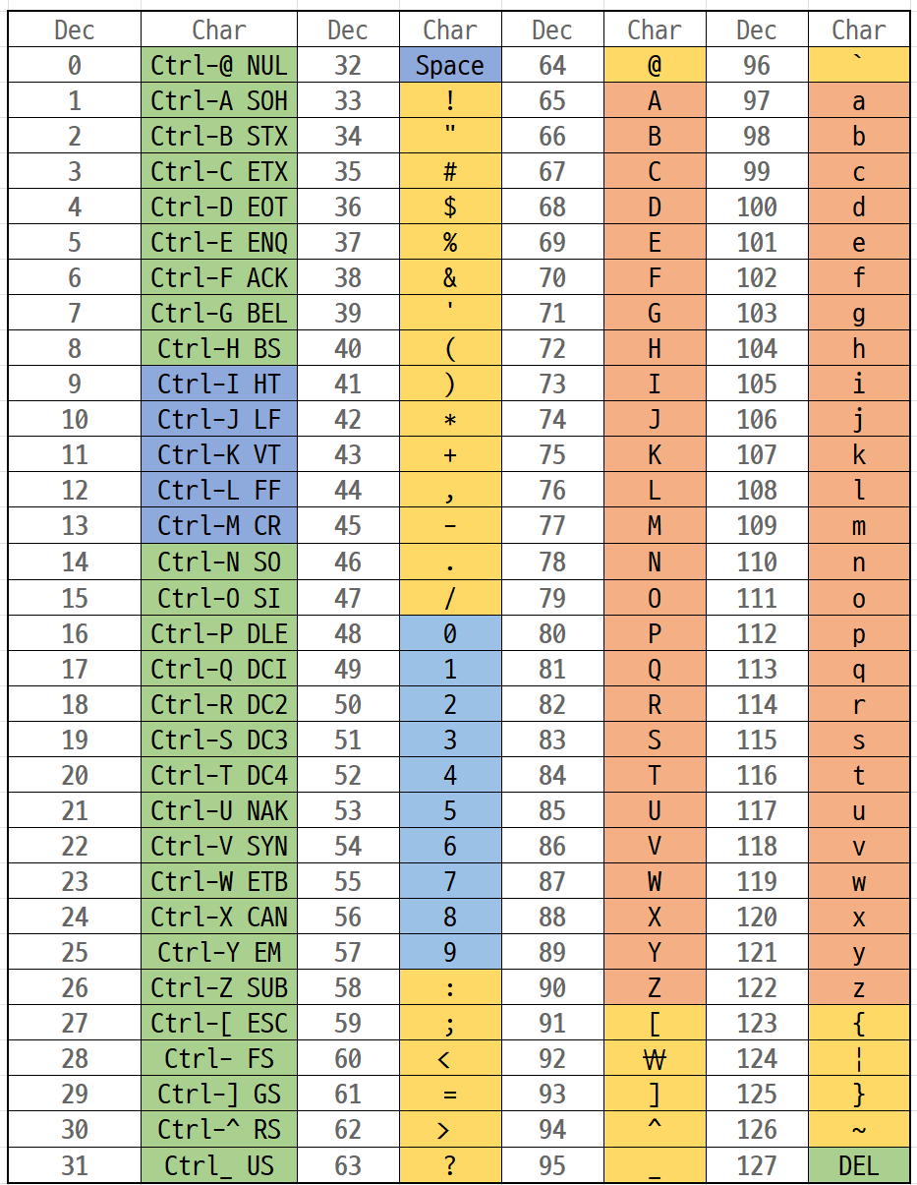
The ASCII Table
https://eunhanlee.hashnode.dev/decimal-ascii-table
'0' is 48
'A' is 65
'a' is 97
'0' + 4 is '4'
'c' – 'a' is 2

Slide 35
String
A char array terminated by a null character '\0' (which has the numeric value 0)
char hello1[7] = {'h', 'e', 'l', 'l', 'o', '!', '\0'};
char hello1[7] = {'h', 'e', 'l', 'l', 'o', '!', 0};
These two are the same!
char hello1[7] = {'h', 'e', 'l', 'l', 'o', '!'};
Not a string. Strange errors may occur.
char hello2[7] = "hello!";
char hello3[] = "hello!";
These are ok as well!
hello1[1] = 'v';
Individual elements can be accessed / modified.

Slide 36
String
If the string does not need to be modified…
char *hello4 = "hello!";
The pointer points to the string which is stored in a protected part of the memory.
hello4[1] = 'v';
Individual elements can be accessed but CANNOT be modified.

Slide 37
String Copy
A loop or the string function strcpy (requires string.h) stringcan be used to make a copy
char src[7] = "hello!";
char dst[7];
for (long i = 0; i <= 7; i += 1)
{
dst[i] = src[i];
}
Can you rewrite the condition using src[i] instead?
char src[7] = "hello!";
char dst[7];
strcpy(dst, src);

Slide 38
Common Mistake
Forgetting the '\0' character!
char src[6] = "hello!";
char src[] = "hello!";
char dst[6];
strcpy(dst, src);

Slide 39
Homework
Diagnostic Quizzes
  Lecture 8: due 20 Mar, 2pm (extended due to PE1)
Problem Set 15-17
Exercises
  Exercise 4 due 20 Mar, 2pm (extended due to PE1)
PE1 Preparation

