Slide 1

CS1010: Programming Methodology
Week 13
The Future

Slide 2
Week 13: The Future
Exam Matters
CS2030 / CS2040

Slide 3
Exam Matters
Date / Time
29 Apr (Wed), 9-11am
Venue
SR2 (COM1-0204)
Format
Pen and Paper
Open book (only printed/written materials allowed)
Calculators allowed
C libraries not allowed in general

Slide 4
Exam Matters
Scope
Everything covered in the course
Structure
MCQs
Short Structured Questions
Long (Programming) Questions

Slide 5
Tips
MCQs
Understanding of Concepts / Algorithms / Functions
Logical Thinking
Basic Syntax
Tracing
Time Complexity
…

Slide 6
Tips
Short Structured Questions
Tracing
Logical Thinking
Assertion / Loop Invariant
Computer Memory
…

Slide 7
Tips
Long Programming Questions
Coding on Paper
Focusing on topics not covered in PEs
Problem Solving
Familiarity with C Syntax
Time Complexity
Tracing
…

Slide 8
Help Session
Date/Time
23 Apr (Thu), 12-2pm
Content
Past year paper (24/25 Sem 2) + Q&A
Format
Online via Zoom
Recorded on a best-effort basis
Zoom Link to be released in Canvas Zoom

Slide 9
Consultations
Date / Time
16/20/23 Apr (Thu/Mon/Thu), 4-6pm
Format
30 minutes per session
Online (via Zoom) or Physical (at COM-02-10)
Signup link to be released in Canvas Announcement
Indicate format when you sign up, e.g., Alex (Online)

Slide 10
From CS1010…
Mainly Procedural
Get input
Compute
Compute intermediate results
Compute final results
Print output
Simple Data Structures / Algorithms
max
last
box1
length
width
height
23
17
5
12
38
44
77
84
90

Slide 11
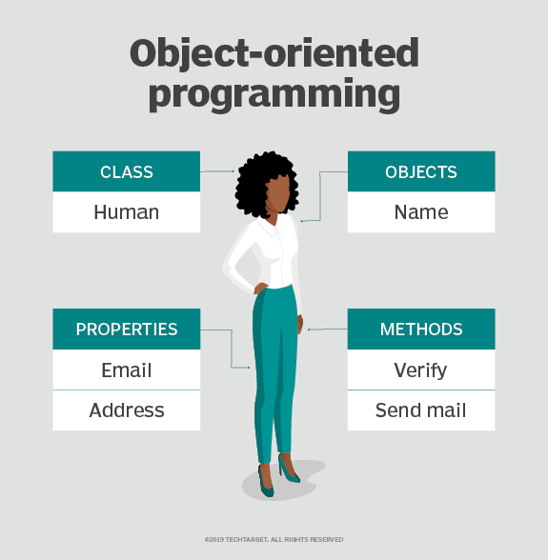
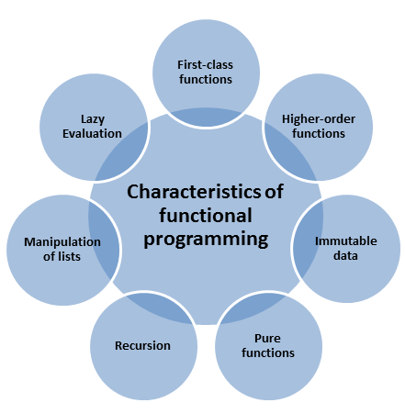
To CS2030…
Modern Programming Paradigms
https://searchapparchitecture.techtarget.com/definition/object-oriented-programming-OOP
https://www.modernescpp.com/index.php/the-definition-of-functional-programming

Slide 12
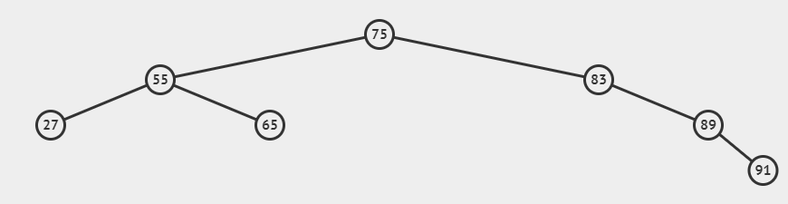
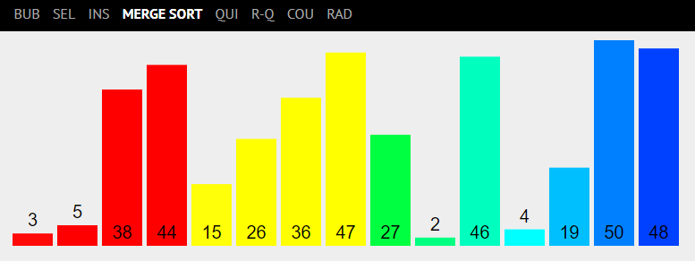
To CS2040…
More about Data Structures and Algorithms
https://visualgo.net/en/

Slide 13
All the best for your Final Assessments!

