Slide 1

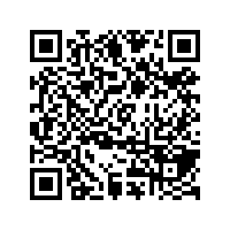
CS1010: Programming Methodology
UNIT 1
What is a Program?
Live Q&A
https://pollev.com/jin

Slide 2




Hardware
Monitor and speaker (output)
Houses CPU, memory, hard disk, etc.
Software
Keyboard and mouse (input)

Slide 3
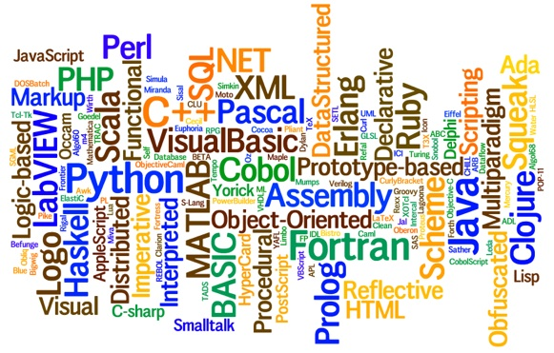
Program (software)
A sequence of step-by-step instructions executed on computers (hardware) to perform a certain task
Programming languages
Languages for writing programs

Slide 4
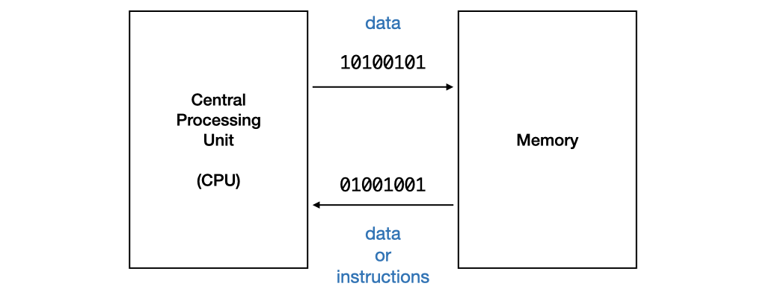
Program Execution
The CPU processes data or instructions from memory and stores data into memory.
Such data or instructions must be in machine code in binary format
E.g., 0001001101101110

Slide 5
Beyond Machine Code
Assembly code
High-level language program
Use mnemonic to represent the instructions, such as load, add, move, etc. in a more human-readable way.
Still difficult to write since the operations are really simple and machine-specific.
Requires translation
Detailed knowledge of the machine is not required. High level of abstraction, such as control structures, functions, object-oriented programming.
Ease of writing and understanding.
Eg: Java, C, C++, Python.

Slide 6
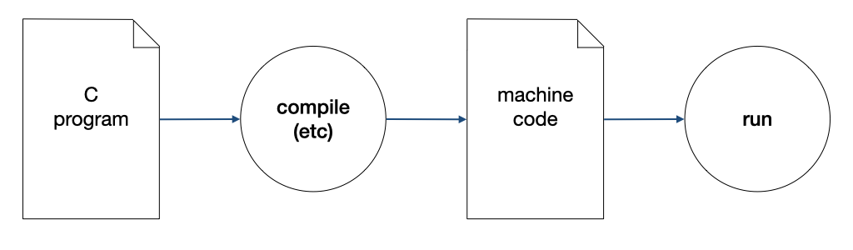
Compilation
A compiler compiles a program written in a high-level language to machine code.

Slide 7
The Edit, Compile and Execute Cycle
Compile
Execute
Edit
Use a compiler to translate the source code into executable
Use an editor to create/modify the source code
Execute/run the executable code
Process is iterative

Slide 8
What have You Learnt?
Fundamentals about Hardware and Software
Programming languages
The edit, compile, execute cycle
But how about problem solving by programming?

Slide 9
CS1010: Programming Methodology
UNIT 2
Computational Problems and Algorithms
Live Q&A
https://pollev.com/jin

Slide 10
Unit 2: Computational Problems and Algorithms
Computational Problems
Algorithm
Flowchart
Variables
Correctness

Slide 11
Computational Problems
Problems that
have well-defined inputs, outputs, and constraints
can be solved step-by-step by a computer

Slide 12
Computational Problems
Example (Decision Problem)
Is a given integer (e.g., 137) a prime number?
What are the inputs, outputs, and constraints?
Is there a step-by-step method to solve it using a computer?

Slide 13
Computational Problems
Example (Search Problem)
Find a route from Point A to Point B.
Example (Counting Problem)
How many different routes are there from Point A to Point B?
Example (Optimization problem)
Find the shortest route from Point A to Point B.

Slide 14
Non-Computational Problems
Examples
What is the meaning of life?
Do I look good in this outfit?
What is the answer to the Ultimate Question of Life, the Universe, and Everything?

Slide 15
Problem Solving Process
Algorithmic
Determine problem features
Analysis
Iterative process
Write algorithm
Design
Produce code
Implementation
What is an algorithm?
Check for correctness and efficiency
Testing

Slide 16
Algorithm
An algorithm is a well-defined computational procedure consisting of a set of instructions, that takes some value or set of values as input, and produces some value or set of values as output.
Input
Algorithm
Output
‘Algorithm’ stems from ‘Algoritmi’, the Latin form of al-Khwārizmī, a Persian mathematician, astronomer and geographer.
Source: http://en.wikipedia.org/wiki/Algorithm

Slide 17
Variables
i, m, k, l and l_{k} are variables (a.k.a., data)
They hold a value in their respective location in the memory
You can
read a value from input (e.g., input k)
write a value to a variable (e.g., set i to 1)
compare values of two variables (e.g., i equals k?)
perform arithmetic operations on variables (e.g., compute i + 1)
print a value to output (e.g., output m)

Slide 18
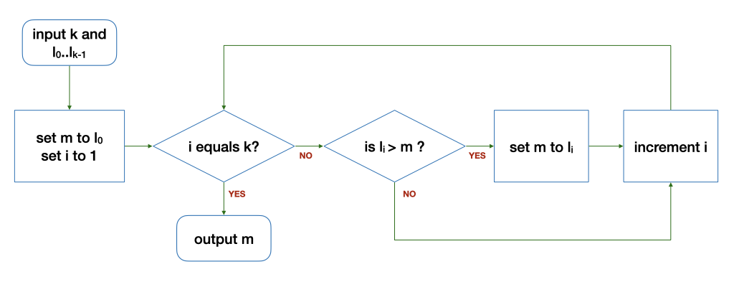
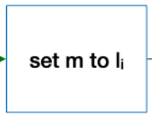
Control structures
Sequence
After step X, do step Y.
Selection
If … then … else …
Repetition
Keep going as long as ...

Slide 19
Algorithm: Example
Problem: Find the average of two integers
Sample input: 2, 5
Sample output: 3.5

Slide 20
Algorithm: Example
Problem: Find the average of two integers
Sample input: 2, 5
Sample output: 3.5
What are the inputs, outputs and constraints?
Inputs: two numbers, which are integers.
Outputs: one number, which is a real number
Constraints: the output number is the average of the two input numbers

Slide 21
Algorithm: Example
Problem: Find the average of two integers
Sample input: 2, 5
Sample output: 3.5
What is the (rough) algorithm?
Input two integers, num1 and num2
Compute the result which is a real number representing the average of num1 and num2
Output the result

Slide 22
Algorithm: Example
Problem: Find the average of two integers
Sample input: 2, 5
Sample output: 3.5
What are the intermediate results?
Intermediate results: one integer, which is the sum of the two input integers

Slide 23
Algorithm: Example
Problem: Find the average of two integers
Sample input: 2, 5
Sample output: 3.5
How to compute the result (i.e., the average)?
Set sum to num1 + num2
Set result to sum / 2

Slide 24
Algorithm: Example
Problem: Find the average of two integers
Sample input: 2, 5
Sample output: 3.5
What is the (full) algorithm?
Input two integers, num1 and num2
Set sum to num1 + num2
Set result to sum / 2
Output the result

Slide 25
Algorithm: Example
Problem: Find the maximum among a list of numbers.
Sample input: 6, {5, 9, 8, 1, 3, 2}
Sample output: 9
What are the inputs, outputs and constraints?
Inputs: a number k = the size of the list, a list of k numbers l = ⟨l₀,...,l_{k−1}⟩
Outputs: a number m
Constraints: m ∈ L and m ≥ l_{i} for all i.
l₀, l₁ , l₂, l₃, l₄, l₅

Slide 26
Algorithm: Example
Problem: Find the maximum among a list of numbers.
Sample input: 6, {5, 9, 8, 1, 3, 2}
Sample output: 9
What is the (rough) algorithm?
Input one integer k, and k integers l₀…l_{k-1}
Scan through the list and keep track of the maximum
Output one integer m, which is the maximum among l₀…l_{k-1}
l₀, l₁ , l₂, l₃, l₄, l₅

Slide 27
Algorithm: Example
Problem: Find the maximum among a list of numbers.
Sample input: 6, {5, 9, 8, 1, 3, 2}
Sample output: 9
How to compute the result (i.e., maximum)?
Record the maximum (m) so far with m = l₀ initially
Record the index (i) of the number being considered with i = 1 initially
l₀, l₁ , l₂, l₃, l₄, l₅

Slide 28
Algorithm: Example
Problem: Find the maximum among a list of numbers.
Sample input: 6, {5, 9, 8, 1, 3, 2}
Sample output: 9
How to compute the result (i.e., maximum)?
Keep going as long as there are more numbers (i.e., i does not equal k)
if m < l_{i}, then update m with the value of l_{i}
Increase i by 1
l₀, l₁ , l₂, l₃, l₄, l₅

Slide 29
Algorithm: Example
The Flowchart
Input: 6 5 9 8 1 3 2

Slide 30
Algorithm: Example
The Flowchart
The loop
Input: 6 5 9 8 1 3 2
k | i | l_{i} | m | Remark
6 | 1 | 9 | 5 | Before the loop
6 | 2 | 8 | 9 | After 1st round of the loop
6 | 3 | 1 | 9 | After 2nd round…
k | i | l_{i} | m | Remark
6 | 4 | 3 | 9 | After 3rd round…
6 | 5 | 2 | 9 | After 4th round…
6 | 6 | - | 9 | After 5th round…

Slide 31
Correctness
An algorithm is correct (i.e., bug free) if it works on all valid inputs.
Very often, a buggy algorithm works on some inputs but fails on others…
Example of an incorrect algorithm for finding the average of two numbers
Input two integers, num1 and num2
Set result to num1
Output the result
This algorithm returns correct results if the inputs are the same numbers (e.g., 3 3)!

Slide 32
Correctness
To check correctness, you can
Find a counter-example to disprove the algorithm
Carefully choose a set of test cases to verify the correctness
Argue formally about the property of the algorithms

Slide 33
Correctness
What is wrong with this modified algorithm?
0

Slide 34
Homework
Post-Lecture Quiz
To be released every Tuesday, 2pm and due the next Tuesday, 2pm
Unlimited number of attempts.
Problem Set 2.1 to 2.3 (under Unit 2)
To be discussed in the forum and tutorials
Course website and programming environment
Submission of Github account name via Canvas

