Slide 1


CS1010: Programming Methodology
UNIT 3
Functions
Live Q&A
https://pollev.com/jin

Slide 2
Unit 3: Functions
Problem Solving Techniques
Functions
More examples
Even more examples

Slide 3
Problem Solving Techniques
How to solve a new problem?
Find the range (i.e., max-min) of a list of k numbers {l₀,…,l_{k-1}}
Input: 6 5 9 8 1 3 2
Output: 8

Slide 4
Problem Solving Techniques
How to solve a new problem?
Find the range (i.e., max-min) of a list of k numbers {l₀,…,l_{k-1}}
What are the inputs, outputs and constraints?
Inputs: a number k = the size of the list, a list of k numbers l = ⟨l₀,...,l_{k−1}⟩
Output: a number r
Constraints: r is the range (i.e., max-min) of the given numbers
Input: 6 5 9 8 1 3 2
Output: 8

Slide 5
Problem Solving Techniques
How to solve a new problem?
Find the range (i.e., max-min) of a list of k numbers {l₀,…,l_{k-1}}
Technique 1: Breaking it down!
Input one integer k, and k integers l₀…l_{k-1}
Compute the range r of a list of k numbers
Output the range r
Input: 6 5 9 8 1 3 2
Output: 8

Slide 6
Problem Solving Techniques
How to solve a new problem?
Find the range (i.e., max-min) of a list of k numbers {l₀,…,l_{k-1}}
Technique 2: Borrowing from what we know!
Input one integer k, and k integers l₀…l_{k-1}
Same as the input step for FindMax (i.e., input one number, followed by a list of numbers)
Output the range r
Same as the output step for FindMax (i.e., output one number)
Input: 6 5 9 8 1 3 2
Output: 8

Slide 7
Problem Solving Techniques
How about the Compute step?
Compute: Compute the range of the given list L of k numbers
Need to apply Breaking it down again. But how?
Observation: range = max – min
max and min are the intermediate results we need!

Slide 8
Problem Solving Techniques
Compute the range r of a list of k numbers
(Breaking it down…)
Compute the maximum m of a list L of k numbers
Same as the compute step of FindMax (Borrowing from what we know)
Compute the minimum n of a list L of k numbers
????
Compute the range r as m-n
Simple Computation

Slide 9
Problem Solving Techniques
Technique 3: Wishful thinking
Assume that we have a magic black box for solving a smaller problem
i.e., given some inputs, this magic black box produces a value (usually an intermediate result) that we need.

Slide 10
Problem Solving Techniques
Compute the range r of a list of k numbers
(Breaking it down…)
Compute the maximum m of a list L of k numbers
Same as the compute step of FindMax (Borrowing from what we know)
Compute the minimum n of a list L of k numbers
Assume we have it. (Wishful thinking)
Compute the range r as m-n
Simple Computation

Slide 11
Problem Solving Techniques
Problem: Find the range (i.e., max-min) of a list of numbers
Algorithm:
Input one integer k, and k integers l₀…l_{k-1}
Compute the range r of a list of k numbers
Compute the maximum m of a list L of k numbers
Compute the minimum n of a list L of k numbers
Compute the range r as m-n
Output: Print the range r
The real problem!

Slide 12
Functions
The magic black box (a.k.a. a Function)
Given some inputs, it produces a value that we need
Where to find it?
Provided by the standard C library or other libraries
Example: sqrt(x) computes the square root of x
Written by you!
Example: modify the algorithm of FindMax so that it finds the minimum instead

Slide 13
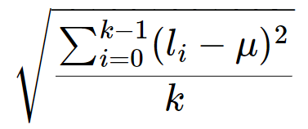
More examples
Problem: Find the standard deviation of a list of numbers
μ: mean (L, k)
L': subtract (L, k, μ)
L'': square (L', k)
μ'': mean (L'', k)
result: sqrt (μ'')
Let say k = 5, L = {1, 3, 5, 7, 9},
μ = 5
subtract (L, k, μ) = {-4, -2, 0, 2 ,4}
square (L', k) = {16, 4, 0, 4,16}
μ'' = mean (L'', k) = 8
sqrt (μ'') = 2.83

Slide 14
More examples
Problem: Find the standard deviation of a list L of k integers
result: sqrt ( mean ( square ( subtract (L, k, mean (L, k)), k), k)
Reuse of functions
A function, once defined, can be reused any number of times!
No need to reinvent the wheel every time!
mean is used twice!

Slide 15
More examples
Problem: Find the standard deviation of a list L of k integers
result: sqrt ( mean ( square ( subtract (L, k, mean (L, k)), k), k)
Function calling other functions
If we treat this computation as a function stddev (L, k), it calls sqrt, mean, square and subtract to complete the computation.

Slide 16



A Simple “Drawing” Problem
Problem: Draw
a rocket ship (which is a triangle over a rectangle over an inverted V),
a male stick figure (a circle over a rectangle over an inverted V), and
a female stick figure (a circle over a triangle over an inverted V)
rocket
male
Analysis:
No particular input / compute needed.
Just draw the needed 3 figures: 1 magic box for each figure.
There are common shapes shared by the 3 figures: 1 magic box for each shape.
female

Slide 17
A Simple “Drawing” Problem
Problem: Draw
a rocket ship (which is a triangle over a rectangle over an inverted V),
a male stick figure (a circle over a rectangle over an inverted V), and
a female stick figure (a circle over a triangle over an inverted V)
rocket
male
female
Design:
Draw 3 Figures
Draw Rocket Ship
Draw Male Stick Figure
Draw Female Stick Figure
Draw Triangle
Draw Rectangle
Draw Inverted V
Draw Circle
Draw Rectangle
Draw Inverted V
Draw Circle
Draw Triangle
Draw Inverted V

Slide 18
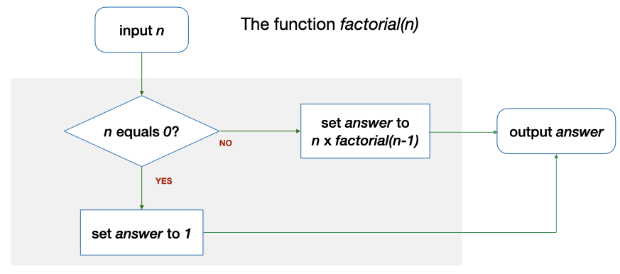
Even more examples
Problem: Compute the factorial of n
E.g., Let n = 4, n! = 4! = 1 * 2 * 3 * 4 = 24
Solution: Use a function factorial (n) which computes factorial n…but with a twist!
factorial calls itself?

Slide 19
Even more examples
Solution: Use a function factorial (n) which computes factorial n?
E.g., Let say n = 0. factorial (n) = …
n (0) == 0? → Yes. The answer is 1.
This is the base case.

Slide 20
Even more examples
Solution: Use a function factorial (n) which computes factorial n?
E.g., Let say n = 4. factorial (n) = …
n (4) == 0? → No. The answer is n * factorial (3) = 4 * 6 = 24.
This is the recursive case.

Slide 21
Even more examples
Problem: Find the maximum of a list of k numbers {l₀,…,l_{k-1}}
Alternative solution: use a function max' (L, i, j) which computes the maximum among L_{i}…L_{j} in a given list L
E.g., Let say L = {5, 9, 8, 1, 3, 2}
max' (L, 5, 5) = 2
max' (L, 4, 5) = 3
max' (L, 0, 5) = 9
l₀, l₁ , l₂, l₃, l₄, l₅

Slide 22
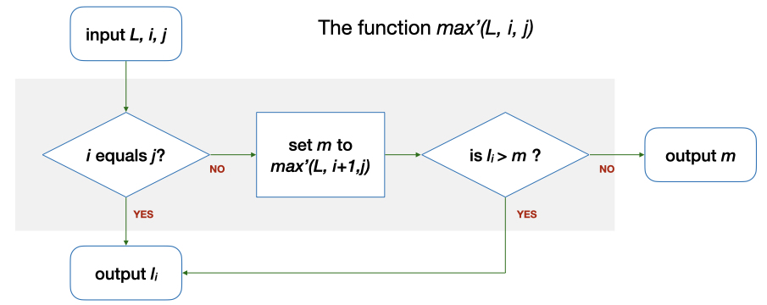
Even more examples
Alternative solution: use a function max' (L, i, j) which computes the maximum among L_{i}…L_{j} in a given list L
E.g., Let say L = {5, 9, 8, 1, 3, 2}, i = 5, j = 5. max' (L, 5, 5) = …
i (5) == j (5)? → Yes. Output l₅ (2)
l₀, l₁ , l₂, l₃, l₄, l₅
This is the base case.

Slide 23
Even more examples
Alternative solution: use a function max' (L, i, j) which computes the maximum among L_{i}…L_{j} in a given list L
E.g., Let say L = {5, 9, 8, 1, 3, 2}, i = 4, j = 5. max' (L, 4, 5) = …
i (4) == j (5)? → No. m is max' (L, 5, 5) = 2 → l₄ (3) > m (2)? → Yes. The answer is l₄ (3).
l₀, l₁ , l₂, l₃, l₄, l₅
This is the recursive case.

Slide 24
Even more examples
Alternative solution: use a function max' (L, i, j) which computes the maximum among L_{i}…L_{j} in a given list L
E.g., Let say L = {5, 9, 8, 1, 3, 2}, i = 0, j = 5. max' (L, 0, 5) = …
i (0) == j (5)? → No. m is max' (L, 1, 5) = 9 → l₀ (5) > m (9)? → No. The answer is m (9).
l₀, l₁ , l₂, l₃, l₄, l₅

Slide 25
Even more examples
Function calling itself (to obtain the solution of a simpler version of the problem and compute the final answer)
factorial (4) uses factorial (3) and multiplies it by 4
max' (L, 0, 5) uses max' (L, 1, 5) and compares it with l₀
This is Recursion!
This is Recursion!
This is Recursion!
…
This is the Base Case!

Slide 26
Yet another solution for FindMax
Problem: Find the maximum of a list of k numbers {l₀,…,l_{k-1}}
Alternative solution: use max' (L, i, j) in a different way.
max' (L, 0, 5) uses max' (L, 0, 4) and compares it with l₅
Can you draw the flowchart?

Slide 27
What have You Learnt?
Problem solving techniques
Algorithms with functions
But how about the variables (i.e., data) used in the algorithms?

Slide 28
CS1010: Programming Methodology
UNIT 4
Types
Live Q&A
https://pollev.com/jin

Slide 29
Unit 4: Types
Computer Memory
Data Types
Data Type Declaration

Slide 30
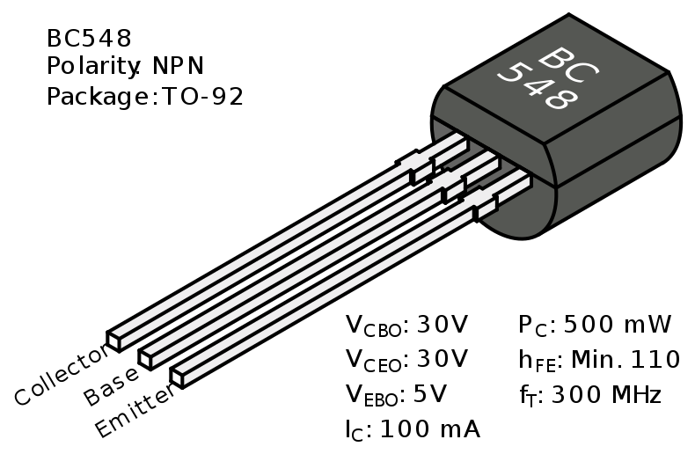
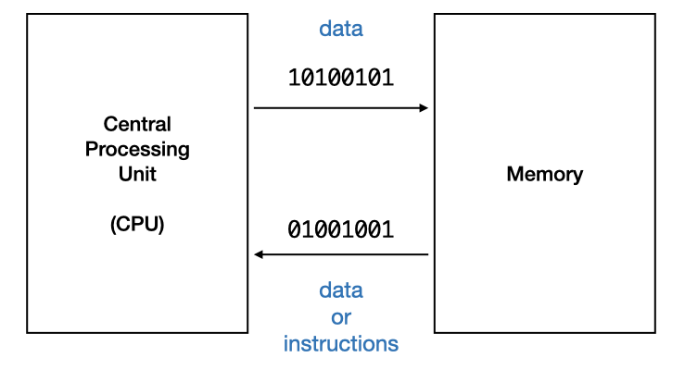
Computer Memory
Memory = a collection of switches (transistors) for storing information
Units
1 bit = the value represented in one switch (transistor)
Two states only: 0 or 1 (e.g., off or on, false or true)

Slide 31
Computer Memory
Units
1 byte = 8 bits
256 possibilities: 00000000, 00000001, …, 11111111 (e.g., integers from 0 to 255)
More bits and/or bytes = more data can be stored / represented.

Slide 32
(Data) Types
The formats used for storing different data
For integers
0~255: 8 bits / 1 byte / unsigned
42: 00101010
201: 11001001
-128~127: 8 bits / 1 byte
42: 00101010
-55: 11001001
-2,147,483,648 to 2,147,483,647: 32 bits / 4 bytes
10953: 0010101011001001
The same binary number may to different values in different type.
More bits required for larger integers.

Slide 33
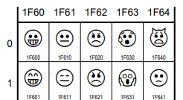
(Data) Types
For characters
ASCII character (e.g., letters, punctuations): 1 byte
A: 01000001
*: 00101010
Unicode characters (e.g. letters, emoticons, Mahjong tiles): 4 bytes

Slide 34
(Data) Types
For real numbers
Single precision: 4 bytes
1.53484220797e-41
Double precision: 8 bytes
5.41150101889917339836595798829e-320
Loss of precision occurs often
More bits required for higher precision

Slide 35
(Data) Types
For compound data?
Sequence of characters (a string)
Pair of real numbers (a point)
A string, a character, a number (a person)
…
No fixed size
To be introduced at the end of this course.

Slide 36
(Variable) Type declaration
Type declaration for variables (before use) is compulsory in C so that the computer can
Allocate the right amount of space in memory
Handle the value accordingly
Examples of type declarations in C
Declaration | Variable Name | Size | For storing
long value; | value | 8 bytes | An integer
char ch; | ch | 1 byte | A character
double ave; | ave | 8 bytes | A real number

Slide 37
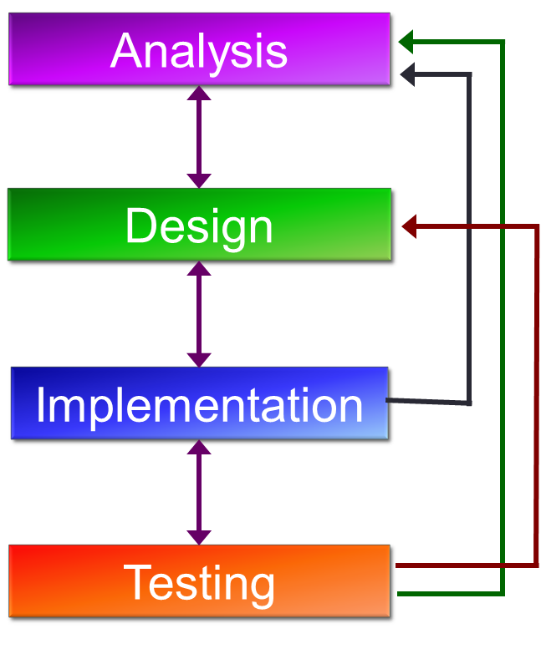
In the context of problem solving
Figure out what variables you need
Declare and use them accordingly in the program

Slide 38
Homework
Diagnostic Quizzes
Lecture 2 (due 27 Jan, 2pm)
Programming Environment (due 27 Jan, 2pm)
Vim (due 3 Feb, 2pm)
Problem Set 3.1 to 3.2 (under Unit 3)
To be discussed in the forum / tutorial
Programming environment
Submission of Github account name via Canvas
By 27 Jan, 2pm

Slide 39
Homework
Exercise 0
Receive the skeleton files
Analyze the problems and design the algorithms
No coding yet!
Tutorials
From Week 3 onwards
Attendance mark: 5% CA

