Slide 1


CS1010: Programming Methodology
Week 2
Recap
Live Q&A
https://pollev.com/jin

Slide 2
Problem Solving Process
Algorithmic
Determine problem features
Analysis
Iterative process
Write algorithm
Design
Produce code
Implementation
Check for correctness and efficiency
Testing

Slide 3
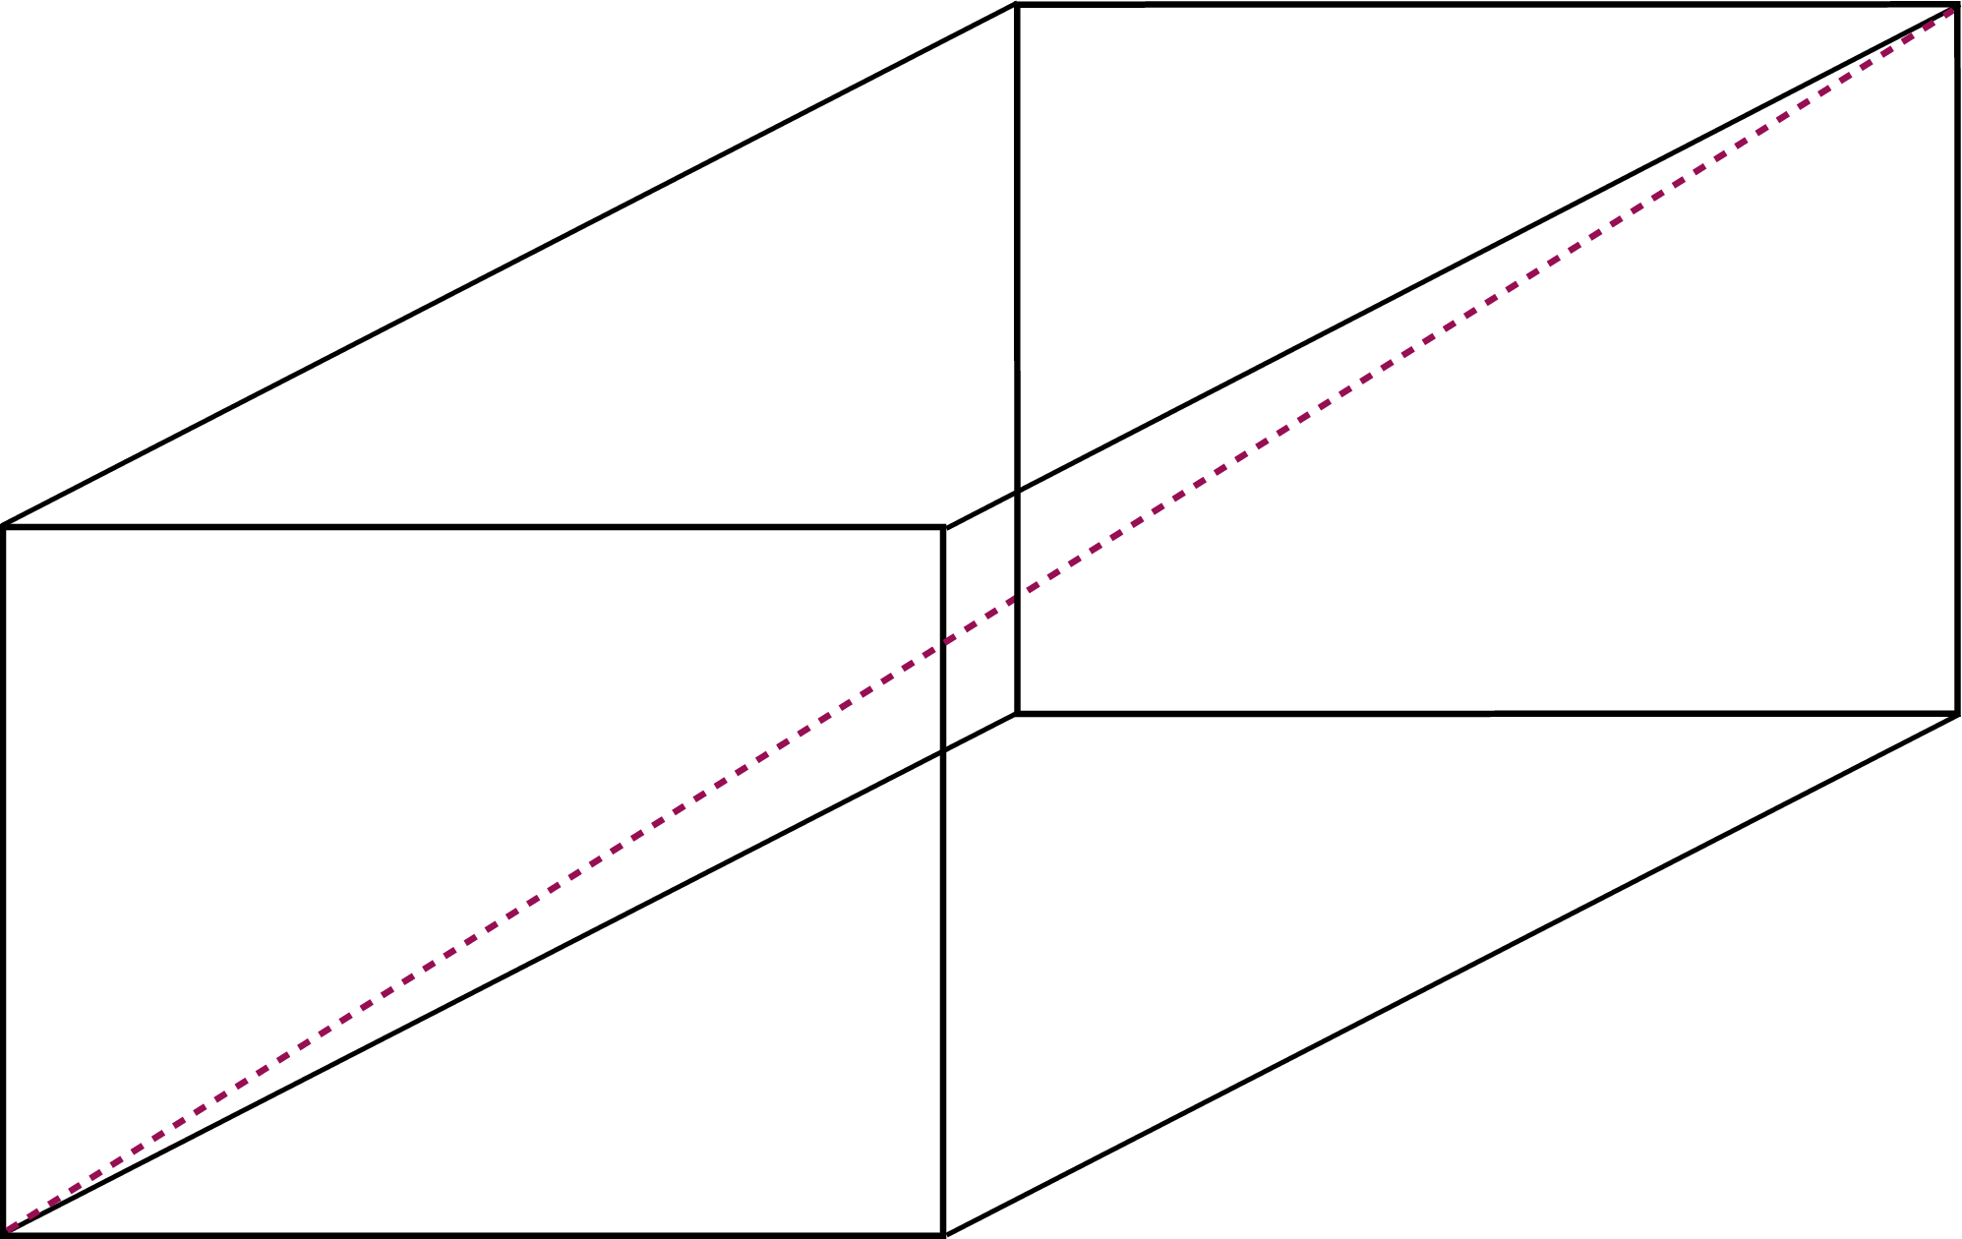
Problem Solving Techniques
Ex00-Q6: Find the surface area and the diagonal of a cuboid
Sample input: 3 4 12
Sample output: 192
13.0000

Slide 4
Problem Solving Techniques
Ex00-Q6: Find the surface area and the diagonal of a cuboid
Problem Analysis
Inputs:
width, length, height (all integers)
Outputs:
surface area (integer)
diagonal (real number)
Constraints:
The outputs are the surface area and the diagonal of the cuboid represented by the inputs.

Slide 5
Problem Solving Techniques
Ex00-Q6: Find the surface area and the diagonal of a cuboid
Algorithm Design
Input 3 integers
Compute the surface area and the diagonal
Output 1 integer and 1 real number
1. Breaking it down!
2. Borrowing from what we know!
3. Wishful thinking!

Slide 6
Problem Solving Techniques
Ex00-Q6: Find the surface area and the diagonal of a cuboid
Algorithm Design
Input 3 integers
Read in an integer for the width (Function from CS1010 Lib.)
Read in an integer for the length (Function from CS1010 Lib.)
Read in an integer for the height (Function from CS1010 Lib.)
Compute …
Output …
1. Breaking it down!
2. Borrowing from what we know!
3. Wishful thinking!

Slide 7
Problem Solving Techniques
Ex00-Q6: Find the surface area and the diagonal of a cuboid
Algorithm Design
Input …
Compute the surface area and the diagonal
Compute the surface area (compute surface area function)
Compute the diagonal (compute diagonal function)
Output …
1. Breaking it down!
2. Borrowing from what we know!
3. Wishful thinking!

Slide 8
Problem Solving Techniques
Ex00-Q6: Find the surface area and the diagonal of a cuboid
Algorithm Design
Input …
Compute: …
Output 1 integer and 1 real number
Print an integer, which is the surface area (Function from CS1010 I/O Lib.)
Print a real number, which is the diagonal (Function from CS1010 I/O Lib.)
1. Breaking it down!
2. Borrowing from what we know!
3. Wishful thinking!

Slide 9
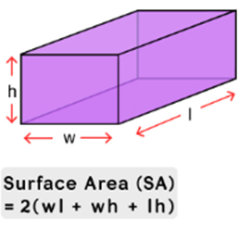
Problem Solving Techniques
Ex00-Q6: Find the surface area and the diagonal of a cuboid
Algorithm Design
Compute surface area function
Compute surface_area as 2 * (width * length + width * height + length * height) (formula)
Computation of area is repeated 3 times with different inputs!
1. Breaking it down!
2. Borrowing from what we know!
3. Wishful thinking!

Slide 10
Problem Solving Techniques
Ex00-Q6: Find the surface area and the diagonal of a cuboid
Algorithm Design
Compute surface area function
Compute area for the bottom (compute area function)
Compute area for the front (compute area function)
Compute area for the side (compute area function)
Compute the surface_area as 2 * the sum of the 3 areas
1. Breaking it down!
2. Borrowing from what we know!
3. Wishful thinking!

Slide 11
Problem Solving Techniques
Ex00-Q6: Find the surface area and the diagonal of a cuboid
Algorithm Design
Compute area function
Compute the area as length * width
1. Breaking it down!
2. Borrowing from what we know!
3. Wishful thinking!

Slide 12
Problem Solving Techniques
Ex00-Q6: Find the surface area and the diagonal of a cuboid
Algorithm Design
Compute diagonal function
Compute the hypotenuse of the base using length and width (compute hypotenuse function)
Compute the diagonal of the cuboid as the hypotenuse of the hypotenuse of the base and height (compute hypotenuse function)
1. Breaking it down!
2. Borrowing from what we know!
3. Wishful thinking!

Slide 13
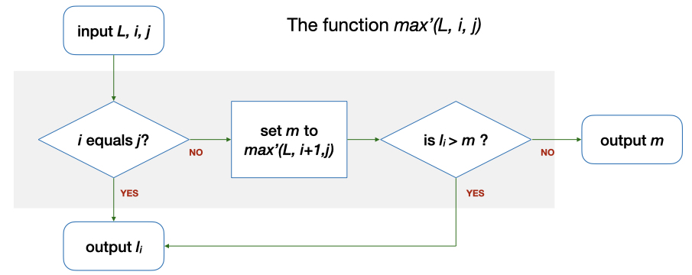
Recursive Solution for FindMax
Use a function max' (L, i, j) which computes the maximum among L_{i}…L_{j} in a given list L
E.g., Let say L = {5, 9, 8, 1, 3, 2}
max' (L, 5, 5) = 2
max' (L, 4, 5) = 3
max' (L, 0, 5) = 9
l₀, l₁ , l₂, l₃, l₄, l₅

Slide 14
Recursive Solution for FindMax
Use a function max' (L, i, j) which computes the maximum among L_{i}…L_{j} in a given list L
E.g., Let say L = {5, 9, 8, 1, 3, 2}
max' (L, 5, 5) = i (2) == j (2) ? → Yes. The answer is l₅ (2).
max' (L, 0, 5) = i (0) == j (5)? → No. m is max' (L, 1, 5) = 9 → l₀ (2) > m (9)? → No. The answer is m (9).
l₀, l₁ , l₂, l₃, l₄, l₅

Slide 15
Yet Another Recursive Solution
Use a function max' (L, i, j) which computes the maximum among L_{i}…L_{j} in a given list L
E.g., Let say L = {5, 9, 8, 1, 3, 2}
max' (L, 5, 5) = i (2) == j (2) ? → Yes. The answer is l₅ (2).
max' (L, 0, 5) = i (0) == j (5)? → No. m is max' (L, 0, 4) = 9 → l₅ (2) > m (9)? → No. The answer is m (9).
set m to
max'(L, i, j-1)
l₀, l₁ , l₂, l₃, l₄, l₅

Slide 16
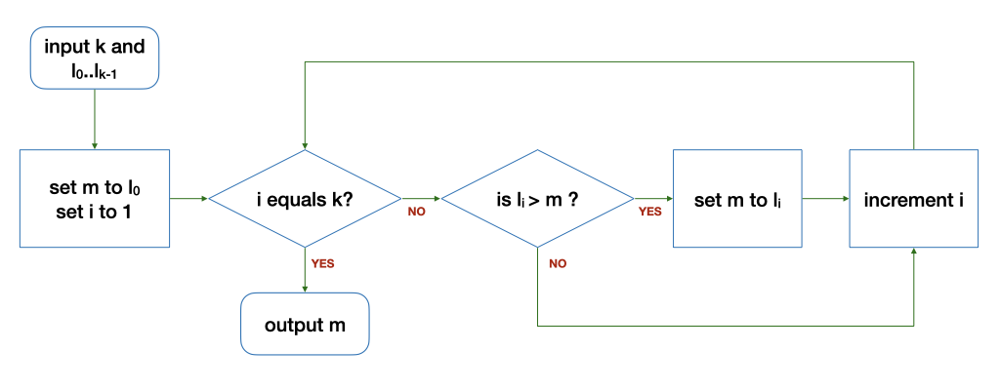
FindMax Revisited
Problem: Find the maximum among a list {L₀…L_{k-1}} of k numbers.
With repetition
FindMax(L, k)
With recursion
max’(L, i, j)
Why i and j are required?
How should max’ be used given L and k?

Slide 17
(Variable) Type declaration
Type declaration for variables (before use) is compulsory in C so that the computer can
Allocate the right number of bits in memory
Handle the value accordingly
Examples of type declarations in C
Declaration | Variable Name | Size | For storing
long value; | value | 4 bytes | An integer
char ch; | ch | 1 byte | A character
double ave; | ave | 8 bytes | A real number

Slide 18
Practice the problem-solving process and techniques.
Get started with recursion.
Know the types of your variables and declare them before use in a C program.

