Slide 1


CS1010: Programming Methodology
UNIT 8
Conditional Statements
Live Q&A
https://pollev.com/jin

Slide 2
Unit 8: Conditional Statements
Sequential / Non-sequential Control Flow
if-else Statements
Skipping else
Conditional Operators
Nested if-else Statements
if-(else-if-)else… Statements

Slide 3
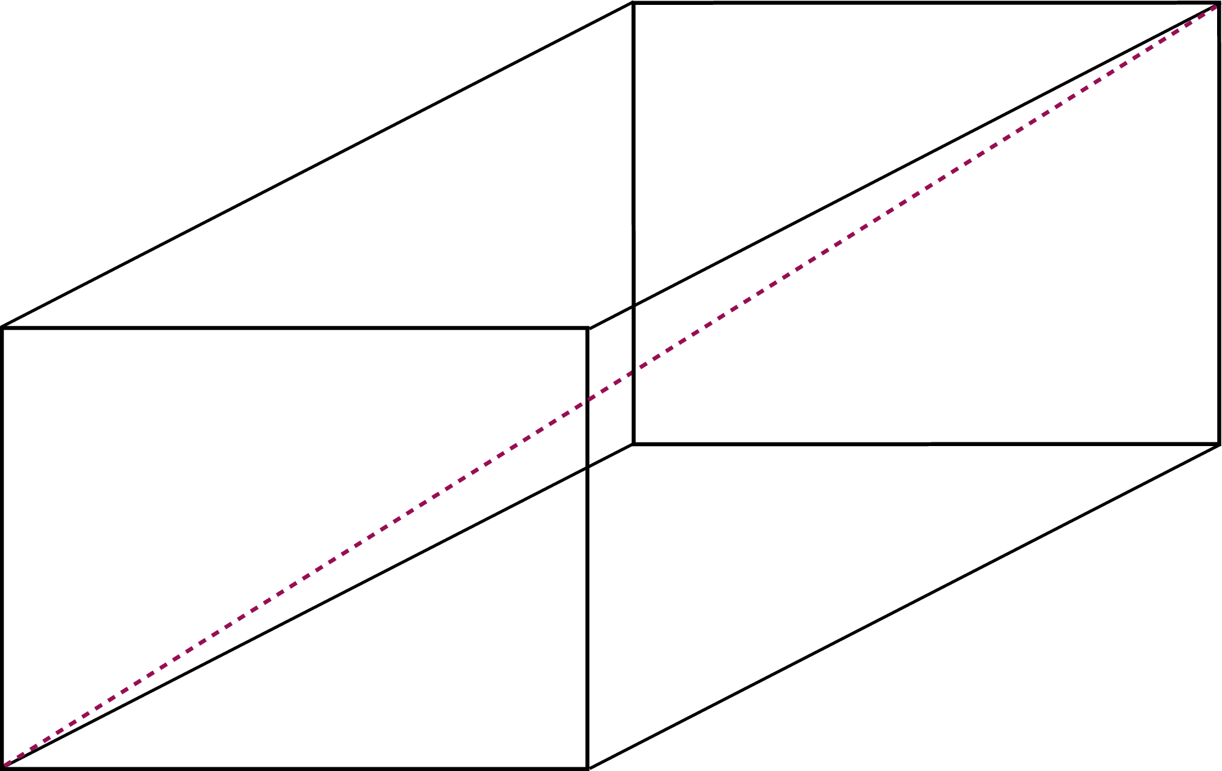
Sequential Control Flow
Ex00-Q6: Find the surface area and the diagonal of a cuboid
Algorithm Design
Input 3 integers (width/length/height)
Compute the surface area and the diagonal
Output 1 integer (surface) and 1 real number (diagonal)
Print the surface area and the diagonal

Slide 4
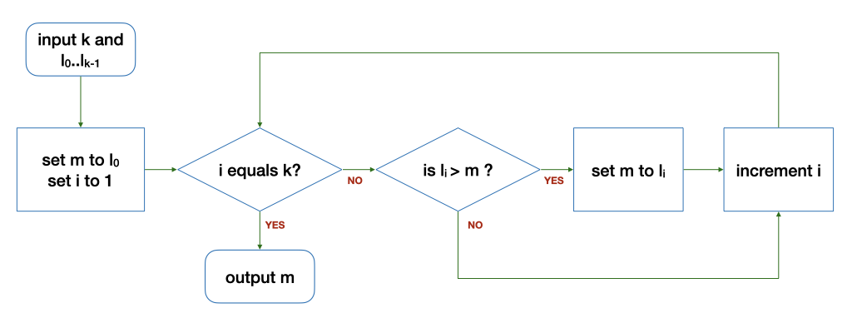
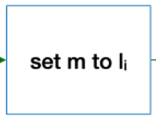
Control Structures
Sequence
After step X, do step Y.
Selection
If … then … else …
Repetition
Keep going as long as ...

Slide 5

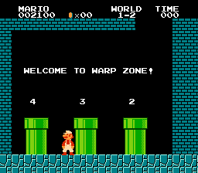
Non-Sequential Control Flow (Selection)

Slide 6
Non-Sequential Control Flow (Selection)
Ex00-Q6: Find the surface area and / or the diagonal of a cuboid depending on user input.
1 for surface area, 2 for diagonal, 3 for both
Algorithm Design
Input 3 + 1 integers (width/length/height + option)

Slide 7
Non-Sequential Control Flow (Selection)
Ex00-Q6: Find the surface area and / or the diagonal of a cuboid depending on user input.
1 for surface area, 2 for diagonal, 3 for both
Algorithm Design
Compute the surface area and / or the diagonal
If option selected is 1 or 3, compute the surface area
If option selected is 2 or 3, compute the diagonal

Slide 8
Non-Sequential Control Flow (Selection)
Ex00-Q6: Find the surface area and / or the diagonal of a cuboid depending on user input.
1 for surface area, 2 for diagonal, 3 for both
Algorithm Design
Output 1 integer (surface) and/or 1 real number (diagonal)
If option selected is 1 or 3, print the surface area
If option selected is 2 or 3, print the diagonal

Slide 9
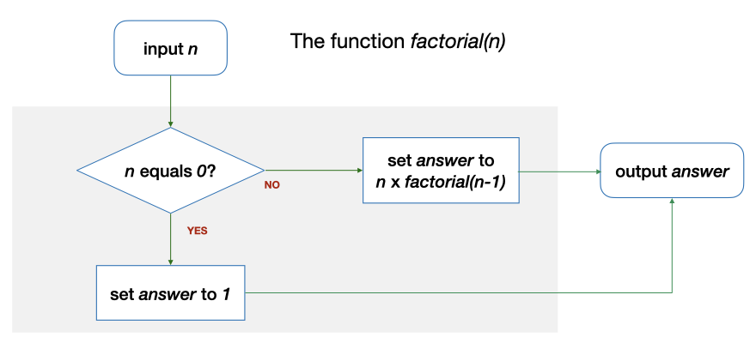
Non-Sequential Control Flow (Selection)
Another example: Base case or Recursive case?

Slide 10
Non-Sequential Control Flow (Selection)
Another example: Base case or Recursive case?
1
2
3
4
5
6
7
8
9
10
long factorial(long n)
{
long answer;
if (n == 0) {
answer = 1;
} else {
answer = n * factorial(n - 1);
}
return answer;
}

Slide 11
if-else Statements
if (n == 0) {
answer = 1;
} else {
answer = n * factorial(n - 1);
}
true
exp?
false
Syntax
if ( <logical expression> ) {
“true block”: statements to be executed if the expression is true
} else {
“false block”: statements to be executed if the expression is false
}

Slide 12
if-else Statements
if (n == 0) …
(Simple) Logical expressions
<exp> comp_op <exp>
<exp>: math expressions, variables, values, function calls
comp_op: ==, !=, >, >=, <, <=
Examples
2 < 3, 5 > n, n % 2 != 0, n == square(x)…

Slide 13

if-else Statements
Common Mistakes
if (n = 0) …
This assigns 0 to n instead.
if (n >= 0)
{
// handle positive values…
}
> should be used instead…
if (0.0000000000000000000049 +
0.0000000000000000000051 ==
0.0000000000000000000100) …
The expression is false since not all real numbers can be represented accurately.

Slide 14
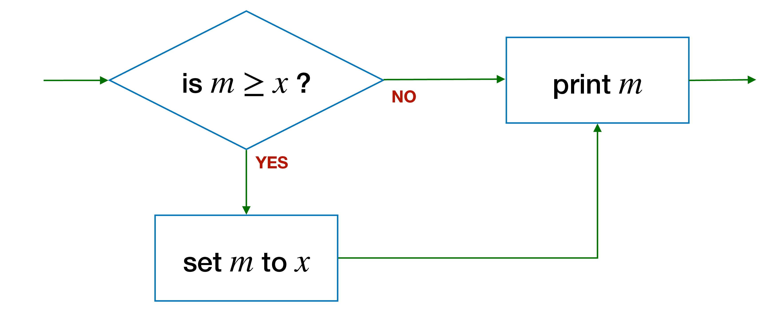
Skipping else
if (v < 0) {
v = -v; // flip the sign
} else {
??? // nothing to do
}
cs1010_println_long(v);
v < 0?
print v
set v to -v
if (v < 0) {
v = -v; // flip the sign
}
cs1010_println_long(v);
true
exp?
false

Slide 15
Pop Quiz
Problem: Find the maximum out of 2 integers.
long compute_max(long num1, long num2) { long max;
if (num1 > num2){ max = num1;
} if (num2 > num1)){ max = num2;
}
return max;
}
if (num1 >= num2){ max = num1;
} if (num2 > num1)){ max = num2;
}
if (num1 > num2){ max = num1;
} if (num2 >= num1)){ max = num2;
}
What is wrong with this function?
What is the correct logic?
if (num1 >= num2){ max = num1;
} if (num2 >= num1)){ max = num2;
}

Slide 16
Pop Quiz
Problem: Find the maximum out of 2 integers.
long compute_max(long num1, long num2) { long max;
if (num1 > num2){ max = num1;
} if (num2 > num1)){ max = num2;
}
return max;
}
if (num1 > num2){ max = num1;
} else {
max = num2;
}
max = num1;
if (num2 > num1){ max = num2;
}
What is wrong with this function?
What is the correct logic?

Slide 17
Conditional Operators
Problem: Find the maximum out of 2 integers.
if (num1 > num2){ max = num1;
} else {
max = num2;
}
max = (num1 > num2) ? num1 : num2;
Syntax
condition ? true expression : false expression;

Slide 18
More than 2 possibilities?
Problem: Print a letter grade based on a score
A possible solution:
if score is 8 or higher → print A
if score is less than 8 but 5 or higher → print B
if score is less than 5 but 3 or higher → print C
if score is less than 3 → print D
Score | Letter Grade
8 or higher | A
Less than 8 but 5 or higher | B
Less than 5 but 3 or higher | C
Less than 3 | D
Completely separate steps!

Slide 19
More than 2 possibilities?
Problem: Print a letter grade based on a score
Score | Letter Grade
8 or higher | A
Else | 5 or higher | B
 | Else | 3 or higher | C
 | Less than 3 | Else | D
Dependent on previous checks.
With nesting.

Slide 20
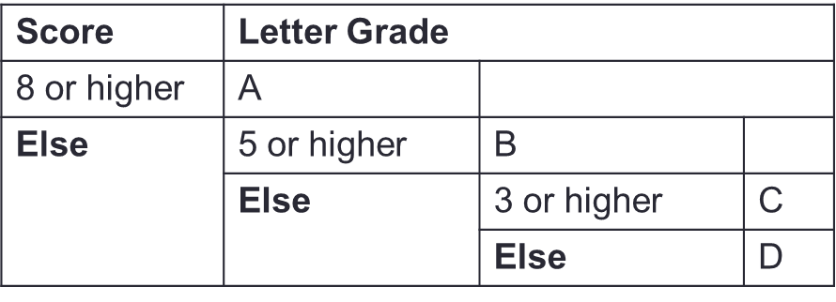
Nested if-else Statements
Problem: Print a letter grade based on a score
…
if (score >= 8) {
// print "A"
} else {
if (score >= 5) {
// print "B"
} else {
if (score >= 3) {
// print "C"
} else {
// print "D"
}
}
}
…

Slide 21
More than 2 possibilities?
Problem: Print a letter grade based on a score
Score | Letter Grade
8 or higher | A
Else 5 or higher | B
Else 3 or higher | C
Else | D
Dependent on previous checks.
No nesting.

Slide 22
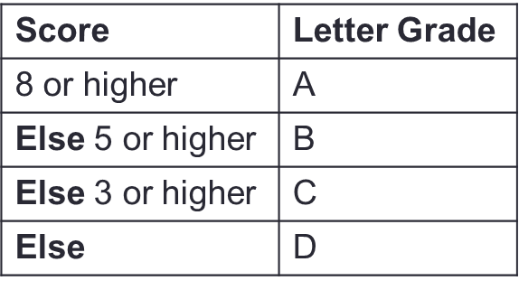
if-(else-if-)else… Statements
Problem: Print a letter grade based on a score
…
if (score >= 8) {
// print "A"
} else if (score >= 5) {
// print "B"
} else if (score >= 3) {
// print "C"
} else {
// print "D"
}
…

Slide 23
Exercise: CS1010 Activity
Problem: Print the CS1010 activity based on day (1/2/3/4/5) and time (1000/1100/…)
E.g., 1 and 1000 → output "T", 2 and 1100 → output "L", 5 and 1200 → output "-"
Work out two sets of logic
Logic 1: Based on one input first and then the other.
Logic 2: Based on both inputs together
 | 1000 | 1100 | 1200 | 1300 | 1400 | 1500 | 1600 | 1700
1 (Mon) | Tutorial | Tutorial | Tutorial | Tutorial | - | - | - | -
2 (Tue) | Lecture | Lecture | - | - | - | - | - | -
3 (Wed) | - | - | - | - | - | - | - | -
4 (Thu) | - | - | - | - | - | - | - | -
5 (Fri) | - | - | - | - | - | - | - | -

Slide 24
Exercise: CS1010 Activity
Logic 1:
if day is 3 or higher → output "-".
Otherwise
if day equals 1
if time is before 1400 → …
Otherwise →
Otherwise …
 | 1000 | 1100 | 1200 | 1300 | 1400 | 1500 | 1600 | 1700
1 (Mon) | Tutorial | Tutorial | Tutorial | Tutorial | - | - | - | -
2 (Tue) | Lecture | Lecture | - | - | - | - | - | -
3 (Wed) | - | - | - | - | - | - | - | -
4 (Thu) | - | - | - | - | - | - | - | -
5 (Fri) | - | - | - | - | - | - | - | -

Slide 25
Exercise: CS1010 Activity
Logic 2:
if day equals 1 AND time is before 1400 → output "T".
Otherwise, if day equals 2 AND time is before 1200 → output "L".
Otherwise, output "-"
 | 1000 | 1100 | 1200 | 1300 | 1400 | 1500 | 1600 | 1700
1 (Mon) | Tutorial | Tutorial | Tutorial | Tutorial | - | - | - | -
2 (Tue) | Lecture | Lecture | - | - | - | - | - | -
3 (Wed) | - | - | - | - | - | - | - | -
4 (Thu) | - | - | - | - | - | - | - | -
5 (Fri) | - | - | - | - | - | - | - | -

Slide 26
Exercise: CS1010 Activity
Alternative Logic 1:
if time after 1400…
Otherwise
…
 | 1000 | 1100 | 1200 | 1300 | 1400 | 1500 | 1600 | 1700
1 (Mon) | Tutorial | Tutorial | Tutorial | Tutorial | - | - | - | -
2 (Tue) | Lecture | Lecture | - | - | - | - | - | -
3 (Wed) | - | - | - | - | - | - | - | -
4 (Thu) | - | - | - | - | - | - | - | -
5 (Fri) | - | - | - | - | - | - | - | -

Slide 27
CS1010: Programming Methodology
UNIT 9
Logical Expressions
Live Q&A
https://pollev.com/jin

Slide 28
Unit 9: Logical Expressions
Boolean Values
Logical Operators
Short-Circuit Evaluation

Slide 29
Boolean Values
All logical expressions evaluate to Boolean values true or false.
Such values can be stored in / returned as a bool variable
bool compare(long x, long y)
{
bool is_diff = x != y; // evaluates to true or false
if (is_diff) {
cs1010_println_string("x and y store different values.");
} else {
cs1010_println_string("x and y store the same value.");
}
return is_diff;
}

Slide 30
Boolean Values
Mathematically, any expression that evaluates to…
Any non-zero value is true
0 is false
Example:
long is_diff = x - y;
if (is_diff) {
cs1010_println_string("x and y store different values.");
} else {
cs1010_println_string("x and y store the same value.");
}

Slide 31
Boolean Values
Mathematically, any expression that evaluates to…
true is 1
false is 0
Example:
long one = 5 > 2;
long zero = 5 < 2;
cs1010_println_long(one);
cs1010_println_long(zero);
Output:
1
0

Slide 32
Logical Operators
&& (and), || (or), ! (not)
For creating complex logical expression
Example:
Gen Z is the generation of people who was born between 1995 and 2005… → (birth_year >= 1995) && (birth_year <= 2005)
A | B | A && B | A || B | !A
False | False | False | False | True
False | True | False | True | True
True | False | False | True | False
True | True | True | True | False

Slide 33
Common Mistake
What is wrong with this code?
The expression 1995 <= birth_year <= 2005 is equivalent to ((1995 <= birth_year) <= 2005)
(1995 <= birth_year) gives 1 or 0
1 or 0 is always less than 2005!
if (1995 <= birth_year <= 2005) {
cs1010_println_string("You are from Generation Z.");
} else {
cs1010_println_string("You are NOT from Generation Z.");
}
…((1995 <= birth_year) && (birth_year <= 2005)…

Slide 34
Short-Circuit Evaluation
expr1 && expr2
If expr1 is false, skip evaluating expr2 and return false immediately, as the result will always be false.
Example: (birth_year >= 1995) && (birth_year <= 2005)
expr1 || expr2
If expr1 is true, skip evaluating expr2 and return true immediately, as the result will always be true.
Example: (birth_year < 1995) || (birth_year > 2005)
Make things faster in some cases
Example: (number < 100000) && is_prime(number) VS
is_prime(number) && (number < 100000)

Slide 35
CS1010: Programming Methodology
UNIT 10
Assertion
Live Q&A
https://pollev.com/jin

Slide 36
Unit 10: Assertion
Assertion
De Morgan's Law

Slide 37
Assertion
A logical expression that must be always (i.e., regardless of input) true for the program to be correct.
Can be written anywhere in the code and checked automatically (e.g., using assert() from assert.h)
Useful for ensuring the algorithm is correctly translated
… // Code for Step 1
// {Assertion that must be true after Step 1}
… // Code for Step 2
// {Assertion that must be true after Step 2}
… // Code for Step 3
// {Assertion that must be true after Step 3}

Slide 38
Example 1
Important: Write assertions based on your algorithm, not your code!
Problem: Find the maximum value between two variables
if (…) {
// { x > y }
…
// {(x > y) && (max == x)}
else {
// { x <= y }
…
// {(x <= y) && (max == y)}
}
x > y
x <= y

Slide 39
Example 1
Important: Write assertions based on your algorithm, not your code!
Problem: Find the maximum value between two variables
if (x > y) {
// { x > y }
max = x;
// {(x > y) && (max == x)}
else {
// { x <= y }
max = y;
// {(x <= y) && (max == y)}
}
x > y
x <= y

Slide 40
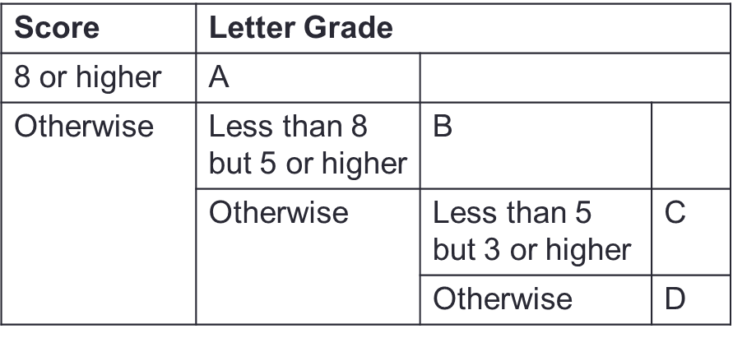
Example 2
Problem: Print a letter grade based on a score
if (…) {
// { score >= 8 }
} else {
// { score < 8 }
if (…) {
// { (score < 8) && (score >= 5) }
} else {
// { score < 5 }
if (…) {
// { (score < 5) && (score >= 3) }
} else {
// { score < 3 }
}
}
}

Slide 41
Example 2
Problem: Print a letter grade based on a score
if (score >= 8) {
// { score >= 8 }
} else {
// { score < 8 }
if (score >= 5) {
// { (score < 8) && (score >= 5) }
} else {
// { score < 5 }
if (score >= 3) {
// { (score < 5) && (score >= 3) }
} else {
// { score < 3 }
}
}
}

Slide 42
De Morgan's Law
!(e1 && e2) is the same as (!e1) || (!e2)
!(e1 || e2) is the same as (!e1) && (!e2)
Help to quickly write the assertion for false block
if (…) {
// { (birth_year >= 1995) && (birth_year <= 2005) }
} else {
// { !((birth_year >= 1995) && (birth_year <= 2005)) }
}
// { (!(birth_year >= 1995) || !(birth_year <= 2005) }
// { (birth_year < 1995) || (birth_year > 2005) }

Slide 43
Homework
Diagnostic Quizzes
Lecture 4: due 13 Feb, 2pm (extended due to PE0)
Problem Set 8/9/10
Exercise 1
Due 13 Feb, 2pm (extended due to PE0)

Slide 44
Homework
PE0 preparation
PE login procedure
Past year questions
Survey
Timing for makeup lecture in Week 6: due 13 Feb, 2pm

