Slide 1

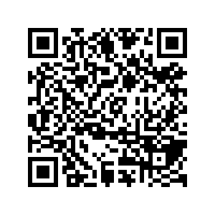
CS1010: Programming Methodology
Week 9
Recap
Live Q&A
https://pollev.com/jin

Slide 2
2D Arrays
Types
Fixed Length 2D Array
Fixed Size Array of Dynamically Allocated Array
Dynamically Size 2D Array
Syntax
Declaration / allocation / initialization
Use of 2D arrays (esp. in functions)
Problem Solving

Slide 3
Efficiency
Avoid redundant / repeated work
E.g., Check for factors up to sqrt(n) instead of n in is_prime(n)
Use an efficient algorithm as quantified by time complexity (esp. in the worst-case scenario)
for (long i = 2; i != n; i += 1) {
first = second;
second = third;
third = first + second;
}
O(n)
long fib(long n) {
if (n == 1 || n == 2)
return n;
else
return fib(n-1) + fib(n-2);
}
long fib(long n) {
if (n == 1 || n == 2)
return n;
else
return fib(n - 1) + fib(n - 2);
}
O(2^{n})
O(1) < O(log n) < O($\sqrt{n}$) < O(n) < O(n²) < O(n³) < … < O(2^{n}) < O(3^{n})

Slide 4
Problem Solving with 2D arrays
Tic-Tac-Toe (n x n grid)
0 / 1 / 2 → empty, player 1, player 2
How to know whether player 1 has won?
How many different algorithms can you think of?
What is the time complexity of each algorithm?
1
0
2
0
1
1
2
2
2

Slide 5
Problem Solving with 2D arrays
Tic-Tac-Toe (n x n grid)
0 / 1 / 2 → empty, player 1, player 2
How to know whether player 1 has won?
Example: Count the number of 1s in each row + column + diagonal, and then check whether the count equals n.
For each line (row/column/diagonal)
n operations to check whether the value in the cell is 1
Up to n operations to increase the count
1 operation to check whether the count is 1
Total:
(n+n+2) lines of (n+n+1) operations = 4n²+6n+2 = ~= O(n²)
1
0
2
0
1
1
2
2
2
How about the best- case scenario?

Slide 6
Problem Solving with 2D arrays
Tic-Tac-Toe (n x n grid)
0 / 1 / 2 → empty, player 1, player 2
How to know whether ANY player has won?
Check whether player 1 has won and then check whether player 2 has won…, or
Check whether player 1 and player 2 has won at the same time…
Does these two approaches differ in terms of time complexity?
Not really…
It is often better to focus on modularity / reusability
1
0
2
0
1
1
2
2
2

Slide 7
Review past programming exercises.
Focus on correctness but start to think about efficiency!

