Slide 1
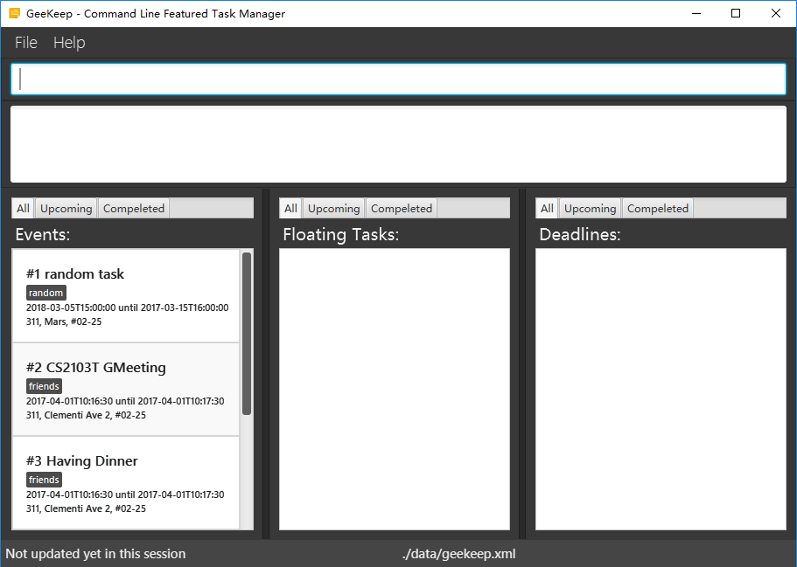
CommandBox
ResultDisplay
TaskListPanel
TaskListPanel
TaskListPanel
StatusBarFooter

