Slide 1
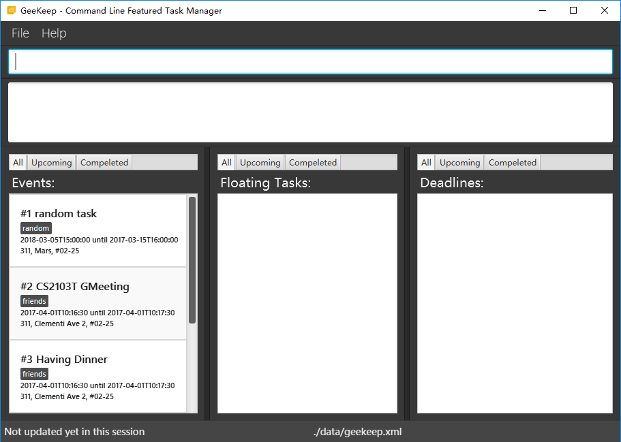
Command Box
Result Display
Event List Panel
Floating Task List Panel
Deadline List Panel
Status Bar Footer

