Slide 1
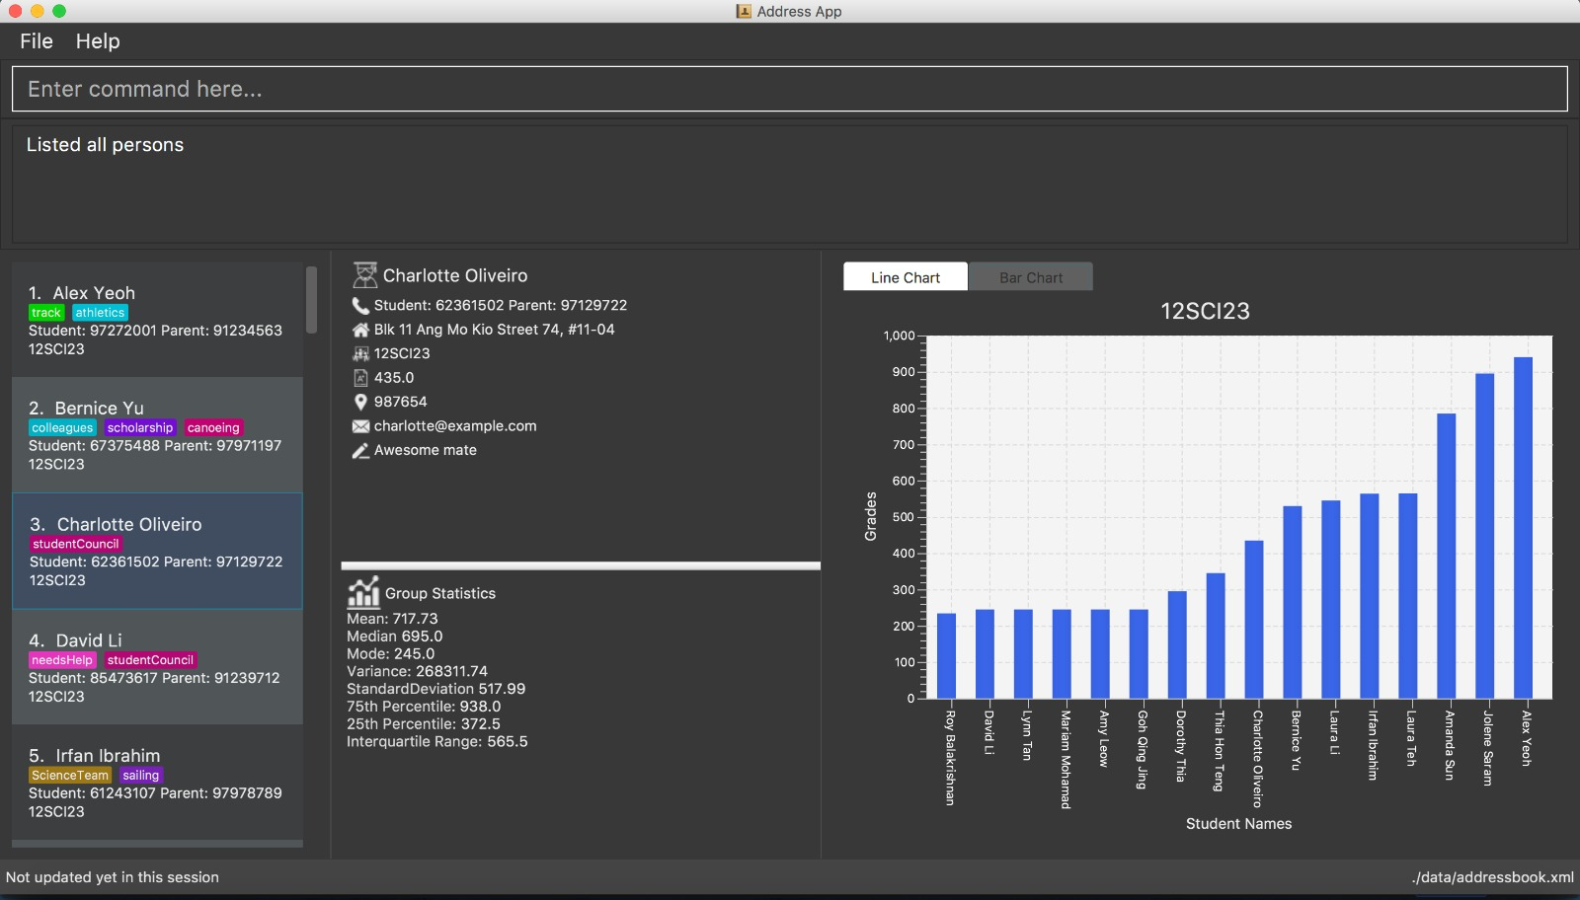
1. Command Box
1
2
2. Status Panel
3
4
6
3. Students Panel
4. Student Details Panel
5. Statistics Panel
5
6. Graph Panel

