Slide 1
Augustine at A Glance

Slide 2
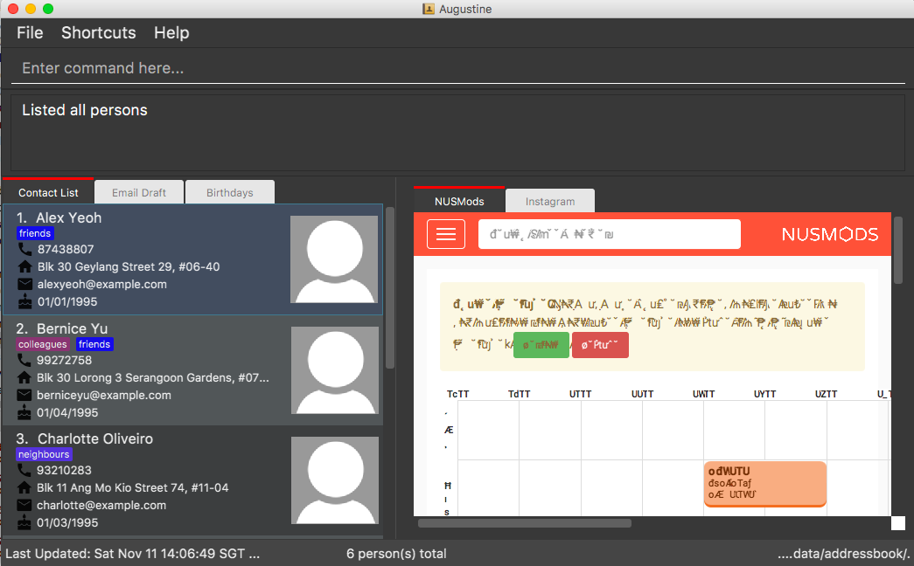
Menu Bar
Command Box
Result Display of executing command
Display Tabs (contact list is currently selected)
Index of person in contact list
Browser Tabs (NUS mods is currently selected
Status Bar

Slide 3
Add Feature

Slide 4
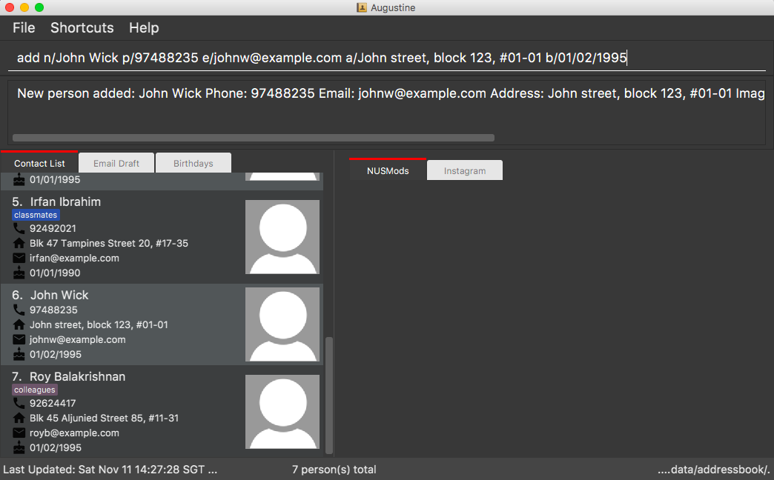

Slide 5
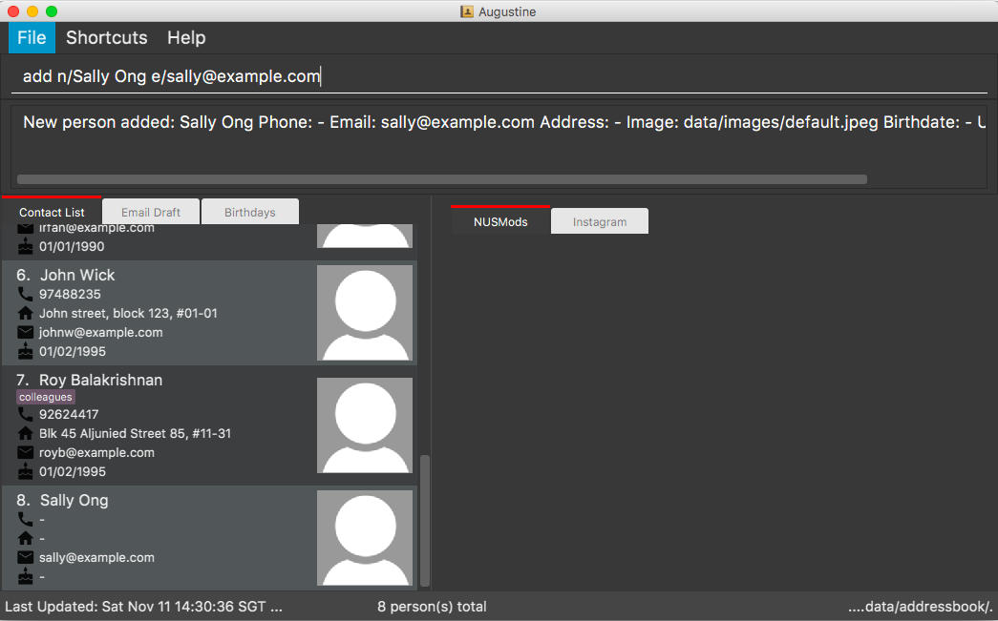

Slide 6
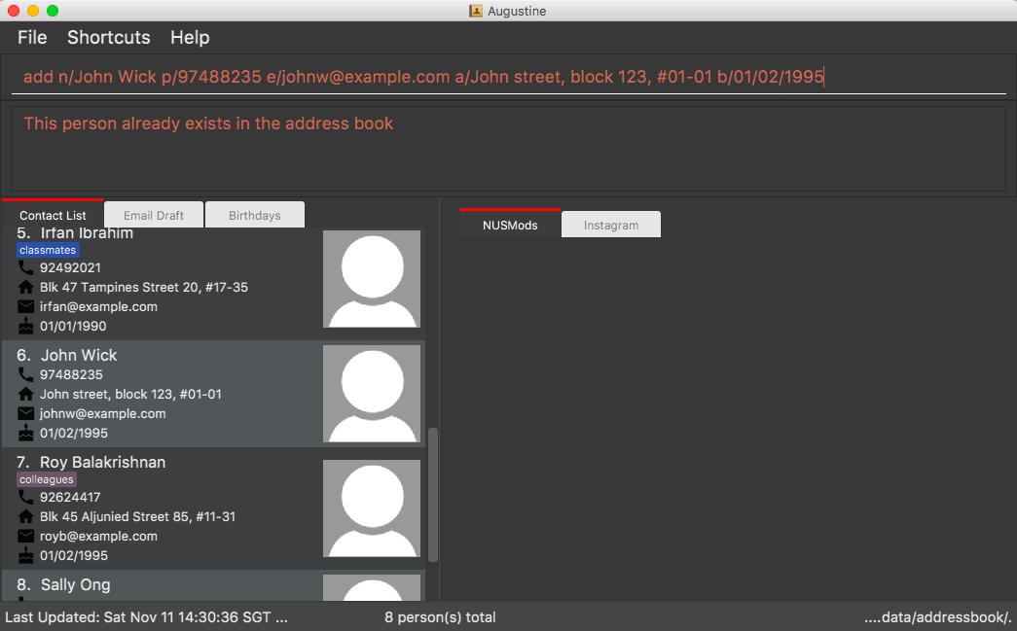

Slide 7
Delete Feature

Slide 8
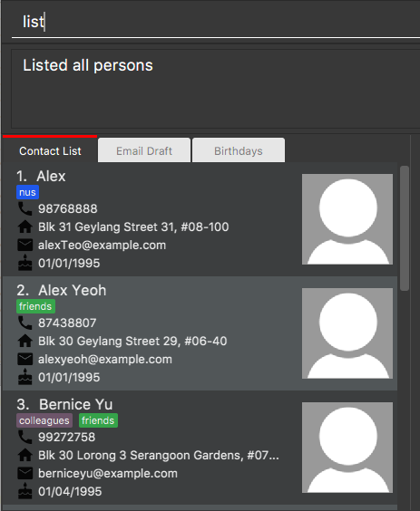
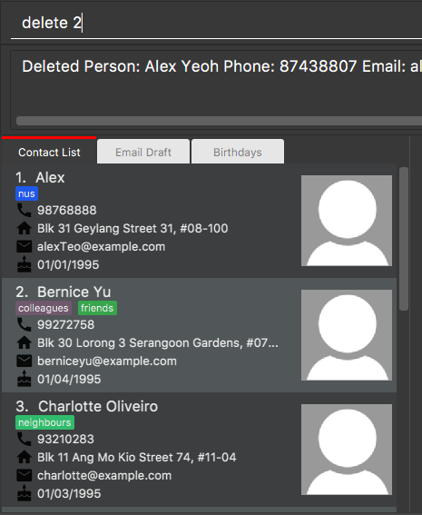
Before
After

Slide 9
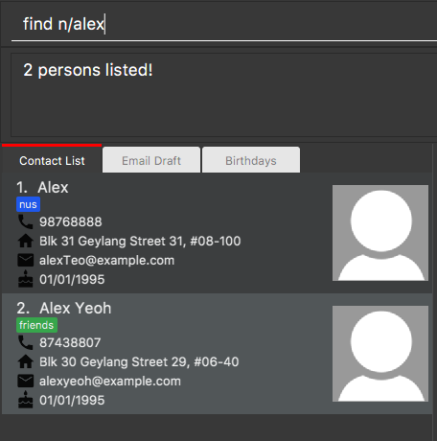
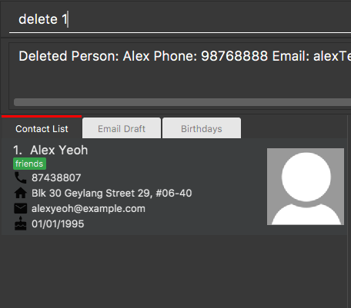
Before
After

Slide 10
Email Feature

Slide 11
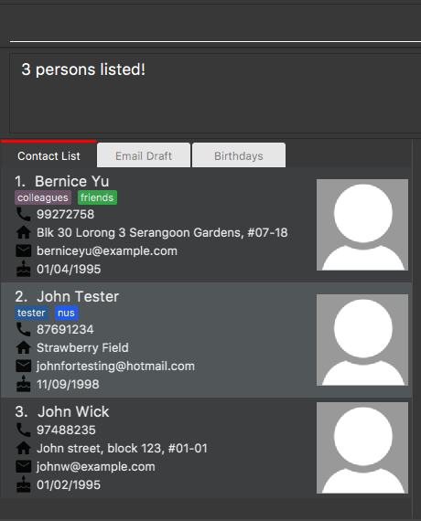
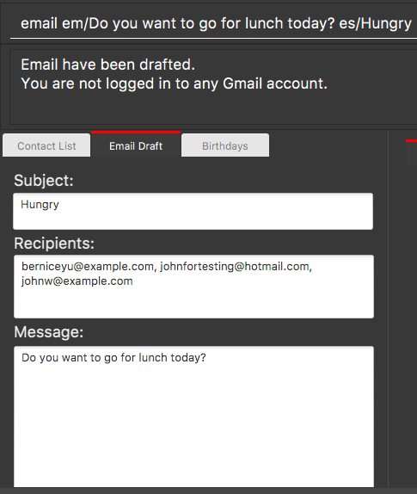
Contacts currently displayed in Augustine

Slide 12
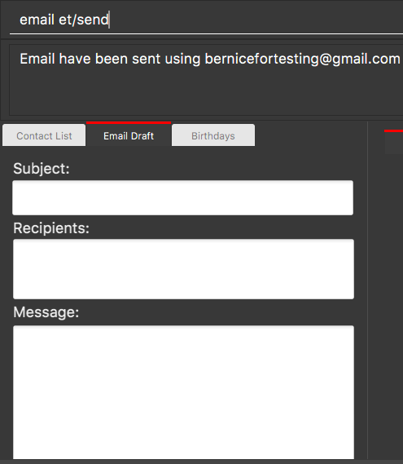
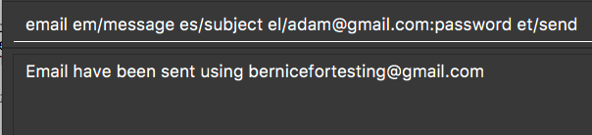

Slide 13
Email Activity Diagram

Slide 14
User inputs email command
[incorrect format]
[correct format]
Display error message to user
Execute email command
[clear draft]
[compose draft]
Reset email draft content
Updates email draft content and user’s login details
[don’t send email]
[send email]
Display email cleared message to user
Display email drafted message to user
Send email
[sending fail]
[sending successful]
Display error message to user
Display email sent message to user

Slide 15
Email Sequence Diagram

Slide 16
:UI
:Logic
:Model
:Email
:EventsCenter
Email
Executes(“Email”)
getFilteredPersonList()
lastShownList
extractEmails
FromContacts
(lastShownList)
loginEmail(loginDetails)
loginEmail(loginDetails)
sendEmail(message)
sendEmail(message)
post(EmailDraftChangedEvent)

Slide 17
:Email
:EmailLogin
:EmailCompose
:EmailSend
loginEmail(loginDetails)
loginEmail(loginDetails)
sendEmail(message)
composeEmail(message)
sendEmail(EmailLogin, EmailCompose)

Slide 18
:UI
:EventsCenter
post(EmailDraftChangedEvent)
HandleEmailDraftChangedEvent()
Update Email Draft Tab

