Slide 1
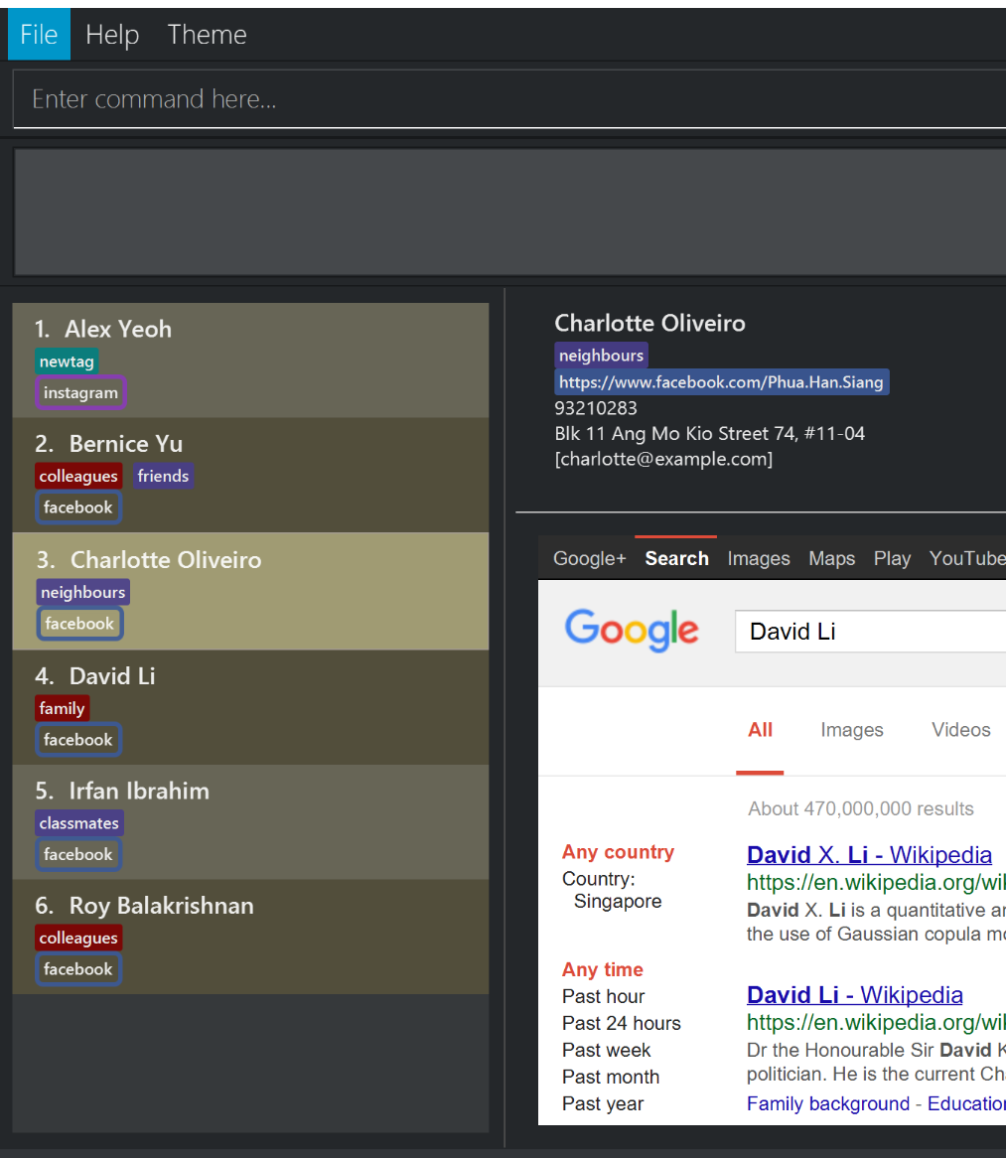
-fx-base-background-color-1
-fx-base-background-color-0
-fx-list-cell-even
-fx-list-cell-odd
-fx-list-cell-selected
-fx-list-cell-empty

