Slide 1
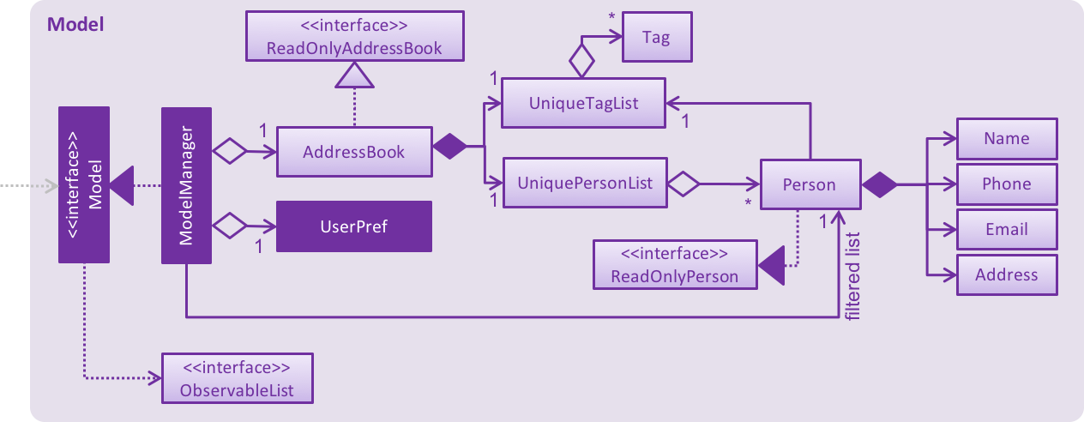
1
Task
UniqueReminderList
Reminder
1
*
Priority
1
<<interface>>
ReadOnlyReminder
Date
filtered list
Message

