Slide 1
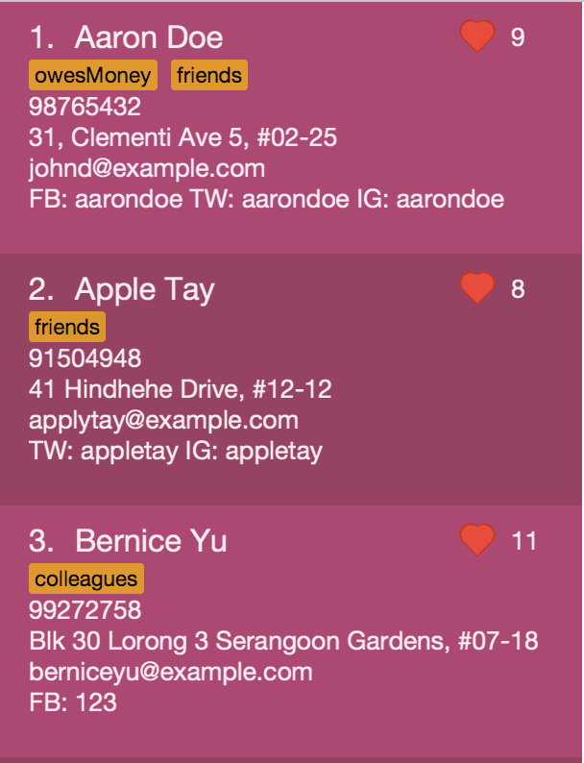
Number of Accesses
Social Media Accounts
Tags

