Slide 1
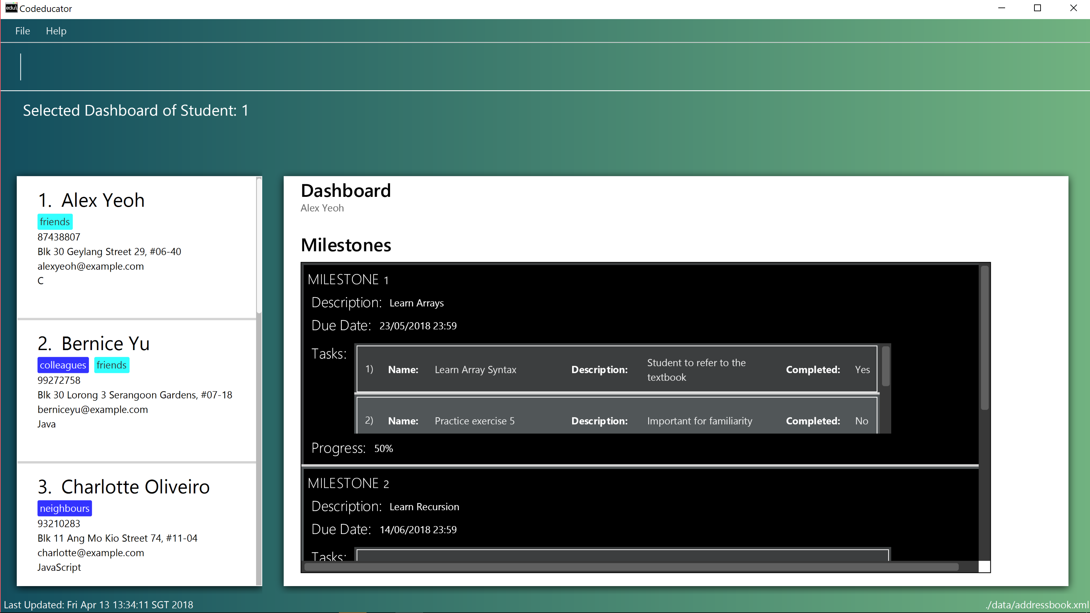
This is the list of tasks in a milestone
This is the list of milestones in your student’s dashboard

