Slide 1
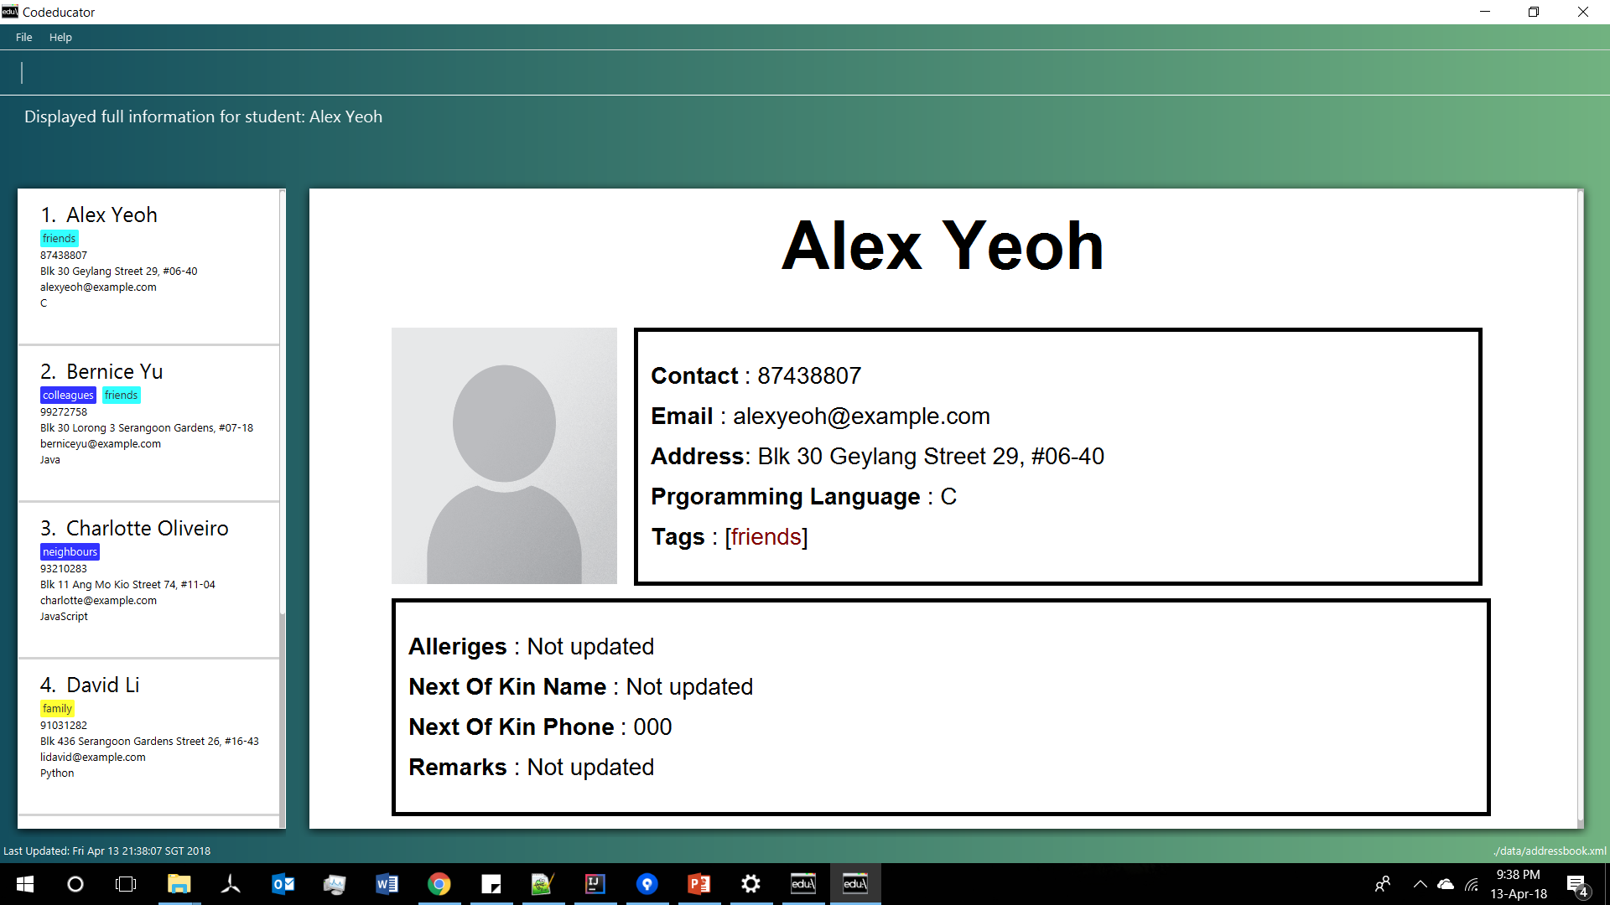
This portion consists of your student’s main information, which can be found on the student list panel on the left
This portion consists of your student’s miscellaneous information. It is only visible to you when you enter the ‘moreInfo’ command

Slide 2
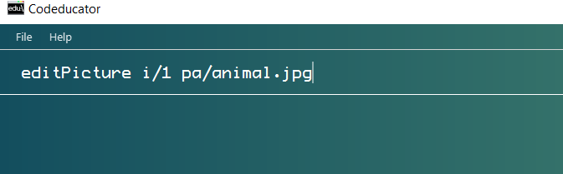
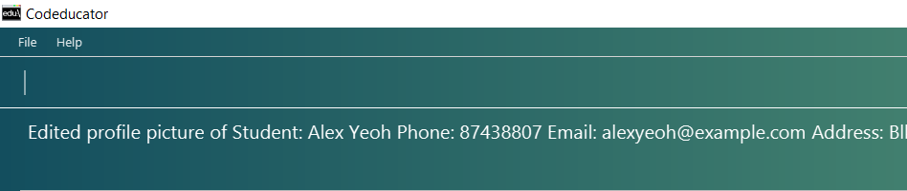
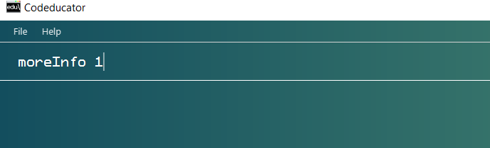

Slide 3
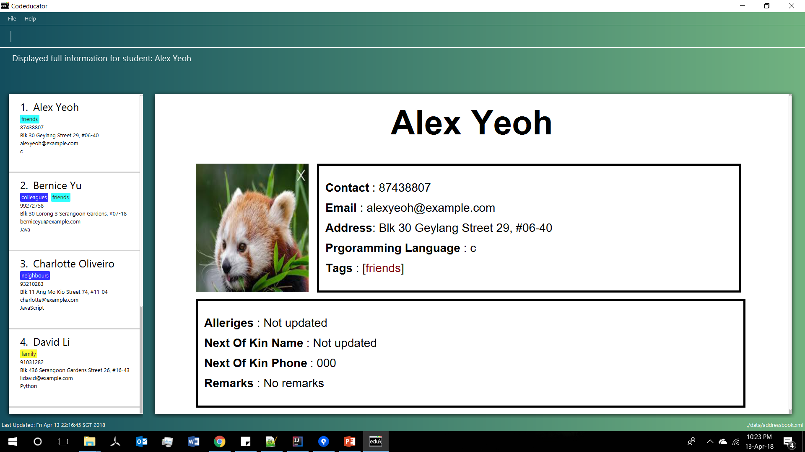

Slide 4


Slide 5
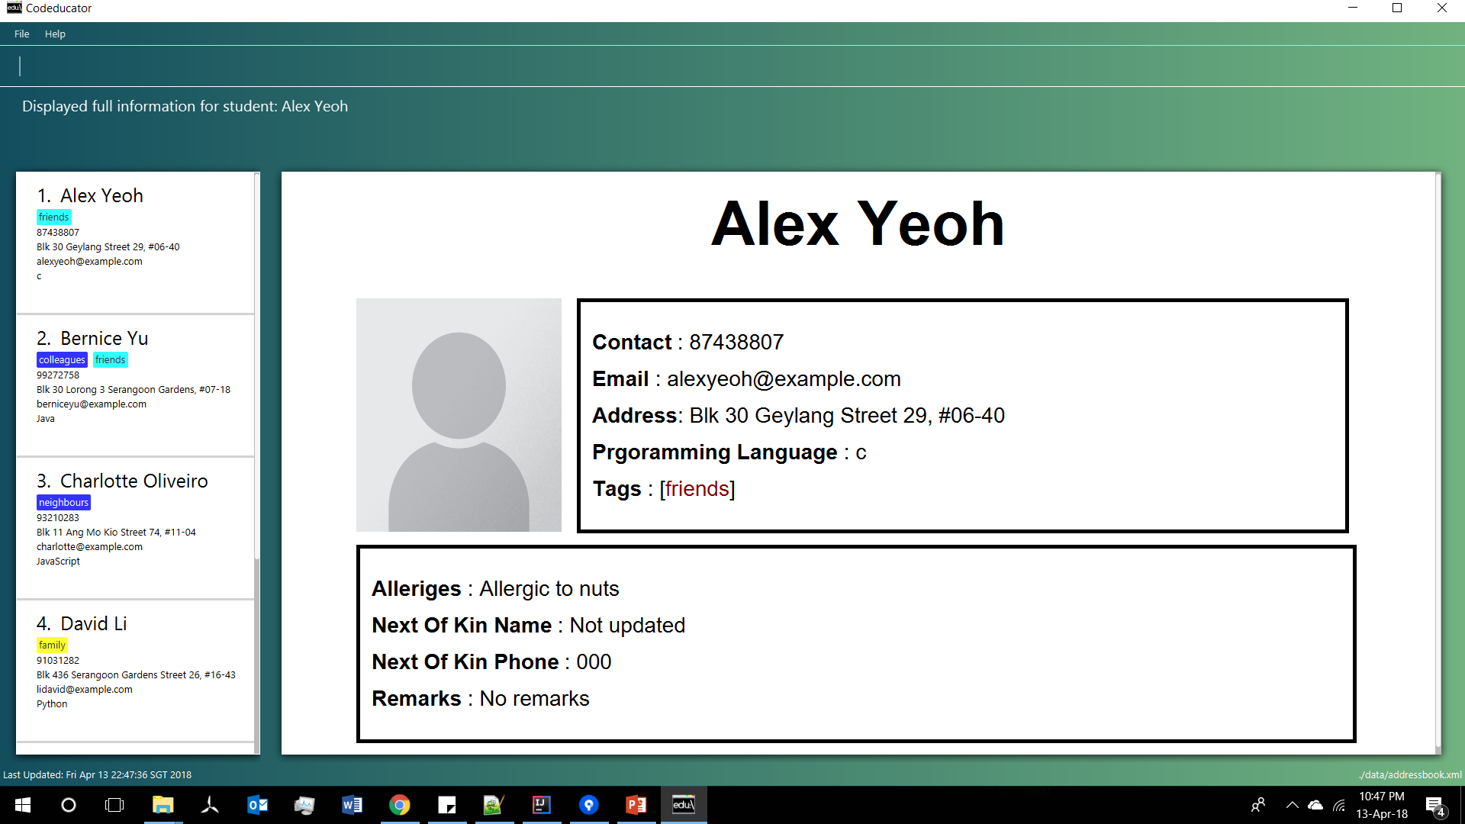
This portion is updated from “Not updated” to “Allergic to nuts”

