Slide 1
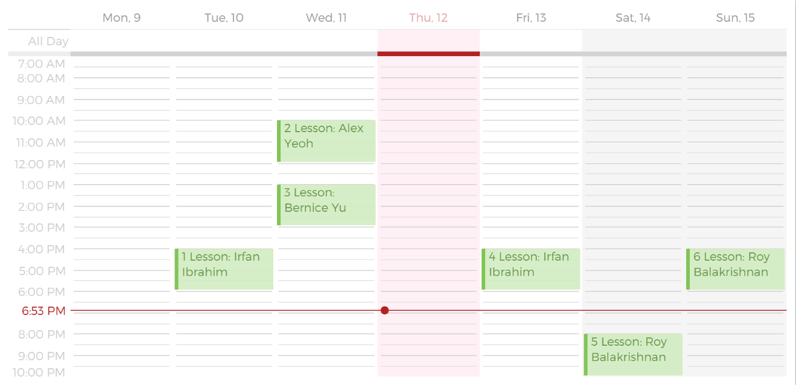
This is a Lesson in your Schedule
This is the Lesson Display Index
This is the Student you are having the Lesson with

Slide 2
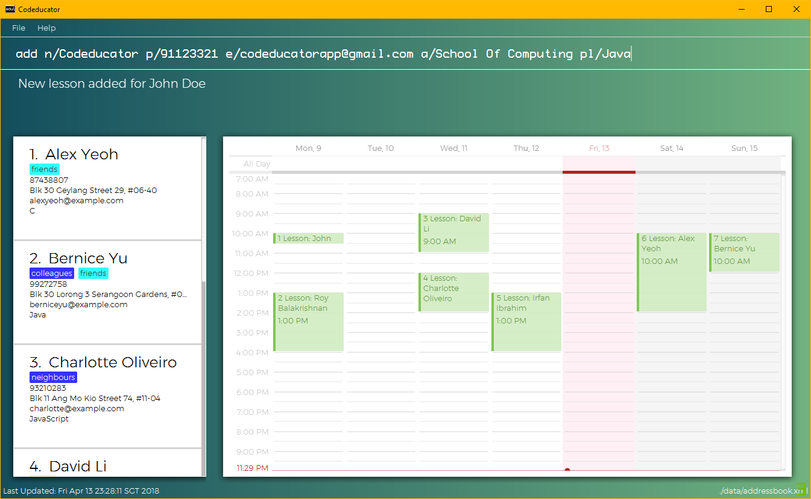
1. Command Box
2. Command Result Box
3. Contacts List
4. Infopanel
5. Status Bar

Slide 3
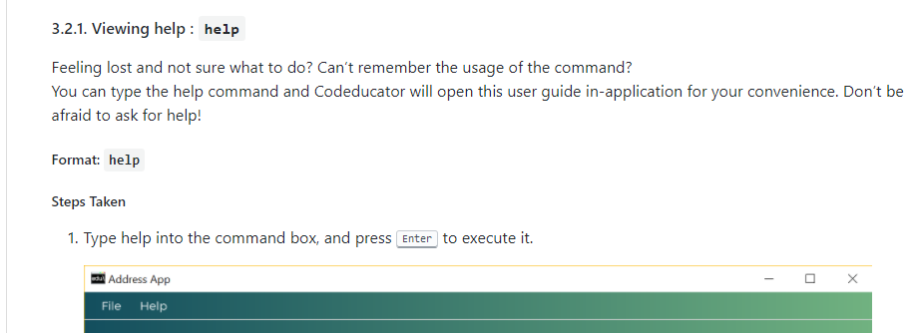
1. Feature Title
2. Description and use case
3. Format of Command
4. Steps Taken

