Slide 1
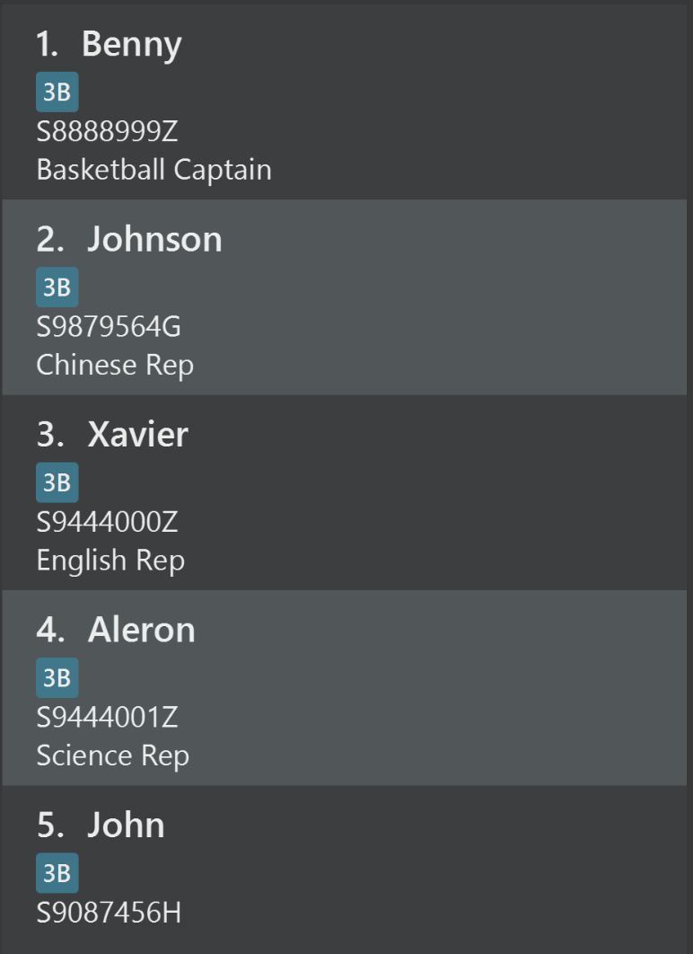
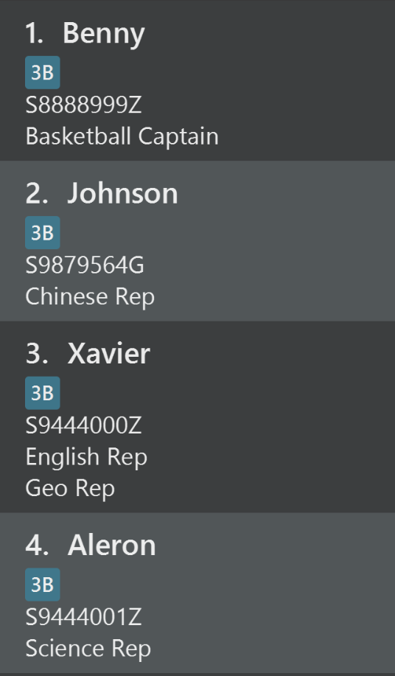

Before
After
Remark
Added

Slide 2
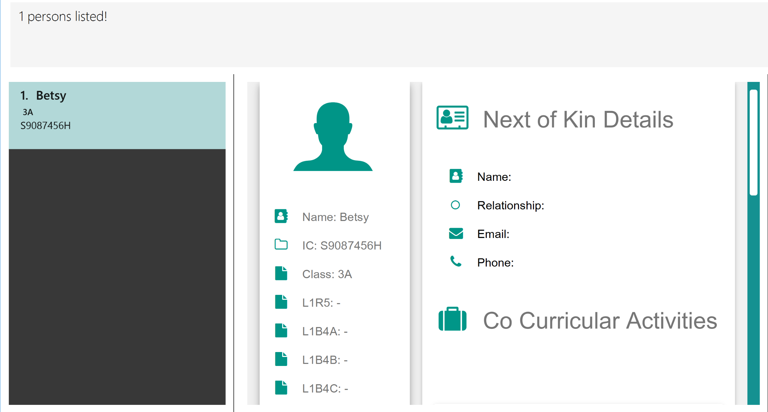
2. Scroll down and you will see the updated injury history
1. Type in “find Betsy” and “select 1”
2. You will see that the Next of Kin portion is empty

Slide 3
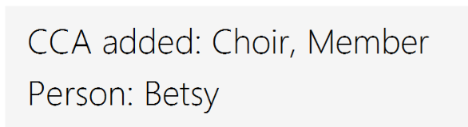

Slide 4
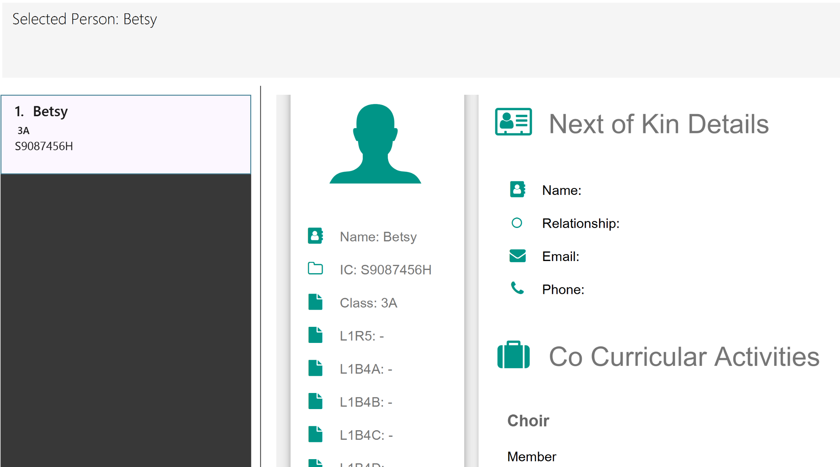
1. Type in “find Betsy” and “select 1” again
2. Scroll down and you will see the updated CCA details

