Slide 1
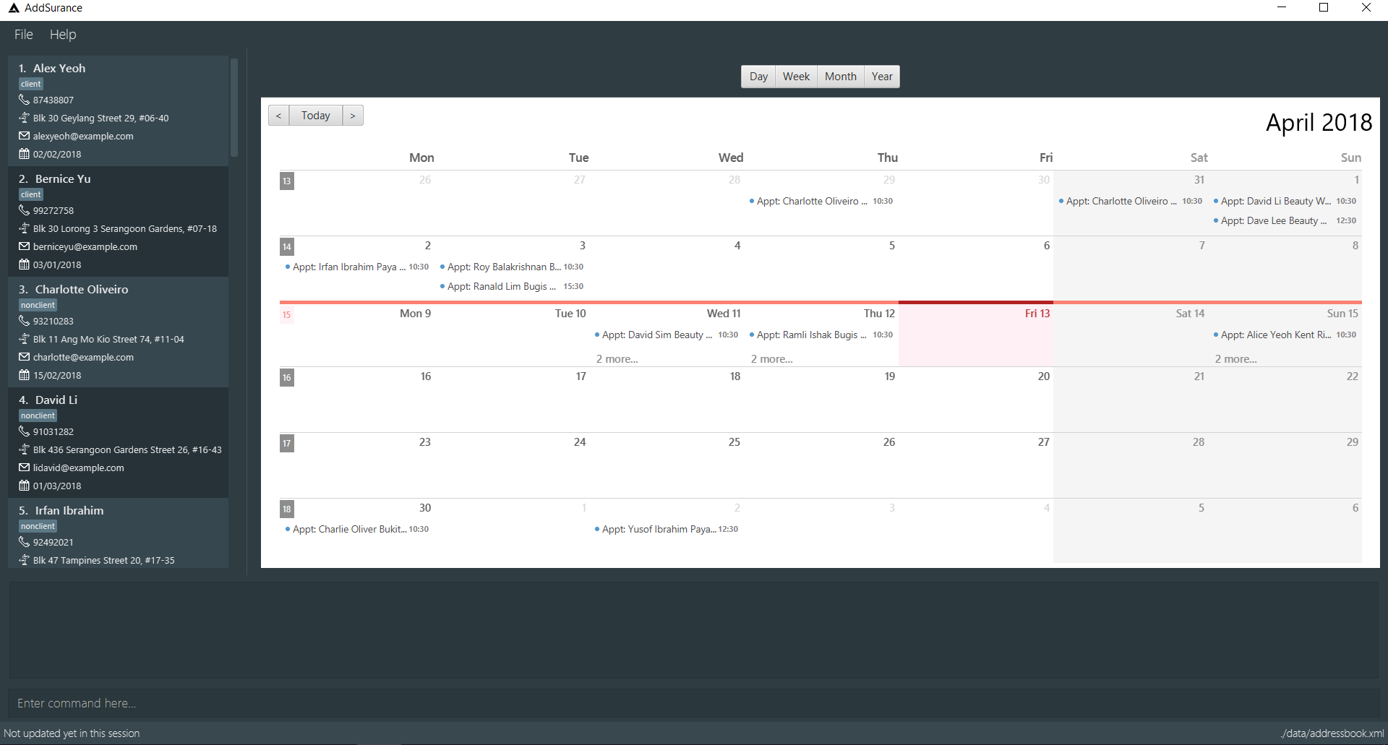
Help Tab
Click on this tab to display the help screen
Calendar Page Switcher
Controls which view to show
File Tab
Click on this tab and select “Exit” to quit
Person List Panel
Displays contacts in the address book
Calendar Panel
Displays appointments in the address book
Result Display
Displays results of executed commands
Command Box
Type in your command here
Status Bar
Shows when the address book was last updated

