Slide 1
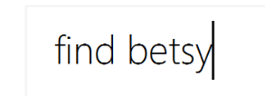

Slide 2
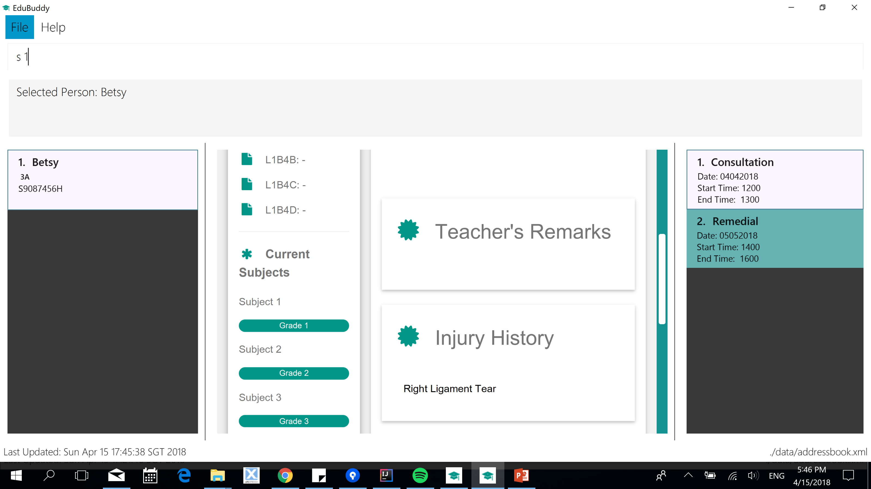

Slide 4
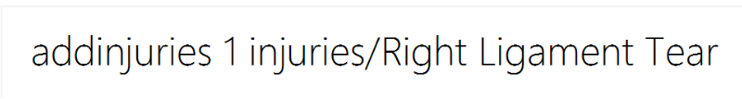

Slide 5
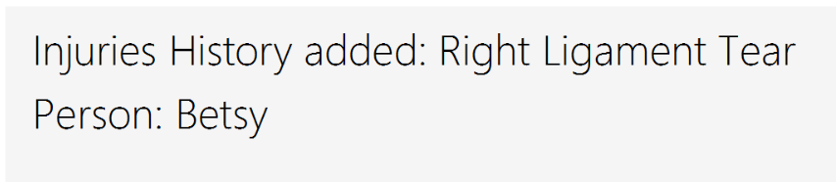

Slide 6

1. Type in “find Betsy” and “select 1” again
2. Scroll down and you will see the updated injury history

Slide 7
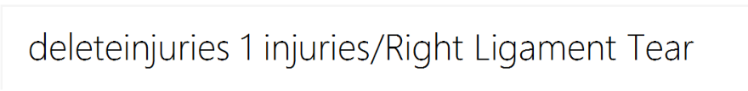

Slide 8
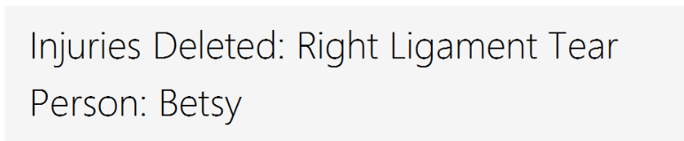

Slide 9
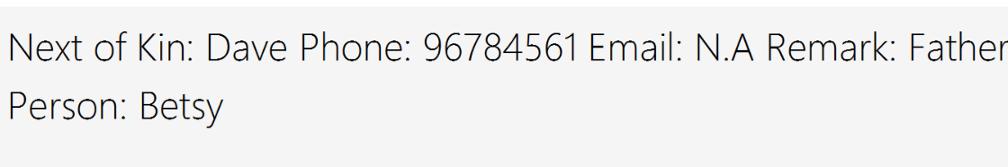

Slide 10
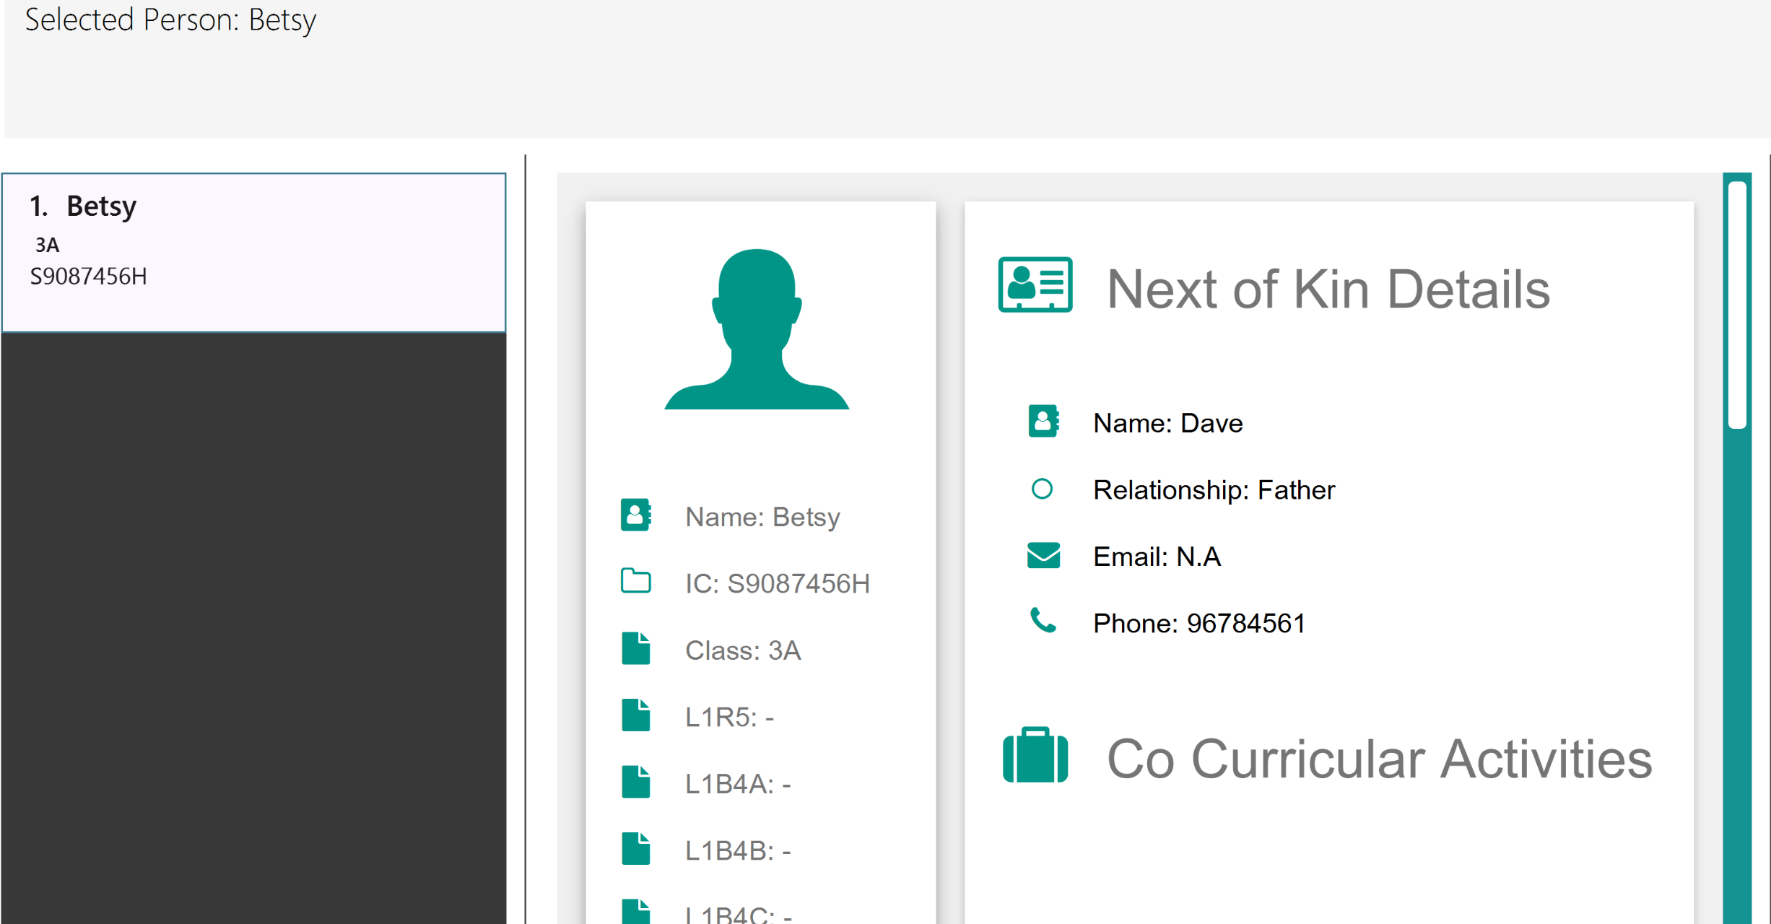
1. Type in “find Betsy” and “select 1” again
2. You will see the updated next of kin details

