Slide 1
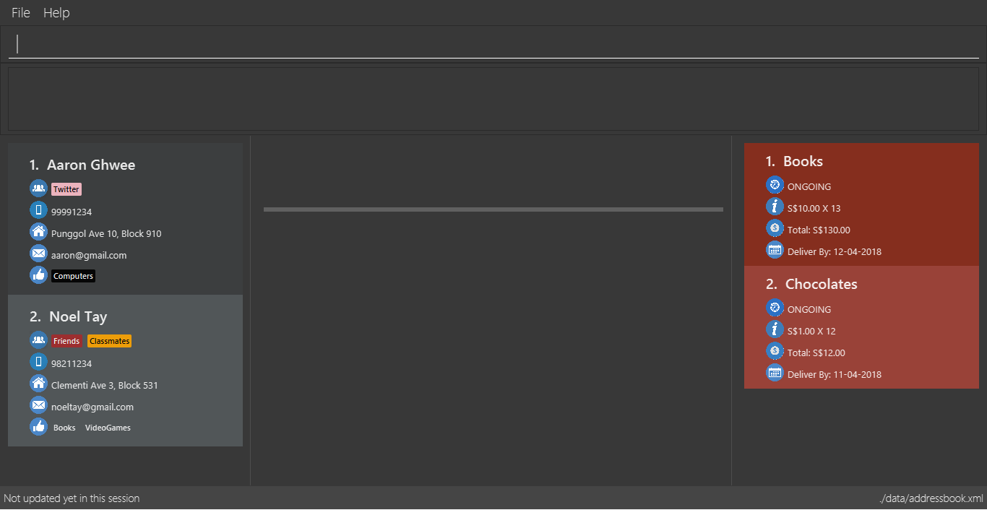
Command Box
Result Display
Person List
Panel
Right Panel
Center Panel

