Slide 1
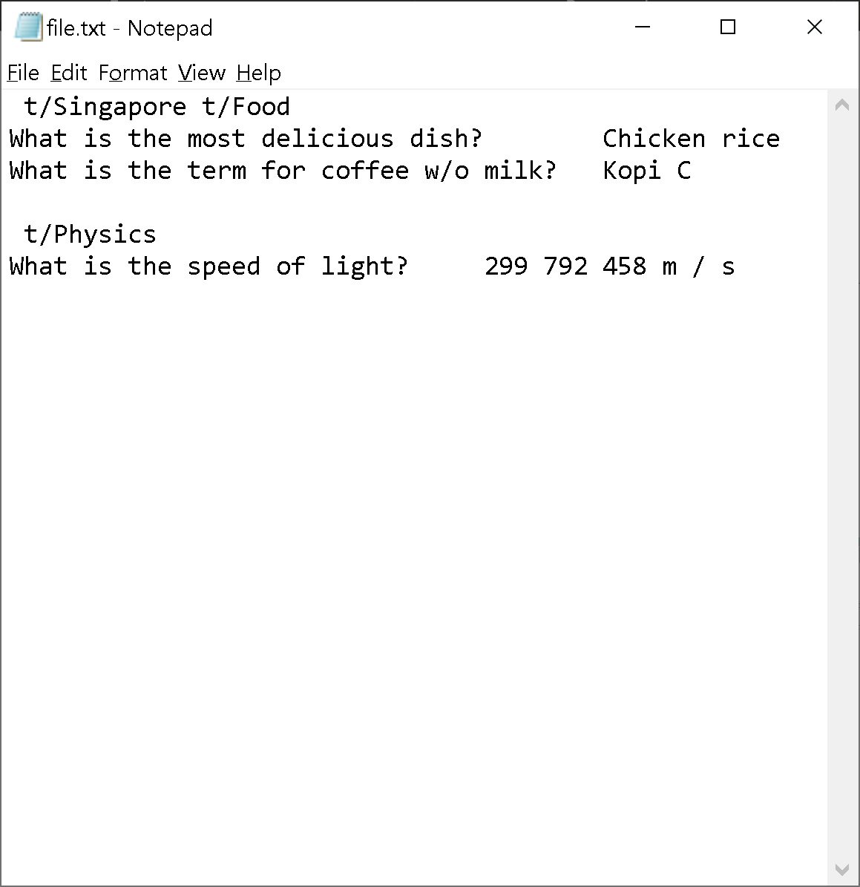
Between Question and Answer: TAB
Before each topic: SPACE + prefix “t/”
Between Cards: NEW LINE
Notes:
Formatting however you want, separate topics
Unhappy with your import, use undo! To revert to status before import

Slide 2
Enter import command

