Slide 1
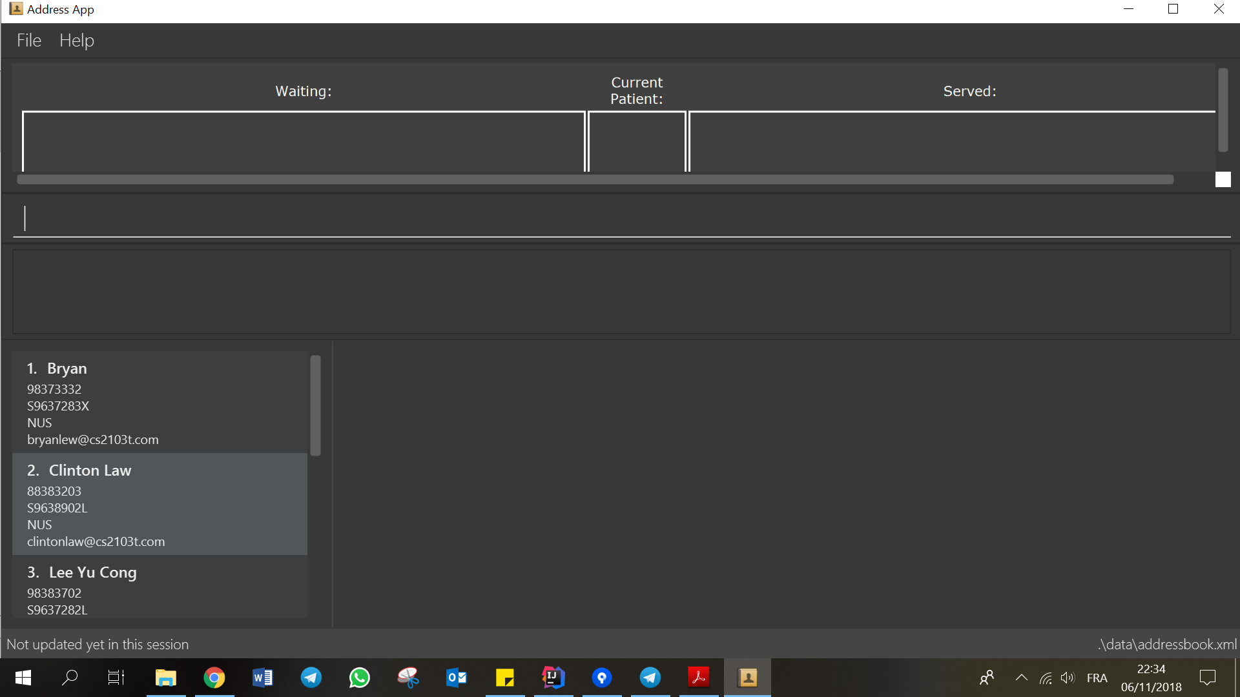
liststock

Slide 2
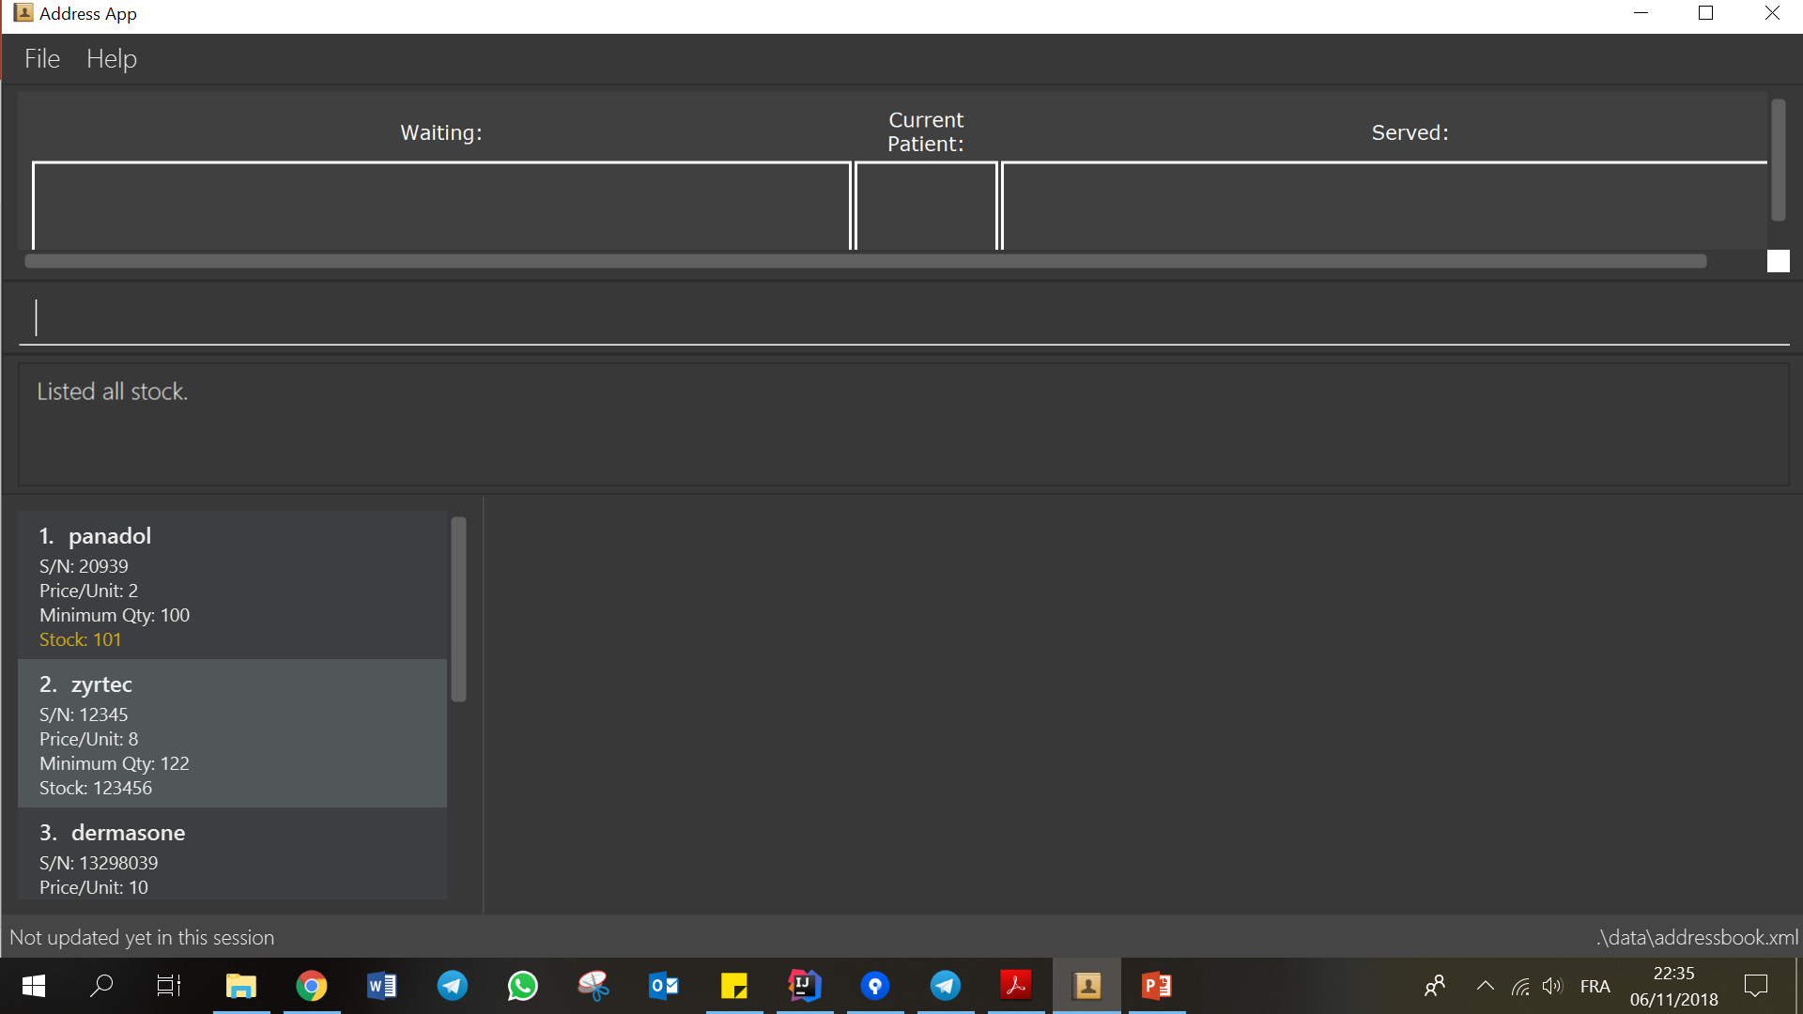

Slide 3
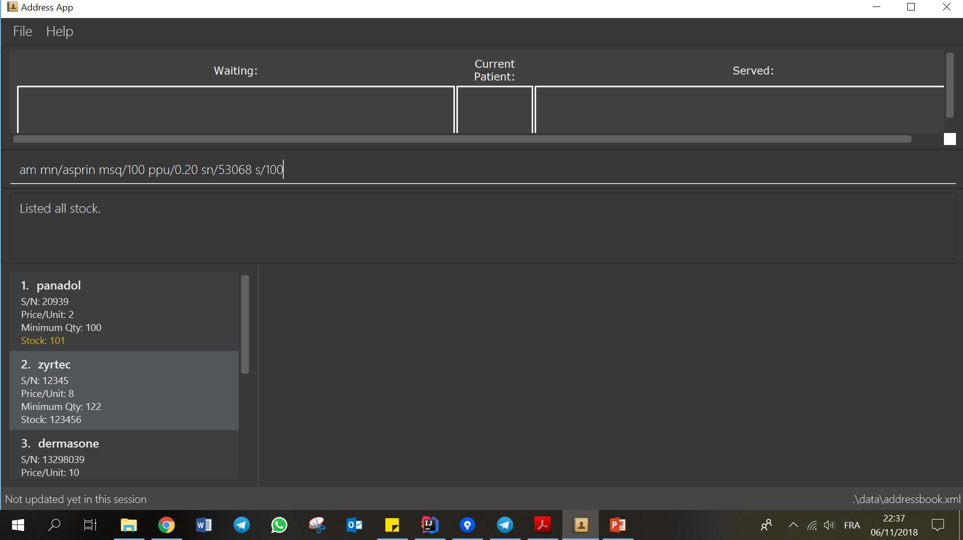

Slide 4
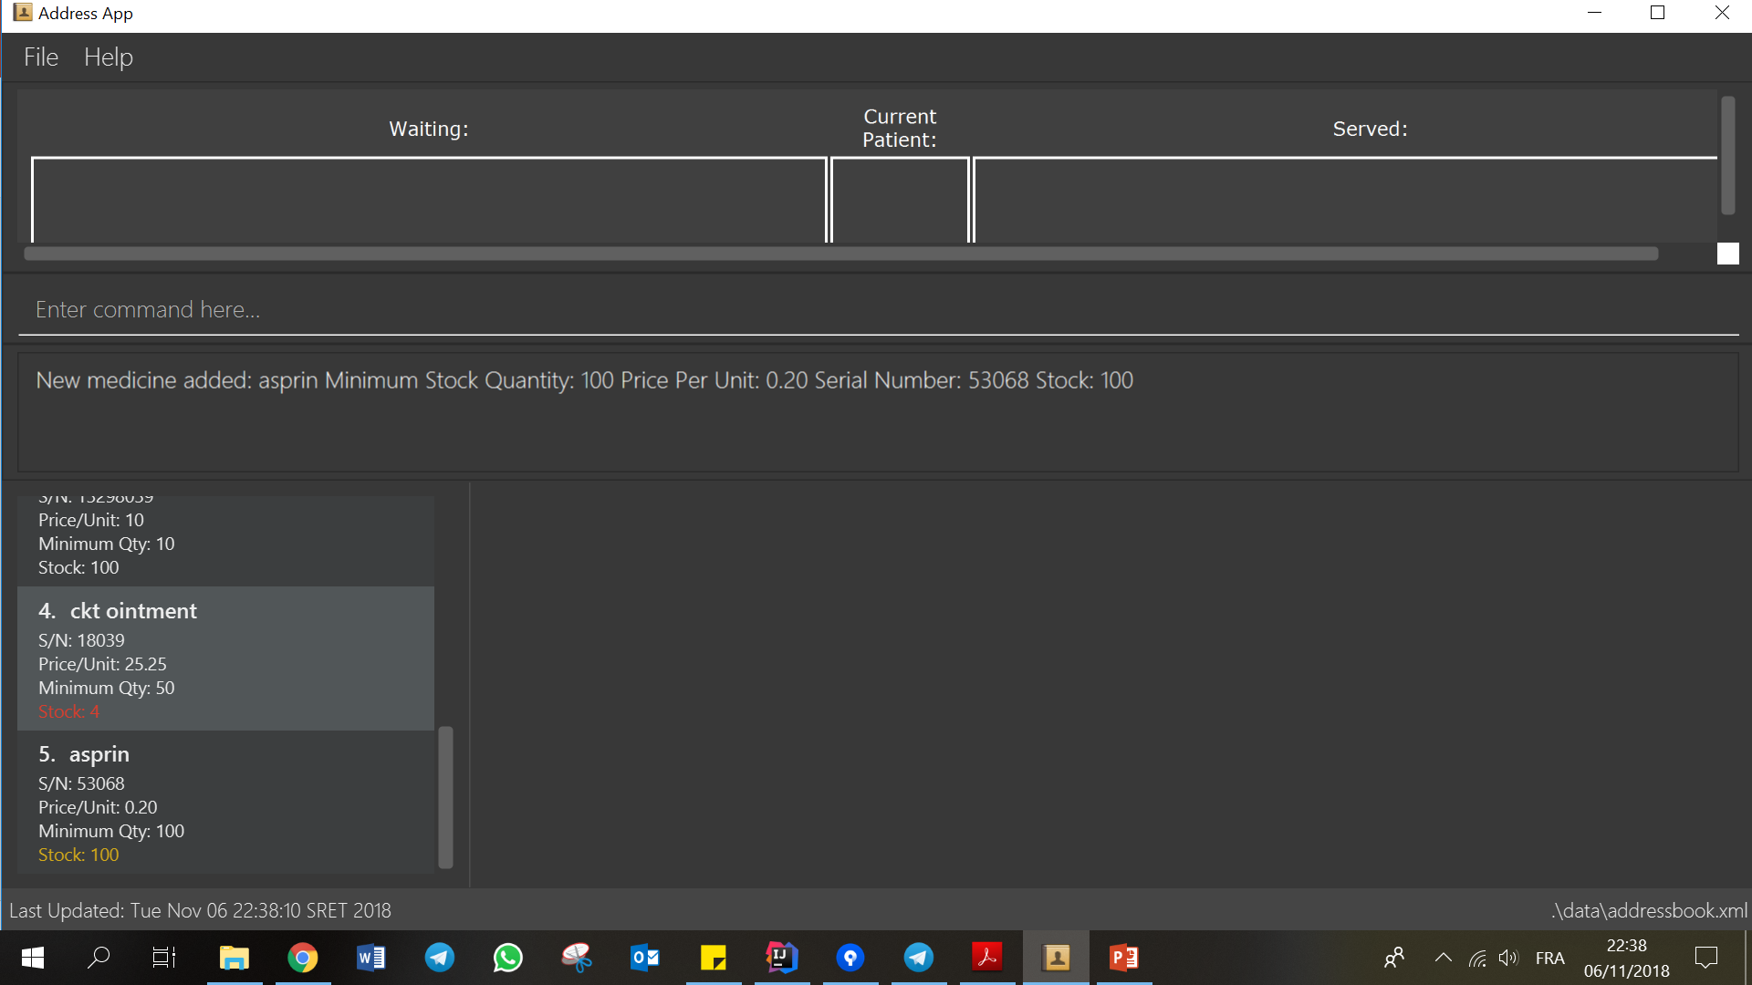
New medicine added is located at the last of the list.
Scroll all the way down to see it!

Slide 5
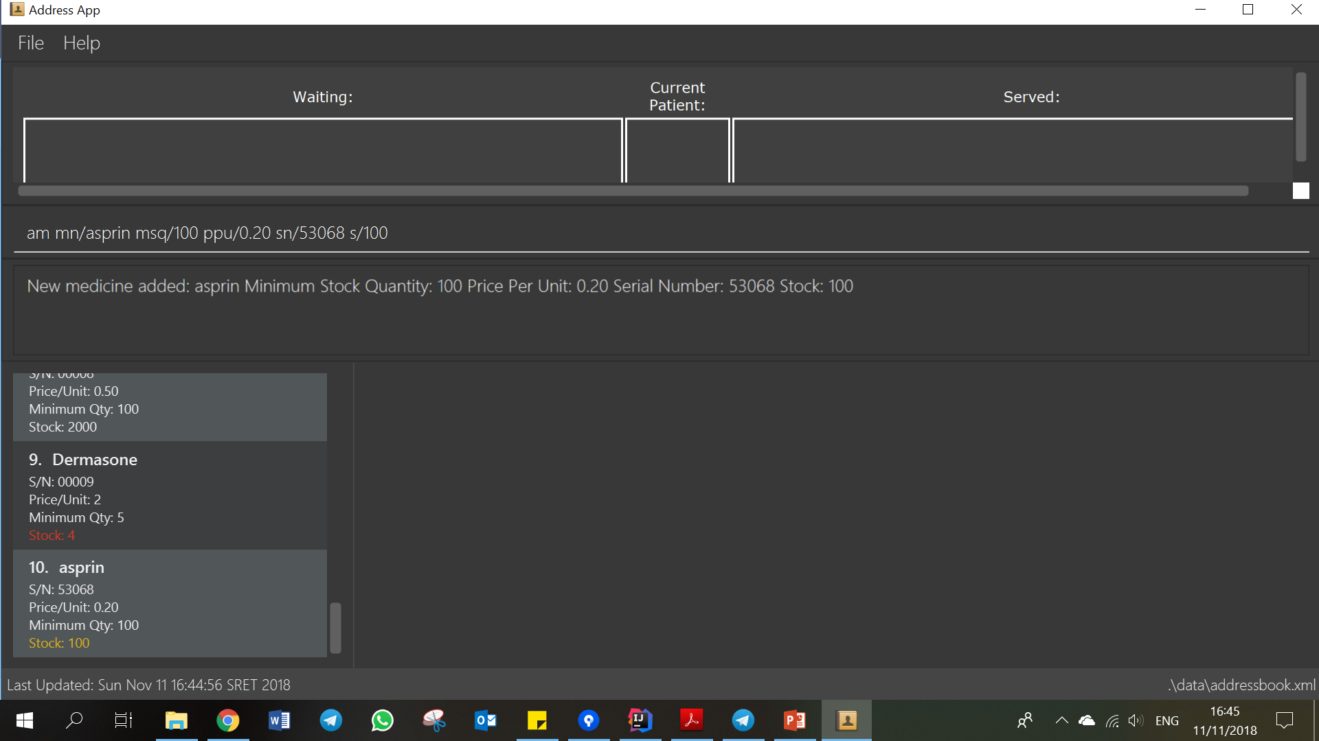
Step 1. Type the command in the command box with the desired parameters.
Step 2. Scroll all the way down
to see the new medicine.

