Slide 1
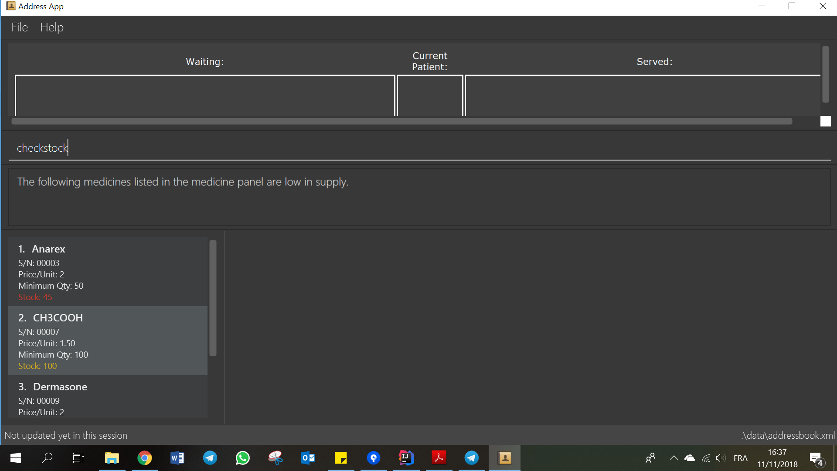
Step 1. Type “checkstock” into the command box.
Step 2. See the medicine panel for the
list of medicines that are low in stock.

