Slide 1
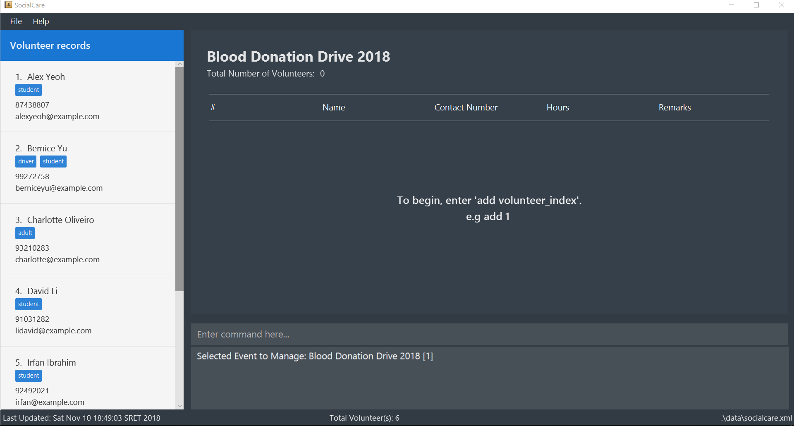
2
1
3
Notes:
Manage record

Slide 2
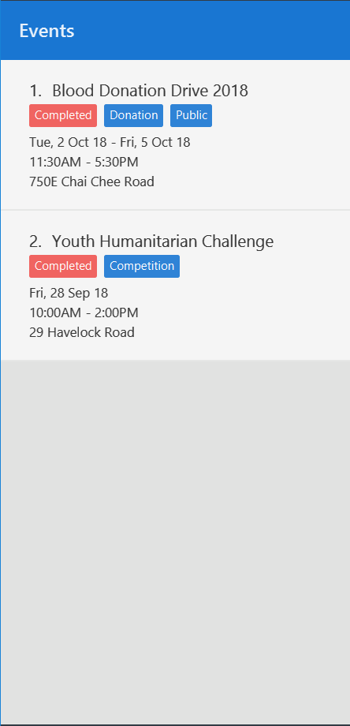
Notes:
Event at index 1

Slide 3
Notes:
Add record- event index

Slide 4
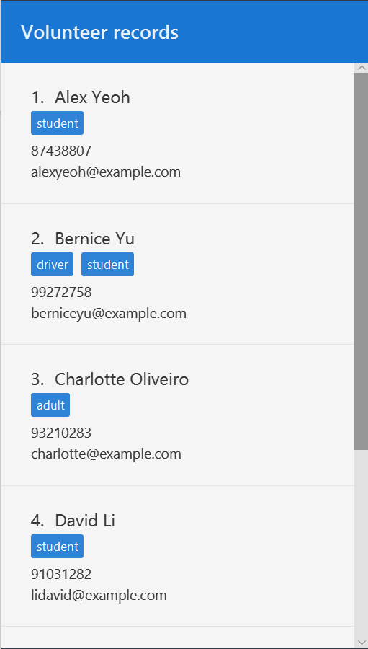
Notes:
Add record- volunteer index

Slide 5
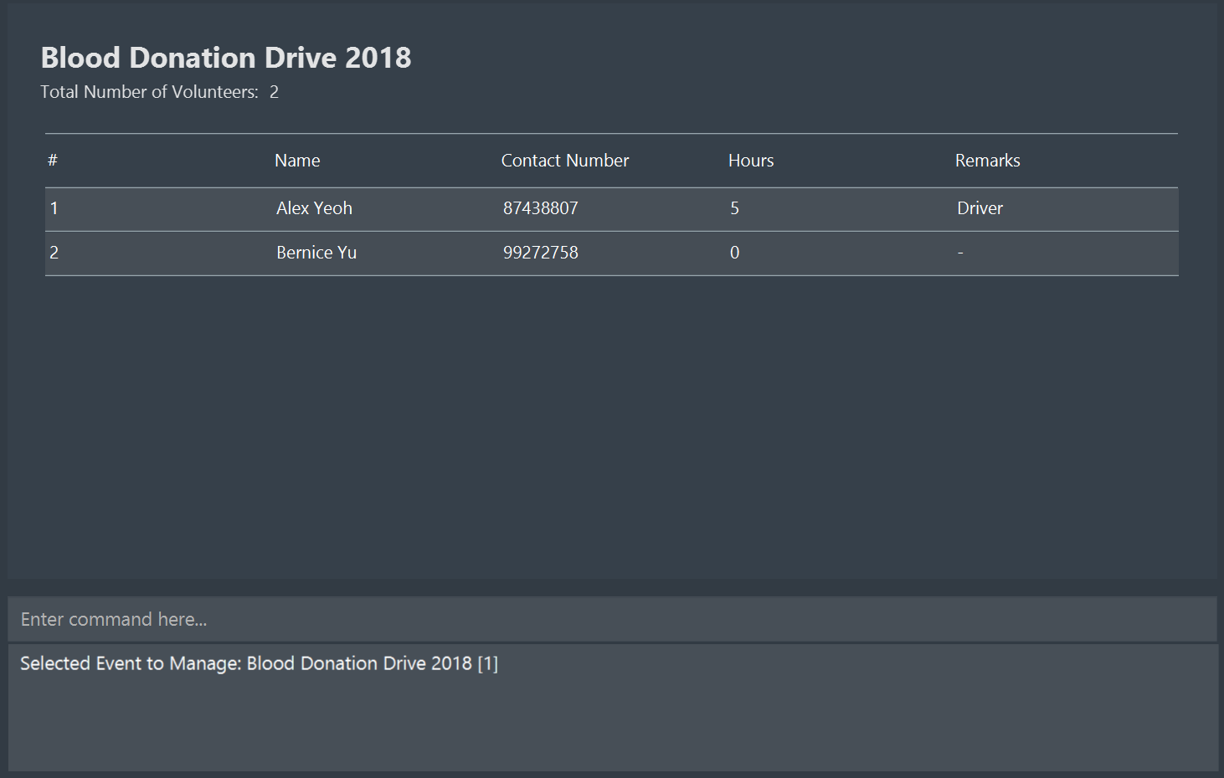
Notes:
Edit record- volunteer index

Slide 6
Notes:
Edit record- before

Slide 7
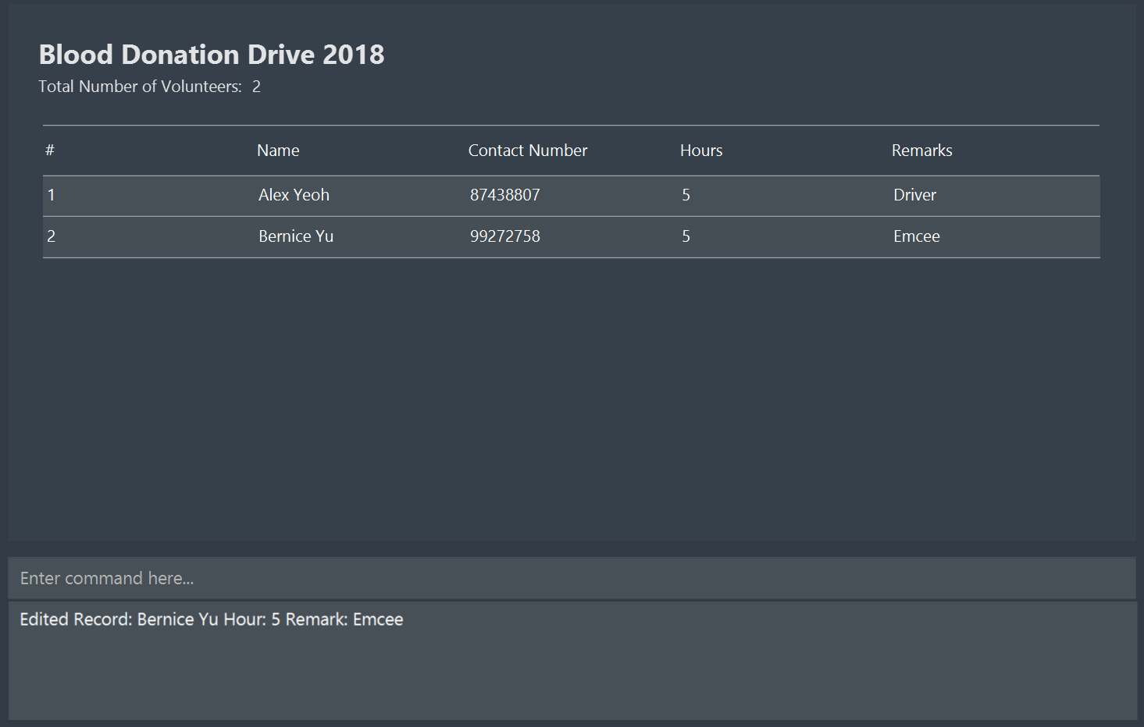
Notes:
Edit record- after

