Slide 1
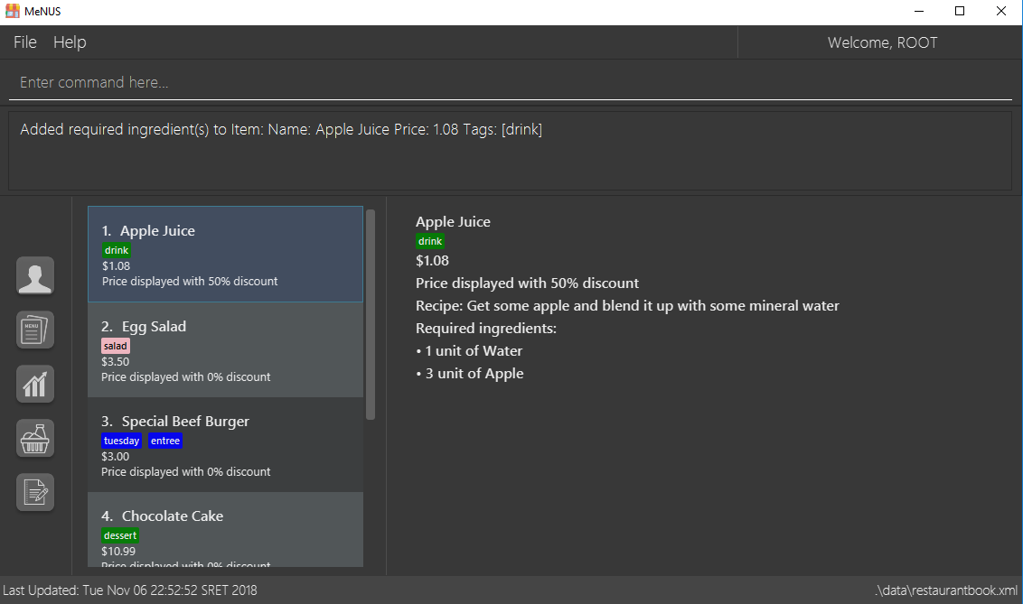
Menu
Username
Command Box
Result Box
Navigation Bar
List of Data
Data’s Details
Last Updated
Data File Location

