Slide 1
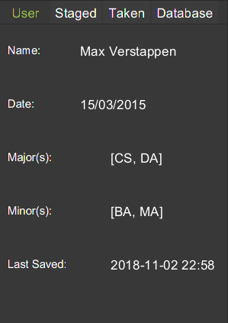
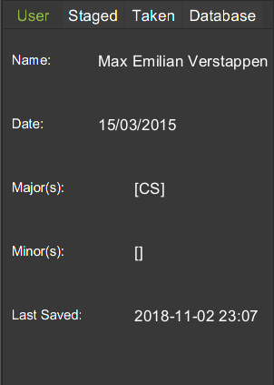
Fig 3a. Before execution of Edit command.
Fig 3b. Expected UI Output(Edit Command)

