Slide 1
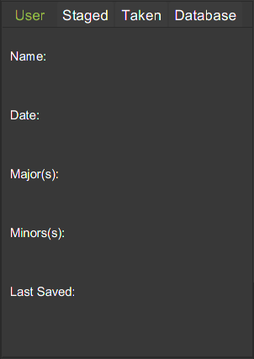
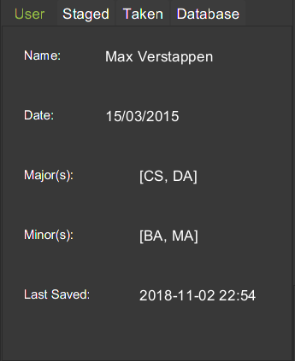
Fig 2a. Before execution of Login command.
Fig 2b. Expected UI Output(Login Command)

Slide 2


