Slide 1
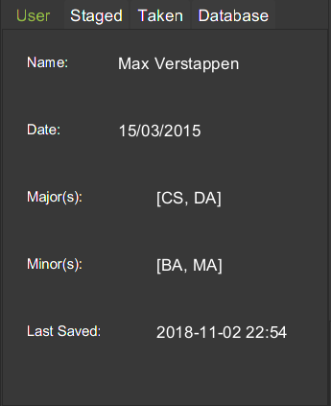
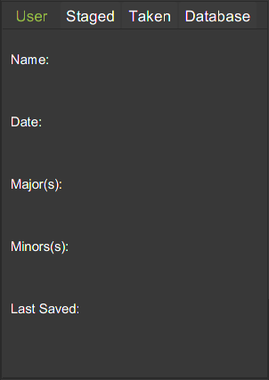
Fig 4a. Before execution of Logout command.
Fig 4b. Expected UI Output(Logout Command)

Slide 2


