Slide 1
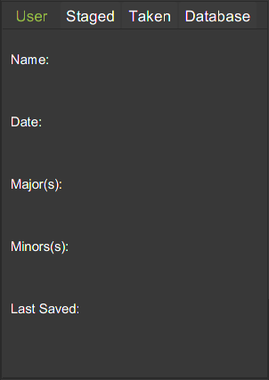
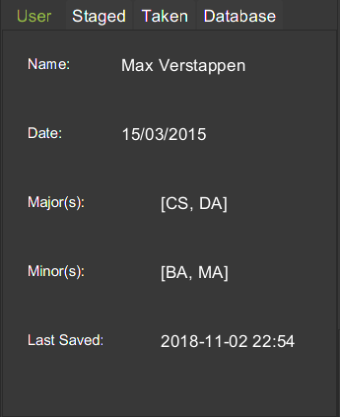
Fig 1a. Before execution of Register command.
Fig 1b. Expected UI Output(Register Command)

