Slide 1
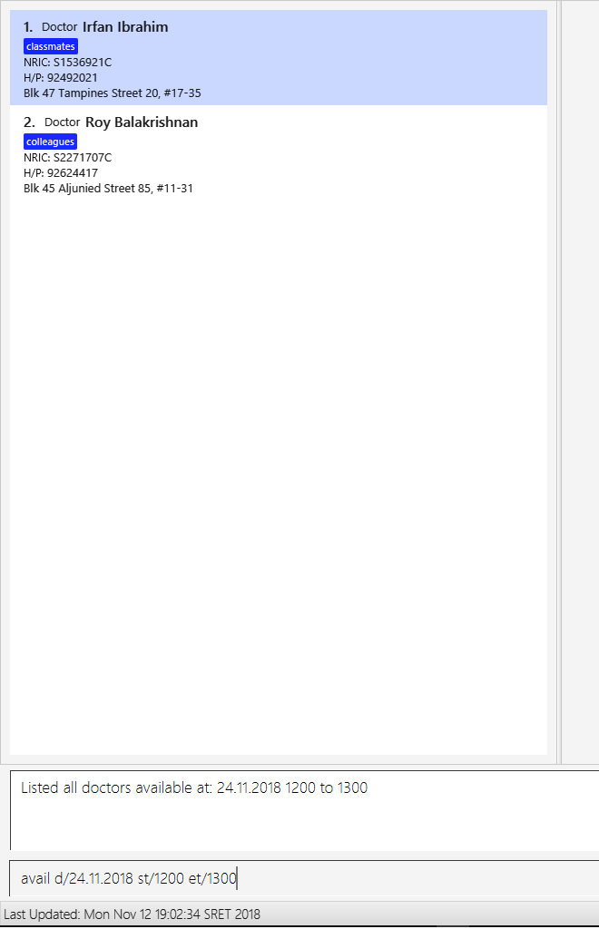
1) Lists all doctors who are available on that day and time
2) Result message and displays the date and time period as well.
3) Command input

Slide 2
Logic
Events
Model
:LogicManager
:AddressBookParser
:ModelManager
:SwitchCommandParser
:SwitchCommand
execute
:DatabaseChanged Event

