Slide 1
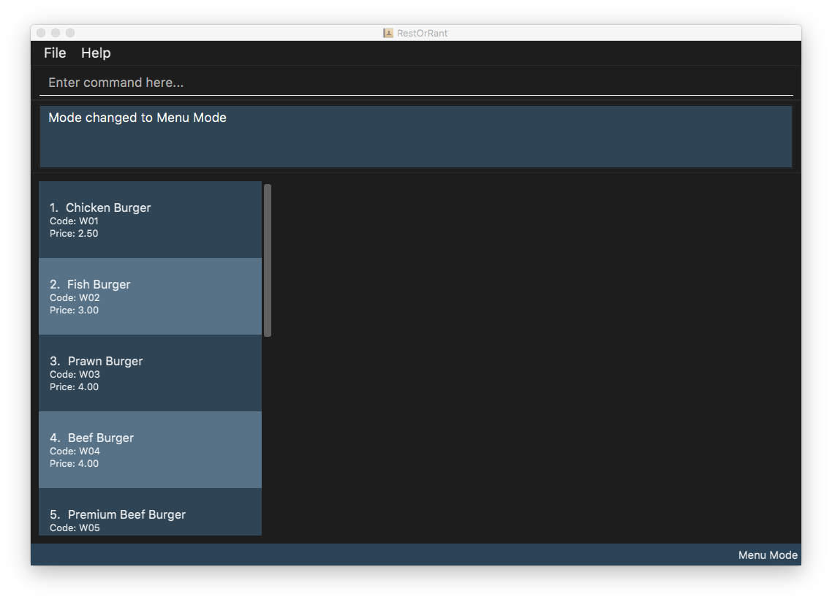
List of

Slide 2
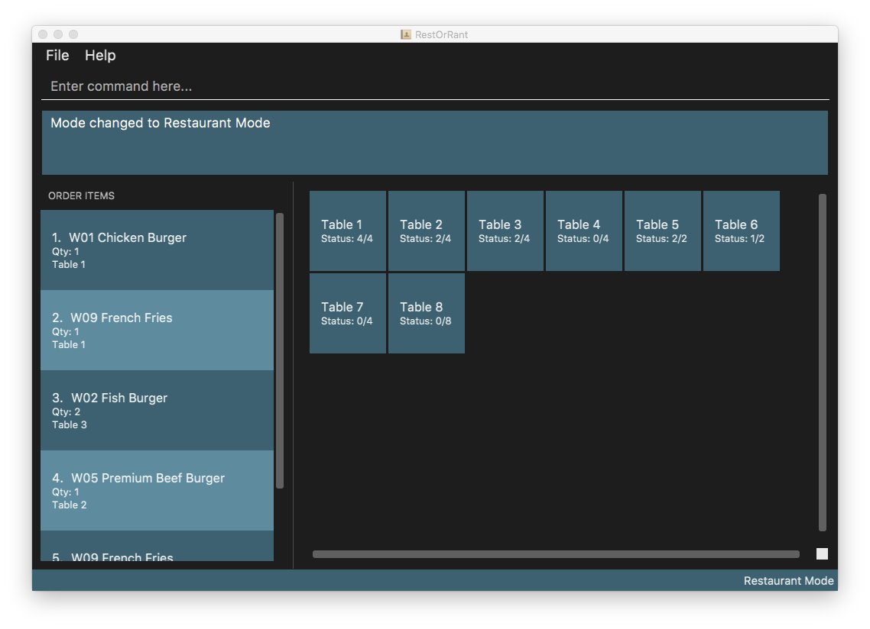

Slide 3
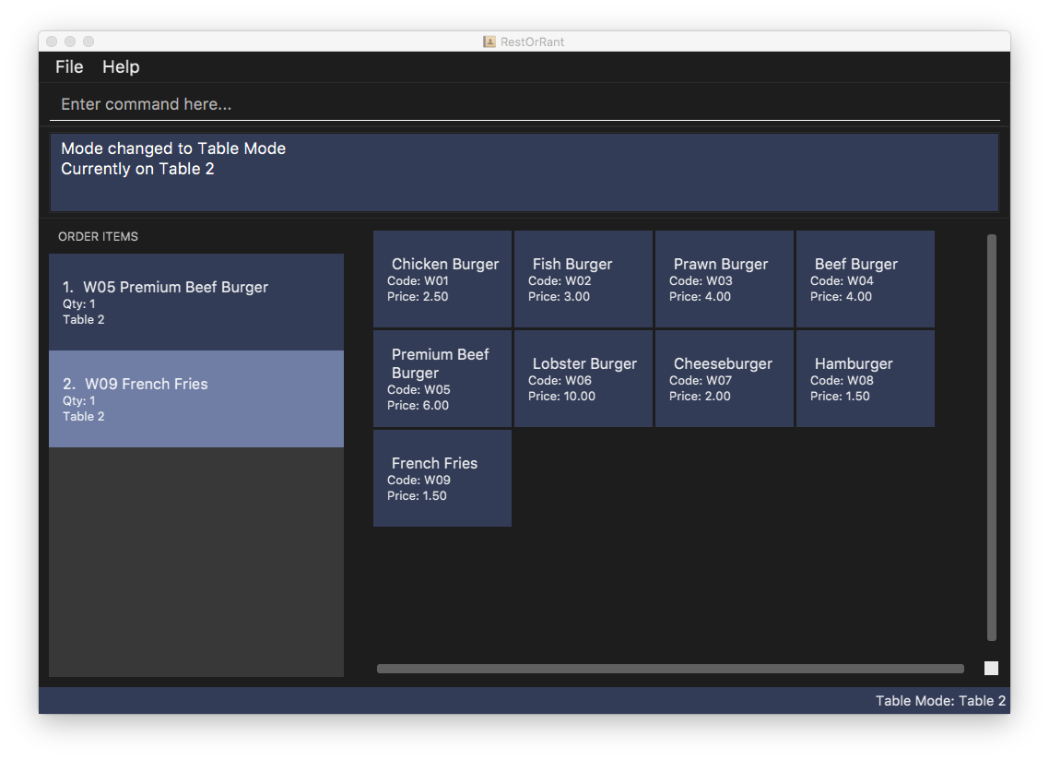

Slide 4
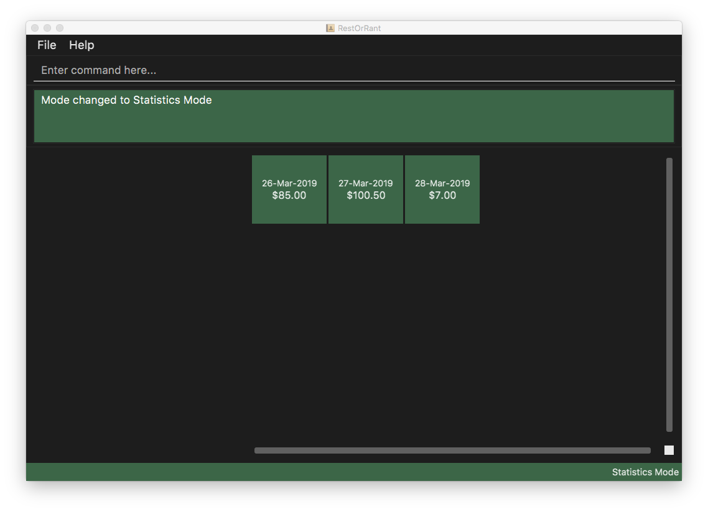

Slide 5
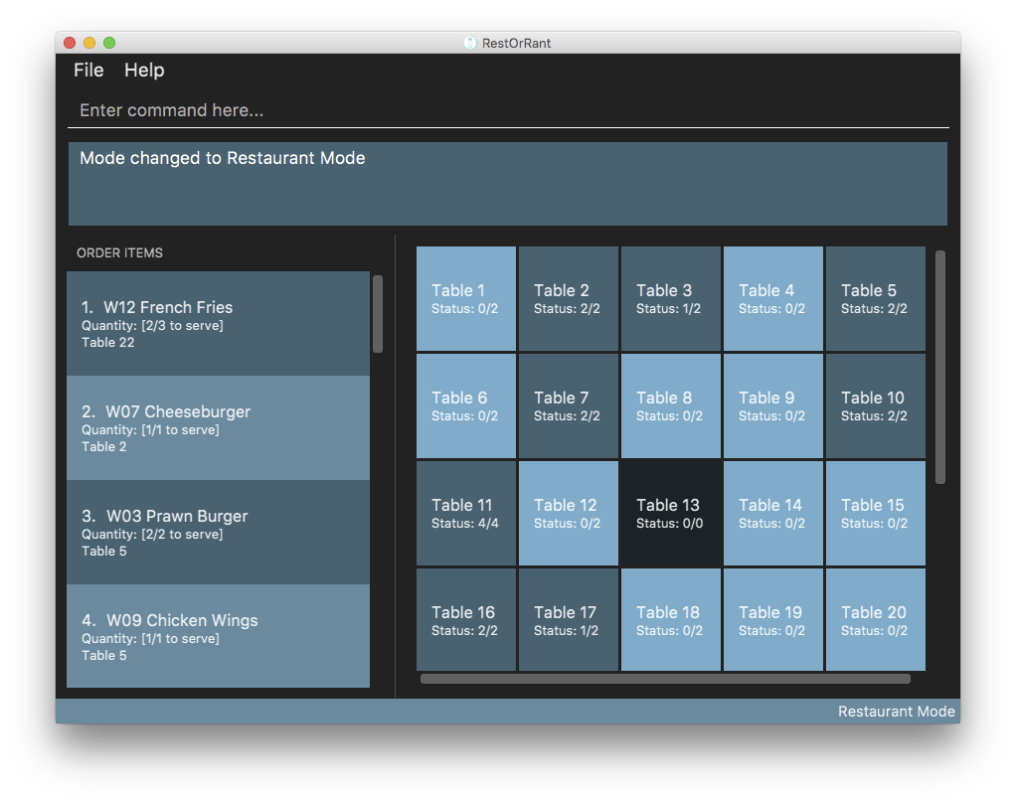
1
Command Box
2
Results Display
4
5
Side Panel
Main Panel
3
Mode Display
Notes:
Enter table mode by selecting the table number, in this case, table 23.

Slide 6
Order Panel
Table Panel
Notes:
Enter table mode by selecting the table number, in this case, table 23.

Slide 7
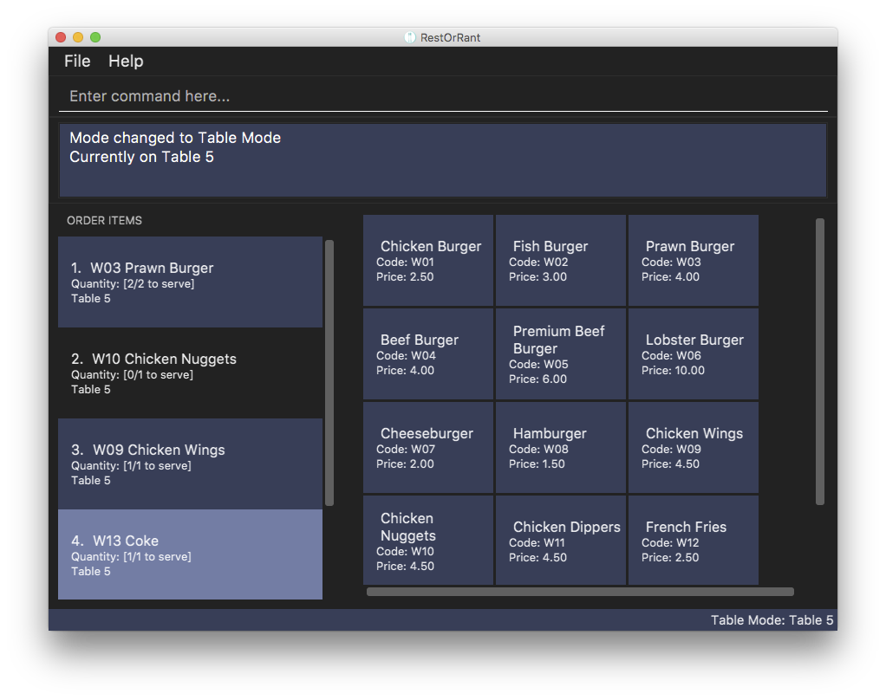
Order Panel
Menu Panel
Notes:
Enter table mode by selecting the table number, in this case, table 23.

Slide 8
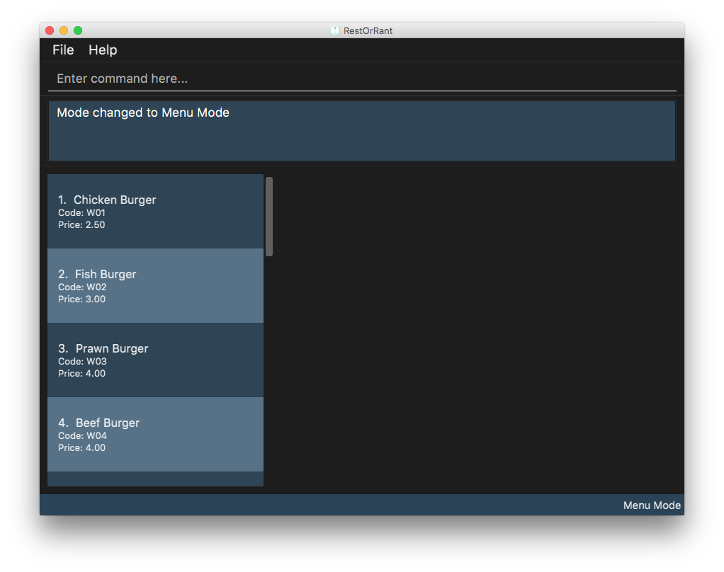
Menu Panel
Notes:
Enter table mode by selecting the table number, in this case, table 23.

Slide 9
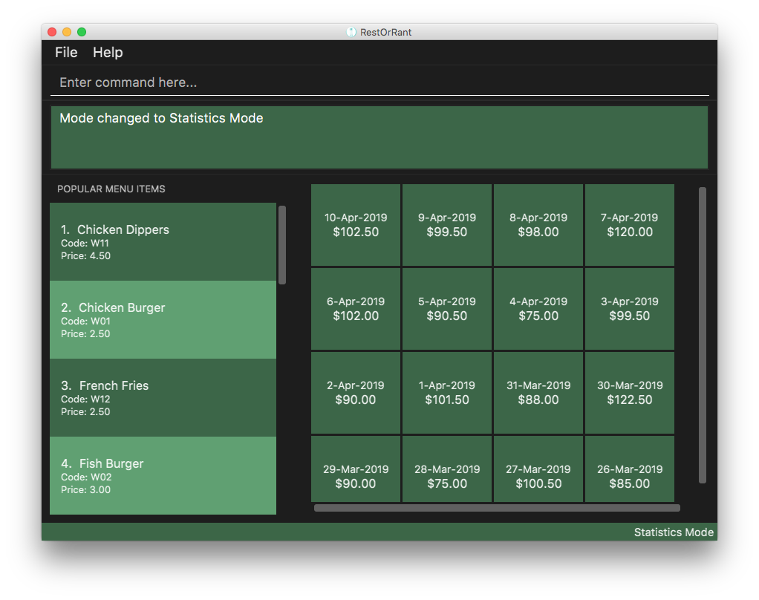
Item Panel
Revenue Panel
Notes:
Enter table mode by selecting the table number, in this case, table 23.

