Slide 1
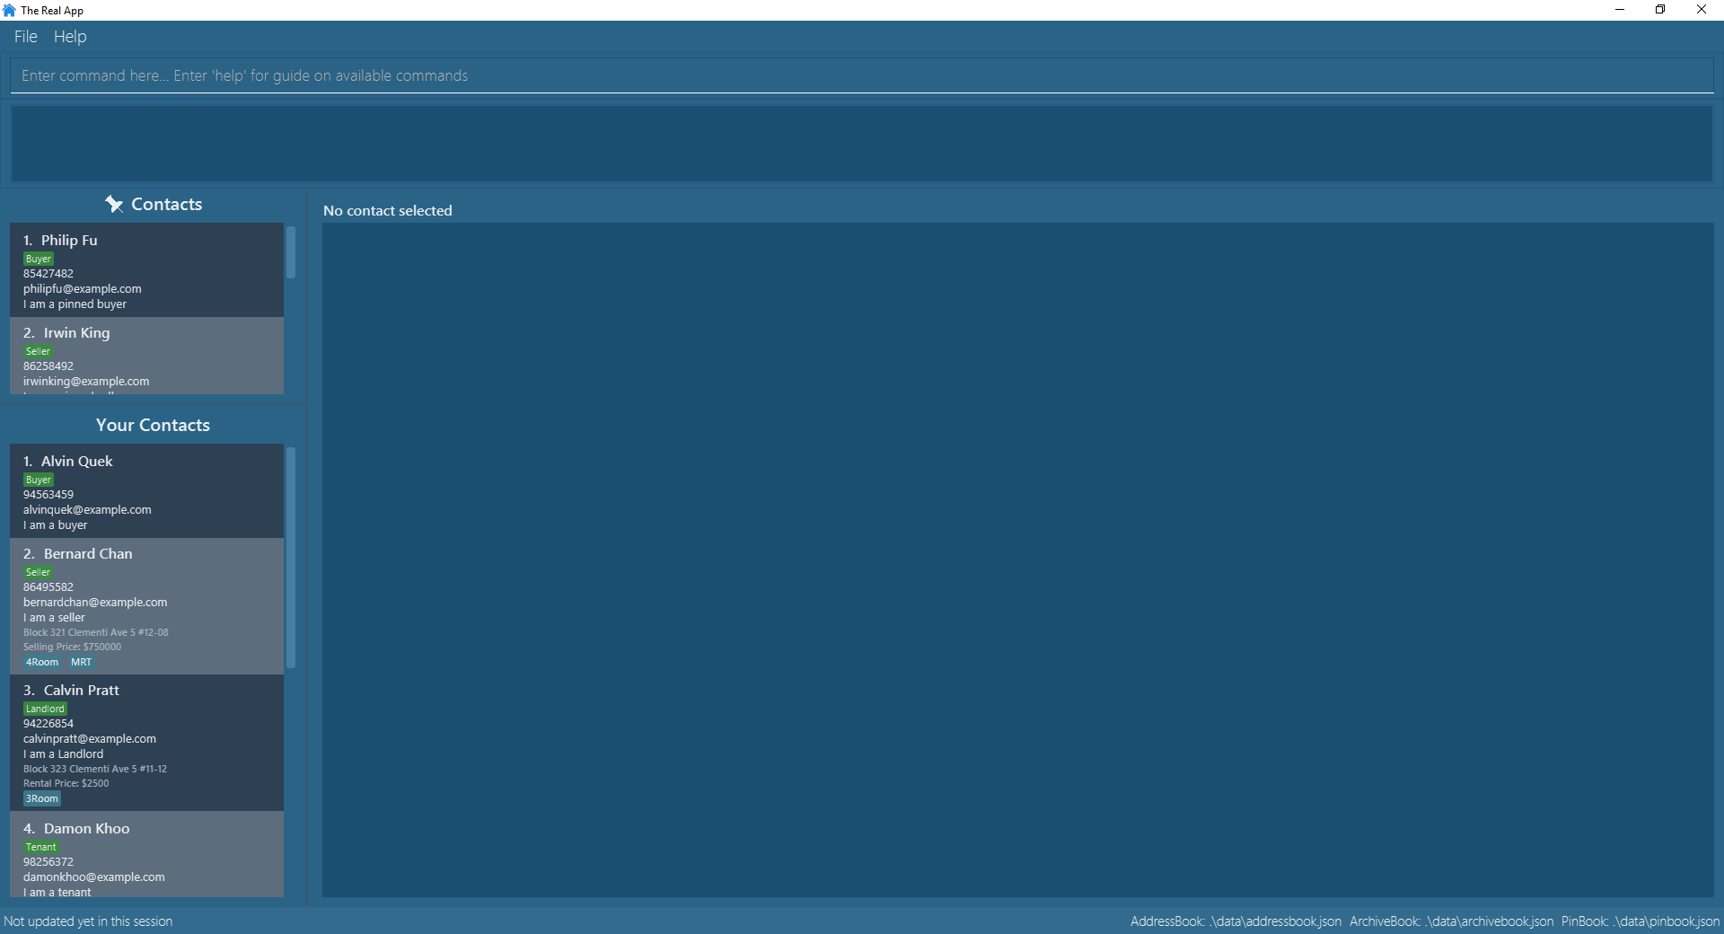
Command Box
Result Display Box
Pin List
Browser Window
Main Contact List

