Slide 1
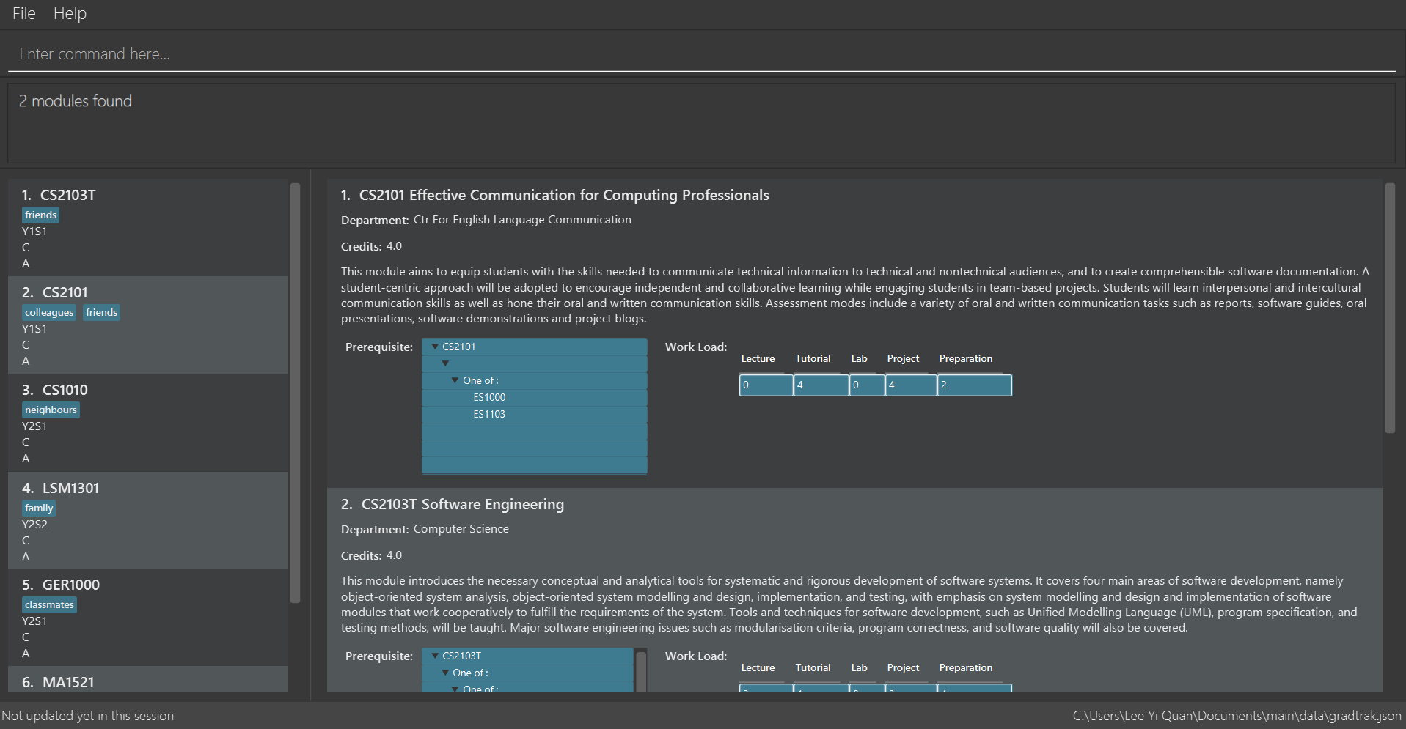
(a) Task Bar
(a) Task Bar
(a) Command Box
(b) Command Box
(d) Result Panel
(c) Result Box
(e) Modules Taken Panel

Slide 2
