Slide 1
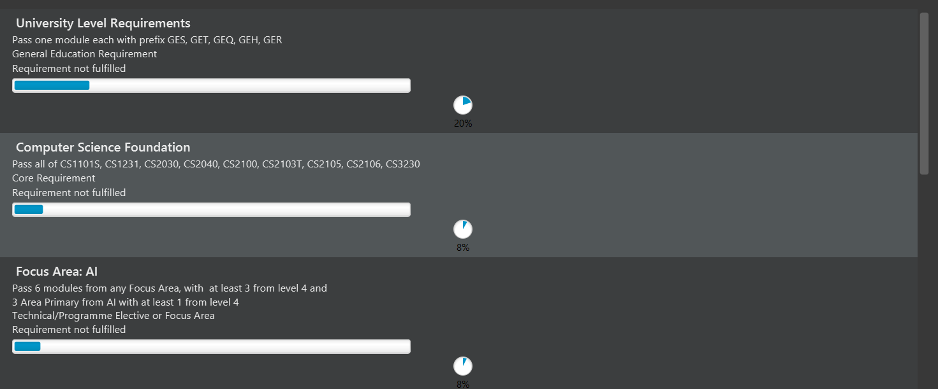
(1) Requirement Name
(2) Requirement Description
(3) Requirement Type
(4) Requirement progress bar and percentage

