Slide 1
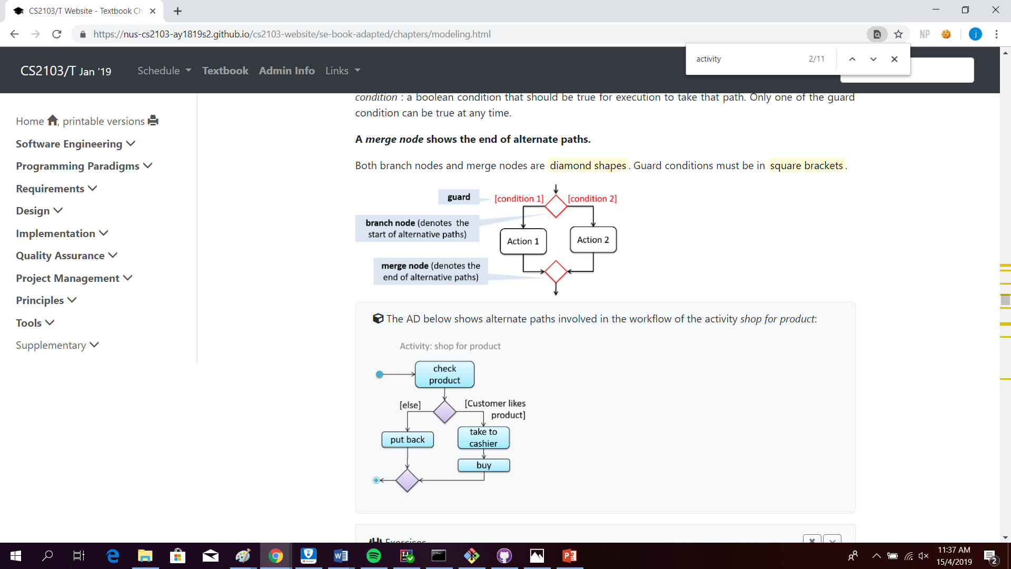

Slide 2
Date is input from user and is in either fixed or flexible date format.
parseDate
isFlexibleInput
[if flexible format]
[else]
parsePocketProjectDate
isValidDateFormat
parseKeyword
formatDate
isValidDayInMonth

